Slide 1
2023-2024
ORGS, BUDGETS, REIMBURSEMENTS
Medical Center Student Council

Slide 2
An umbrella organization for all student groups in the School of Medicine and Health Sciences (MD, PT, PA)
The GW Student Association (SA) gives money to MCSC, and then MCSC allocates funds to health sciences student groups
Annual Organization Budgets
Reimbursement Processing
Plan SMHS-wide events
Medical School Formal
Follies
WHAT IS MCSC?

Slide 3
1. Registering or Renewing a Student Organization
WHAT ARE WE GOING TO COVER?
Create and Submit a Constitution, and statement of any outside funding by 09/15/2023
Using Organization’s Budget and Getting Reimbursed
Co-Sponsorships
Miscellaneous Rules Regarding Student Orgs

Slide 4
Fill out Student Group Registration/Renewal Form:
https://docs.google.com/forms/d/e/1FAIpQLSdyixXoOUUywobQkdhzWQpmS-RjQ67oZVY-K7UW1y-C3nHXbw/viewform?usp=sf_link
STARTING
OR RENEWING A STUDENT
ORG
Complete section 1: constitution upload required
Complete section 2: questionnaire
DEADLINE = Friday, September 15th AT 11:59 PM

Slide 5
Constitution Guidelines:
Must haves: non discrimination clause, statement that organization will abide by all University policies, membership statement
Recommended 7 parts: name, purpose, membership, officers, operations, finances, amendments
Example Constitution:
https://studentcouncil.smhs.gwu.edu/sites/g/files/zaski b716/files/2021-06/MCSC%20Constitution%20Final.pdf
CONSTITUTION

Slide 6
THESE 3 THINGS MUST BE IN YOUR CONSTITUTION….

Slide 7
What Happens After Approval?
All organizations will receive a base allocation of $250
Additional funding for specific events can be requested by…
Completing following form at least one month in advance…
https://smhs.gwu.edu/studentcouncil/co-sponsorships
MCSC will then vote on the proposal and get back to you within 2 weeks
MCSC may approve all or part of the allocation
Once your organization accepts the allocation supplement, we will work with you to figure out the best way to complete your purchase/s

Slide 8
So you’re spending your allocation on an event and would like reimbursement…
1. Ask for an itemized receipt from your vendor
2. Complete fields on the following website:
https://docs.google.com/forms/d/e/1FAIpQLSfPM-70KxNYw
3dGYc1m5Apj04f3tFna13_0lEHEC-cV0oqCPw/viewform?usp
=sf_link
3. Complete all in < 2 weeks
4. Make a concur expense profile:
REIMBURSEMENTS
Steps to Complete Concur Expense Profile
Go to ibuy.gwu.edu and select iBuy+ Concur Portal
Log in using your GWID credentials
Select Profile, then Profile Settings
Select Expense Delegates, Click Add, Search "Dozier", Select "Orlando Dozier"
Check boxes "Can Prepare", "Can Submit Reports", "Can View Receipts", and "Receive Emails" and Save
To Add/Update banking info, select Expense Settings**
Click Bank Information, complete form and Save**
**Students who work for the University can skip steps 6 & 7.

Slide 9
Reimbursements Continued
So you’ve submitted all the of the proper documents, what happens next?
MCSC resubmits the provided information to GW SA (student association) within 2 weeks
Individuals there review the request and approve or deny it
Their “verdict” is emailed to MCSC & we’ll forward that to you
Reimbursements from approved requests are direct deposited into your account or are sent to the address linked with your banweb
The entire process can take up to 3 months
Why might a request be denied?
Proper information not provided, non-itemized receipt submitted, receipt past deadline

Slide 10
Reimbursements Continued
Is there anything I can’t buy with allocated budget?
Alcohol, tobacco, firearms, gift cards, drugs, flowers
Other Important Information
Individual being reimbursed MUST be the same person that made the original purchase
Students CANNOT/WILL NOT be reimbursed for money spent for services requiring contracts (for performer/DJ/Speakers, etc.)

Slide 11
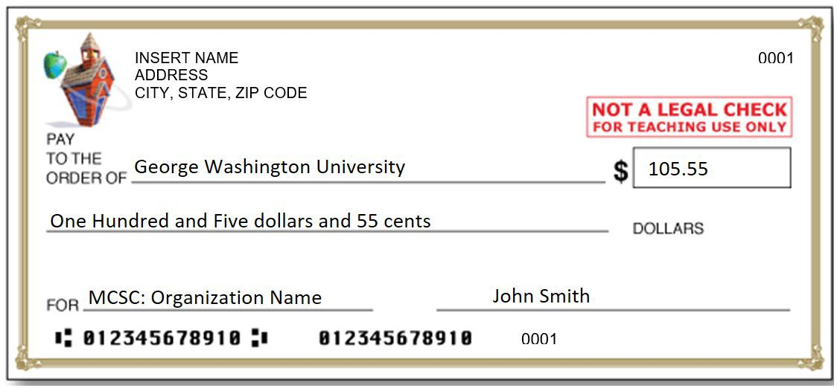
Supplementing MCSC Allocation
Fundraisers or donations!
All money collected must be submitted to me in following CHECK format
We will add the equivalent amount to your student organizations budget

Slide 12
Miscellaneous other Student Organization policies
If you want to have an event with alcohol, please let us know ≥1 month in advance
Don’t sign a contract
Cannot make donations from a student org account
Meaning you can’t donate to a cause with your allocation
“Drawings” not raffles
If you call it a raffle, must obtain DC raffle license, etc., but if you call it a drawing you get away with it

Slide 13
CO-SPONSORSHIPS
Approval Process: MCSC can either approve, partially approve, or deny to co-sponsorship request. All or a portion of the request may be allocated. MCSC will communicate the decision with you and you will have the opportunity to discuss the decision with the group. Please keep in mind that the budget for these co-sponsorships requests is shared amongst all student orgs, so partnering with another organization or hosting an event that will attract more individuals is ideal.
https://studentcouncil.smhs.gwu.edu/co-sponsorshi ps
Request must be filled out atleast one month in advance

Slide 14
Summary of Reminders
Fill out Student Group Registration/Renewal Form
Submit Constitution (& additional fundraising sources if applicable) by September 15th at 11:59pm
Submit reimbursement requests and PDF copy of your receipt & flyer (if food) within 2 weeks of purchase
If you need extra funding, complete a co-sponsorship request ≥1 month in advance
If you fundraise or receive a donation, make money available in check form and turn it into MCSC so we can add the funding to your account
Please communicate these rules to your classmates & organization members

Slide 15
Questions? Contact…
Email: gwmcsc@gmail.com

