Slide 1

Telehealth Extends EM Opportunities to Participate in CCM
Robert J. Wagner, MD, FACEP
And
Sylvan Waller, MD, FACEP
George Washington University
School of Medicine & Health Sciences

Slide 2
Bio
  Robert J. Wagner, MD, FACEP
  Partner Consulting Services, Schumacher Clinical Partner
  Dr. Robert Wagner is a Partner with the Consulting Services Division of Schumacher Clinical Partners. In this role he has had the opportunity to help multiple hospitals and health systems managing strategies to drive clinical, operational and financial excellence. Recently he has worked with clients to develop telehealth strategies, free standing emergency department development, transitions of care and denials management.
  Dr. Wagner has been with SCP since 2010 in multiple roles including Medical Director, President of Care Management and Chief Medical Information Officer.
  Dr. Wagner is a graduate of Albany Medical College. He did his internship in General Surgery at the University of Maryland and completed his Emergency Medicine residency at Shands Hospital in Jacksonville, FL.

Slide 3
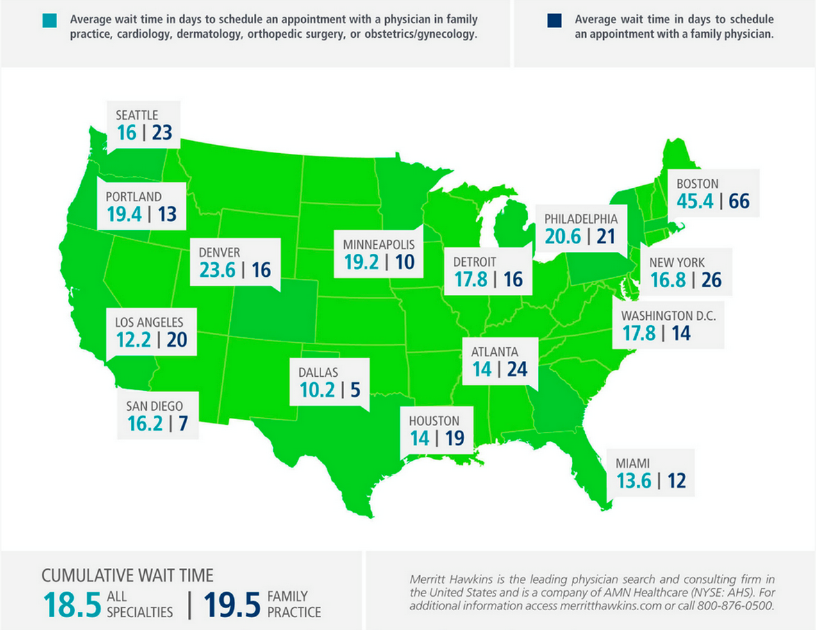
Defining the Problem
Average wait time to see a doctor in the US is 18.5 days,

Slide 4
Where We are Today
Confluence between Technology, Medicine, and the Affordable Care Act:
Consumers awareness of coverage
Focus on consumerism and transparency
Proliferation of technology
Technology
ACA
Medicine

Slide 5
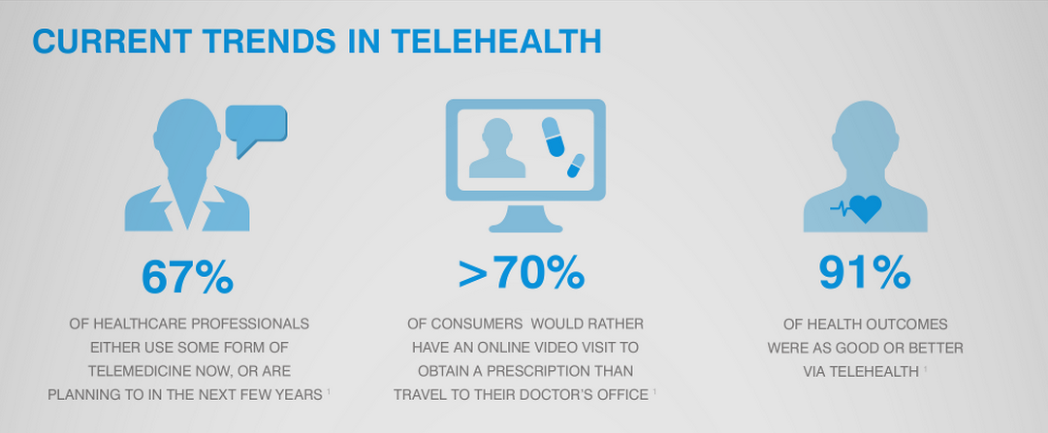
Acute Episodic Care
Most common medical issues being treated by Telemedicine today:
Allergies
Colds / Sinus Infections
Ear infections
Eye infections / Styes
Headaches
Influenza (flu)
Sexually Transmitted Diseases
Skin Conditions / Eczema / Rash
Sprains and Strains
Stomach flu (gastroenteritis)
Strep / Sore throat
Urinary tract infections (UTIs)

Slide 6
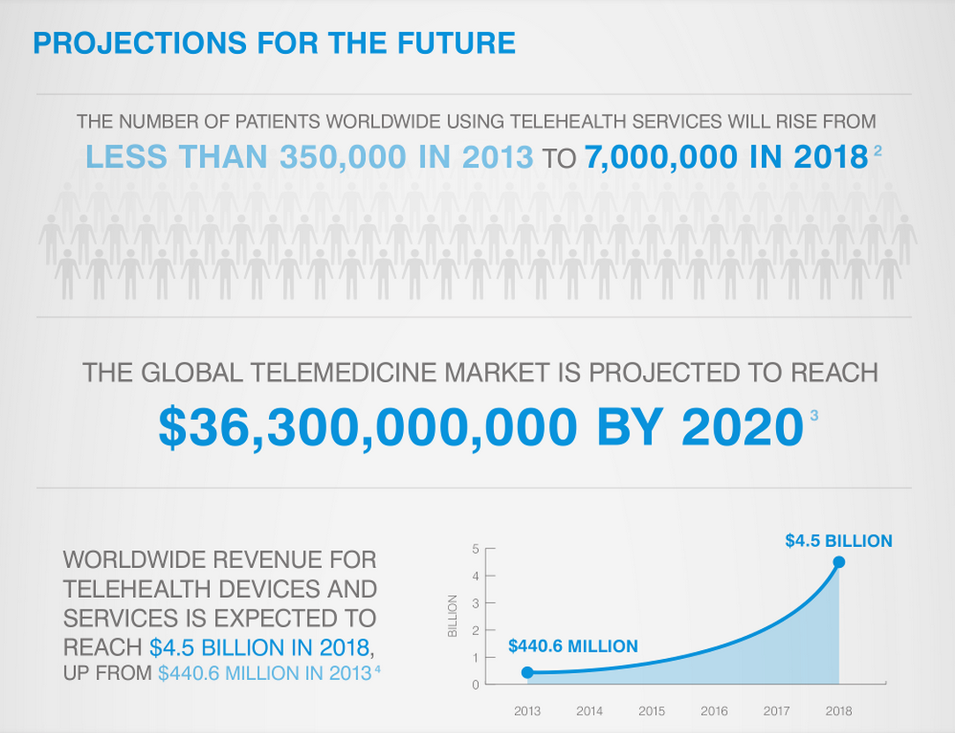
Future of Telemedicine

Slide 7
Confluence of Technology,
Medicine, and Consumerism
Technology
- Mobile first
-Video
- Connected devices
Medicine
- Personalized care
- Efficiency
- Cost transparency
- Integrated into fabric
Consumerism
- Services delivered on demand
- Concierge quality
- Greater consumer choice for seeking care

Slide 8
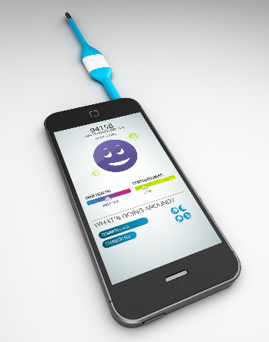
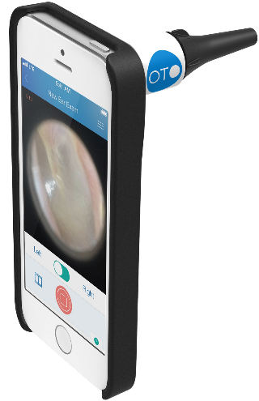
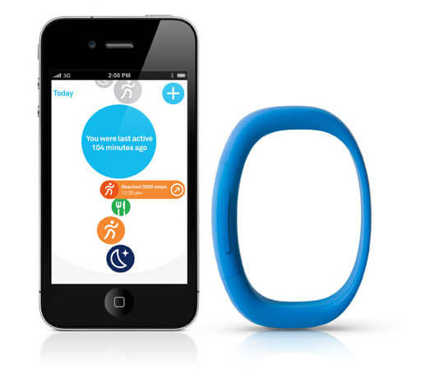
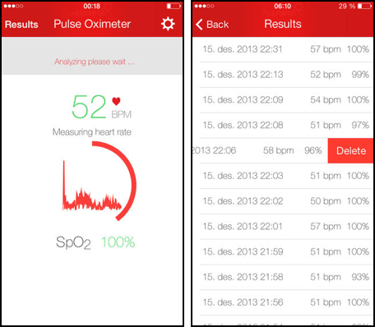
Technology Advances
Today we rely on physical exams and clinical algorithms
Tomorrow, with the proliferation of technology we will be able to transform healthcare with digital connected devices:

Slide 9
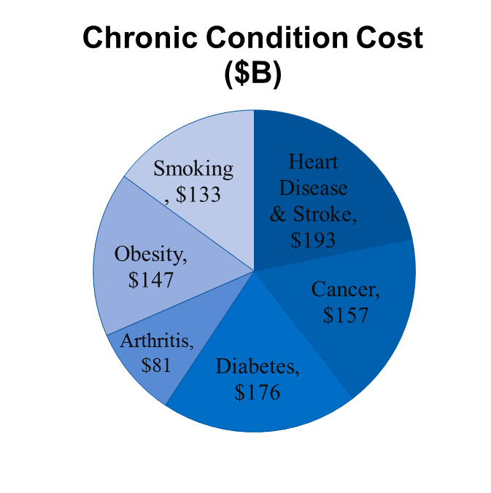
Increased Exposure
FSED’s, Hybrid Models and UC increase our exposure and ability to manage chronic conditions
Create models that allow for identification and navigation of chronic conditions
Increased accessibility will result in increased opportunities for EM physicians to actively participate in CCM
Source: http://www.cdc.gov/chronicdisease/overview/

Slide 10
The Future of Chronic Care
Increased access to care through the ACA increases the number of individuals in need of chronic care management
Payment models continue to shift from volume to value-based payment requiring more Chronic Care Management (CCM) specific programs
Effective use of health care resources allocated across the entire system
Innovative payment models create incentives for health providers and systems to improve care models
Attention placed on prevention and wellness - from reactive to proactive care
Innovative care models will continue to drive enhanced value
Advancing technology will provide greater value

Slide 11
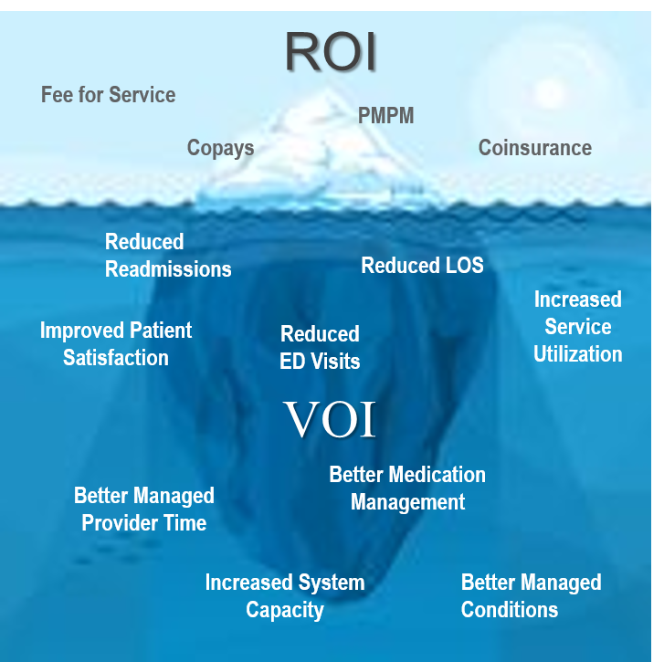
ROI vs. VOI

Slide 12
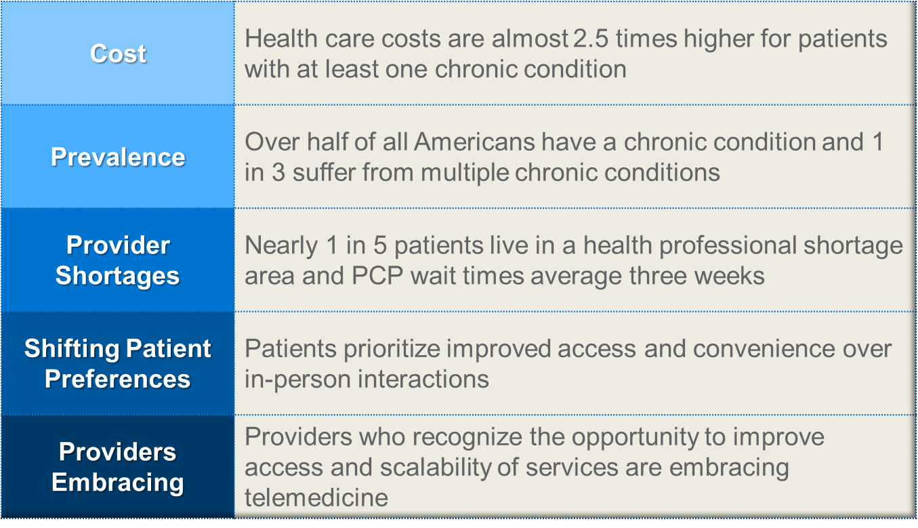
Drivers of Telehealth in CCM

Slide 13
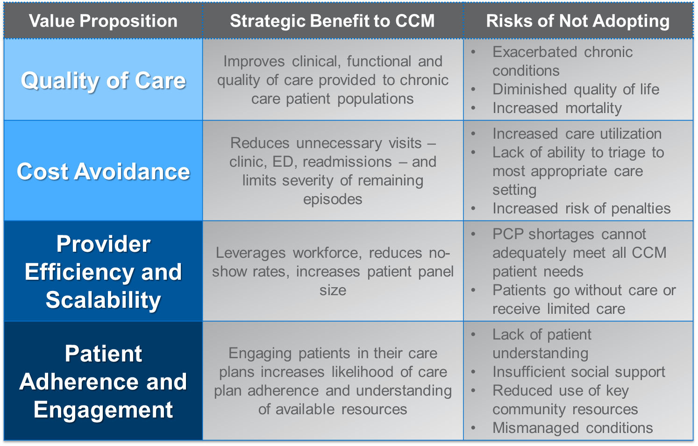
Telehealth
Value Proposition in CCM

Slide 14
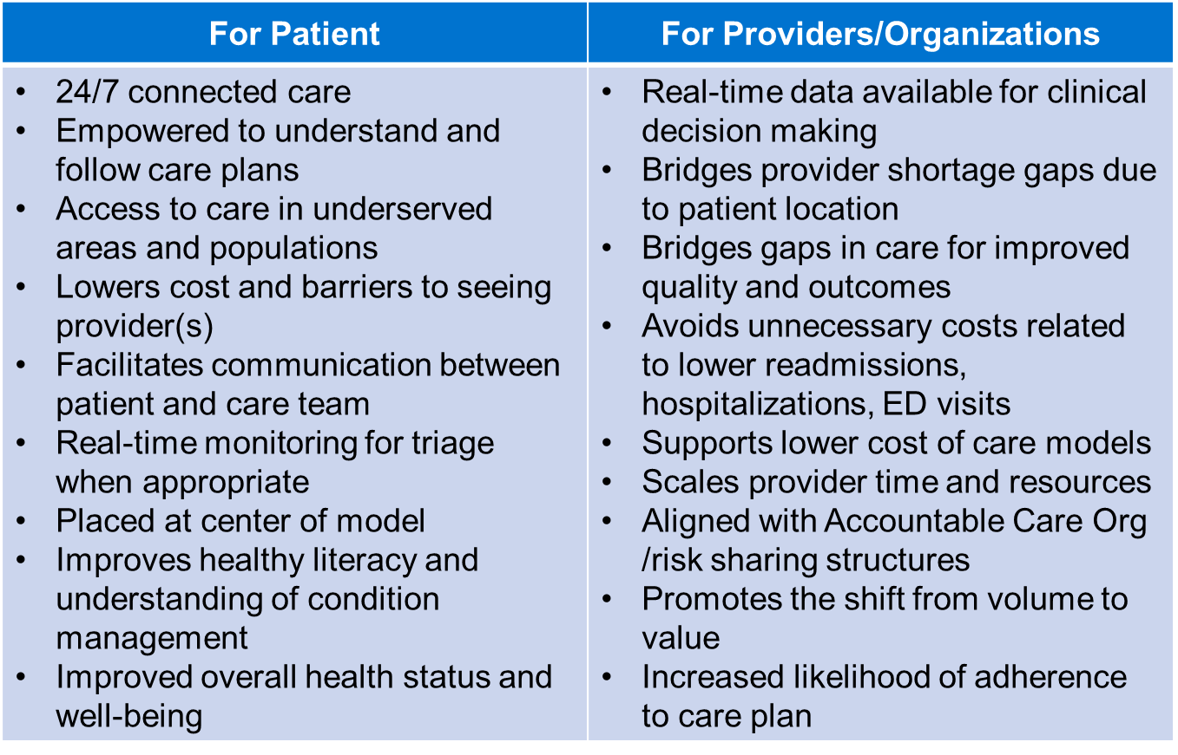
Benefits to Tele-CCM

Slide 15
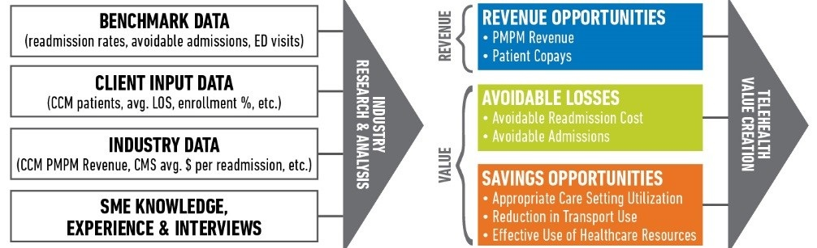

Slide 16
Thank you
Sylvan Waller
Rehan Virani
Monica Leslie
Jeff Jones

