Slide 1
Virtual Provider in Triage
October 15th, 2016
Presenters: Dr. Paul Coogan & Mike Rodgers
George Washington University
School of Medicine & Health Sciences

Slide 2
Is a not-for-profit health care system headquartered in Milwaukee and serving Wisconsin since 1984
1.2M
1,800
32K
Patients
physicians
employees
15
159
70
Hospitals
Clinics
pharmacies

Slide 3
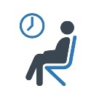
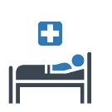
AT THE START
Door-to-Doc
LWOBS
Sinai Medical Center
60
10%
minutes
percent
Length of Stay
(Inpatient)
Length of Stay
(outpatient)
260
180
minutes
minutes
‘Onsite Provider in Triage’
was started on day shift

Slide 4
CHANGING OUR ALTITUDE
Provider in Triage
West Allis
decreases door-to-provider times, gives ED flow options, and improves patient satisfaction
Sinai
Kenosha
Cost Prohibitive
to station additional clinicians at triage, particularly in moderate volume emergency departments.

Slide 5
RESULTS
THINKING DIFFERENTLY
Door-to-Doc
Capacity
75%
10%
decrease
increase
Length of Stay
Press Ganey
45 min.
6 questions
decrease
rating increase

Slide 6
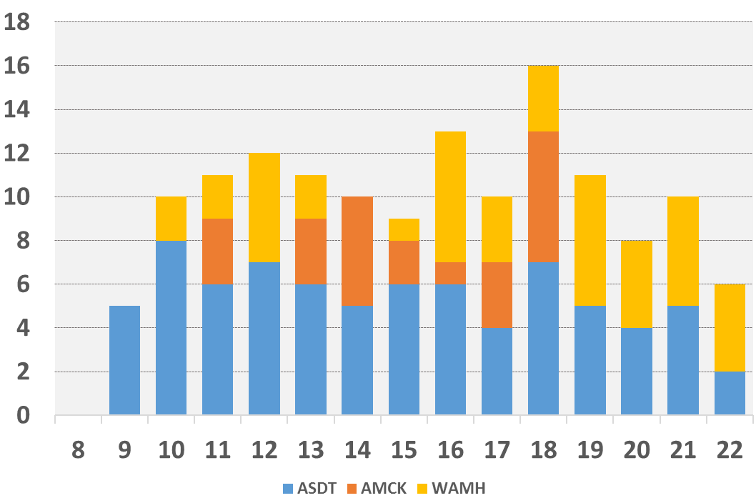
RESULTS
THINKING DIFFERENTLY
12,796
# of Consults
Since 12/9/15
23
Patients
per hour
01:21
Time
per consult
Multiple Site Simultaneously
1 to 3
Coverage
Provider to Dept. Ratio

Slide 7
RESULTS
THINKING DIFFERENTLY

Slide 8
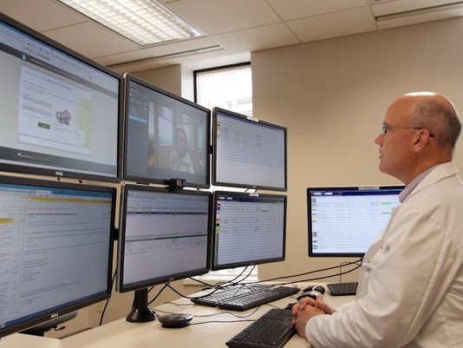
FEEDBACK
Providers
“ I did 60 remote consults in a seven hour shift, the pace was very reasonable, I’m sure I could have done significantly more…”
Nursing
“It’s great to get input and get orders started immediately instead of wasting time calming patients and families that are still waiting…”
Patients
“Look Lisa, it’s the doctor ! Cool ! “

Slide 9
LESSONS LEARNED
1
Altitude = Impact
Network vs. Brick & Mortar Framing
2
Respect Current State
Each implementation site needs a demand & supply assessment
3
Agile Development
Use Lean Startup & Rapidly test

Slide 10
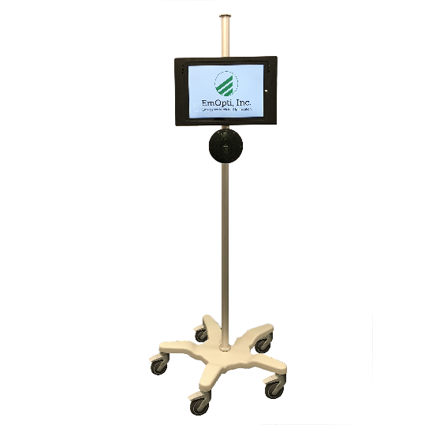
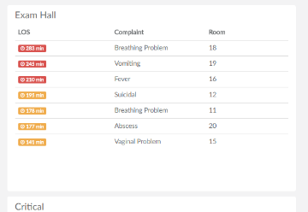
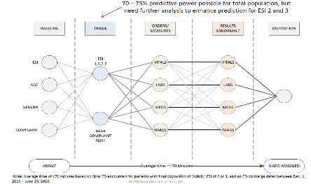
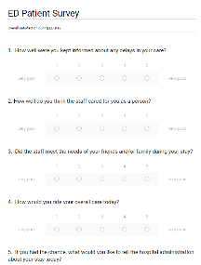
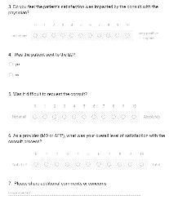
MOVING FORWARD
Actionable Dashboards
Length of Stay
FRED
Free Roaming Emergency Doctors
Patient Satisfaction
Real-time
Admission Prediction
Prepare Inpatient Beds

Slide 11
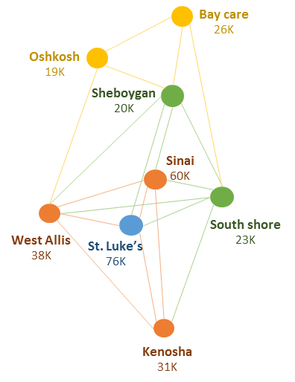
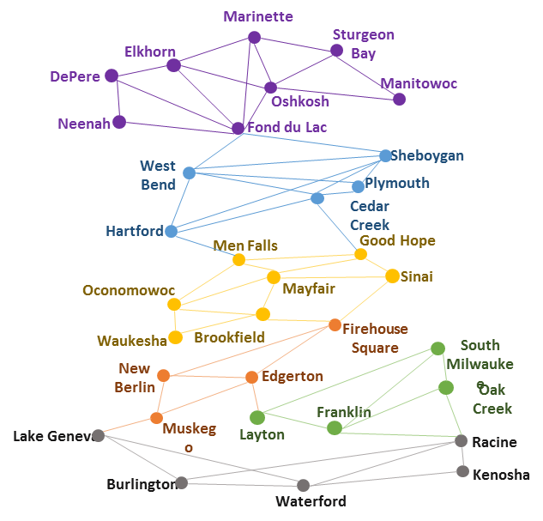
MOVING FORWARD
Emergency Departments
Urgent Cares
Build & Optimize
Build & Link
Use Command Center approach to maximize
‘Network’ Effect

