Slide 1
Acute Care at Home Program – UCSD and West Health
Vaishal Tolia, MD

Slide 3
GOAL
For a subset of patients with specific medical conditions and criteria, rather than short stay admissions to the inpatient setting (<72 hours), we want to provide acute care at home with the assistance of home health services and coordinated by their outpatient provider
Collaborative pilot project with West Health

Slide 4
Setting
UCSD La Jolla ED is located in a suburban community (La Jolla-North San Diego) with an annual census of 35,000 and is staffed mainly by attending faculty of the UCSD DEM. This ED also serves as receiving and treatment area for our JCAHO certified strokecenter as well as a locally certified cardiac center.
UCSD La Jolla is also the site of the new Jacobs medical center and as an extension of the Emergency Department: The Gary and Mary West Senior Emergency Care Unit (SECU)
Currently 32 beds (7 bed EDOU), planned expansion for the “geriatric ED” for 17 beds, 15 hallway spaces.

Slide 5
CONDITIONS
  Cellulitis
  Pyelonephritis
  Community Acquired Pneumonia
  Heart Failure
  Dehydration/Nausea/Vomiting
  Hyperglycemia
  Asthma/COPD
  Syncope
  Lab Monitoring

Slide 6
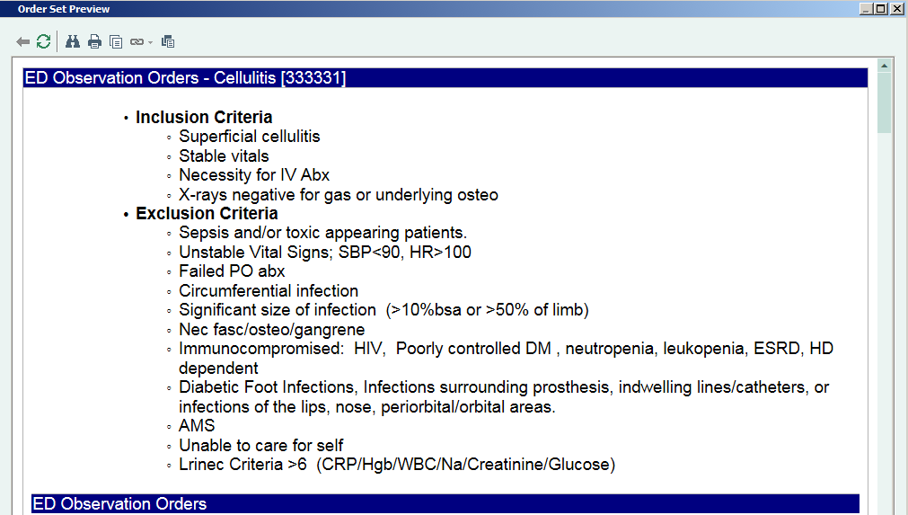

Slide 7
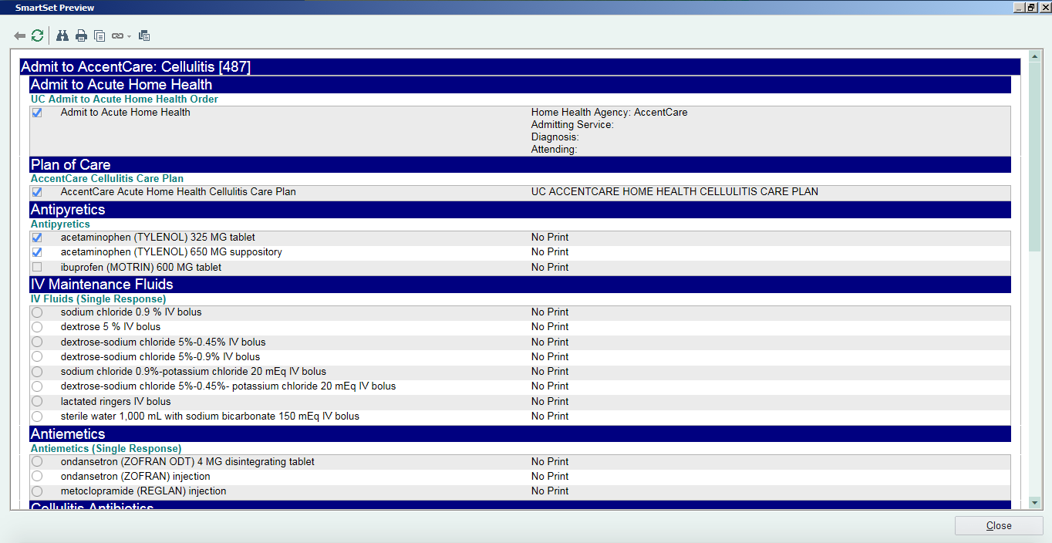

Slide 8
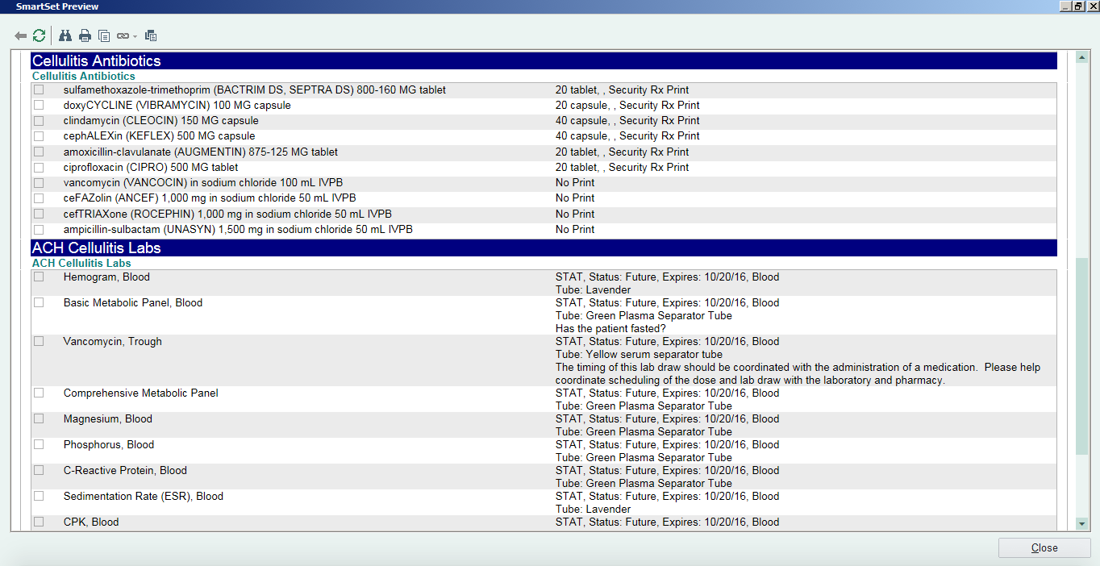

Slide 9
ED Workflow
Attending ED MD Determines appropriateness for ACH
Clinical leadership, NP and Case Manager review clinical and insurance information
Patient consented
Primary MD who will follow patient at home for 3 days MAX contacted
Patient admitted to ED Observation Unit
  UCSD PCP/on call MD will assume care upon discharge from the ED to acute care at home with appropriate follow-up
  HHRN and PCP “round” on patient up to 4x/day via phone/tiger text including image transmission.

Slide 10
Key Roles
ACH Care Coordinator
  Consent
  Insurance verification
  Coordinating with primary care
  Contacting home health
  Infusion center pharmacy
ED NP
  In charge of EDOU
  Manage clinical care and documentation for ACH
  Assist in clinical communication for all ACH candidates
  Callbacks and ensuring that ACH patients are followed and protocol is being adhered

Slide 11
21 Patients Enrolled
18 of 21 patients > age 65
Cellulitis most common diagnosis
7 patients were discharged with iv antibiotic plans
All had good follow-up arranged
No return visits for clinical deterioration/need for admission

Slide 12
Thank you
Questions?
Comments?

