Slide 1
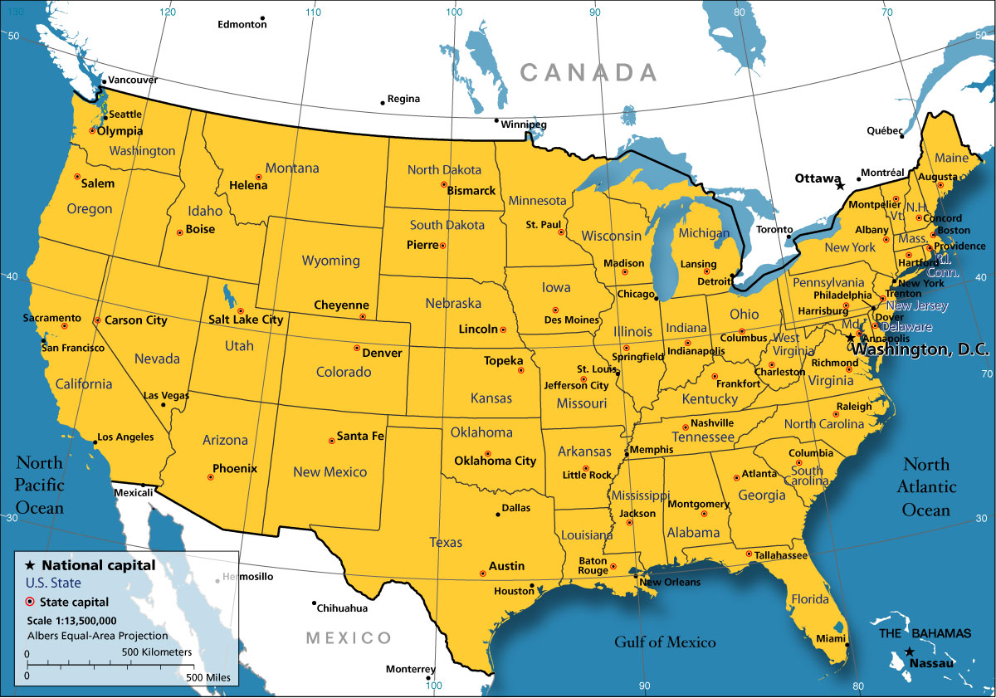
Designing a Roadmap for Justice-Health Integration in U.S. Medical School Curriculum
Cara Buchanan, BA, Newton Kendig, MD
George Washington University School of Medicine and Health Sciences
Background
Integrated Curriculum Initiatives by Medical School Year
In 2017, the authors began to explore ways to introduce justice-health content into medical education. In the context of a highly-regulated and accelerated medical school curriculum, this project was designed to create avenues for justice-health integration into medical school topics throughout the 4-year program. In 2018, the George Washington University School of Medicine and Health Sciences (GW SMHS) launched the GW Criminal Justice Health Initiative (GW CJHI). As part of this initiative, the authors outline a longitudinal and integrated approach to justice-health education throughout a medical school curriculum.
Approved Initiatives Future Opportunities | MSI | MSII | MSII | MSIII | MSIV
Pre-Clinical coursework | Immunology & Infection Skin & Soft Tissue article CJHI Podcast, Infection Prevention (Bur, Kendig) Hep C article CJHI Podcasts, Hepatitis C in the Correctional Setting, Update on HCV (Thorton, Kendig) TB article | Endocrine & Reproduction Carolyn Surfrin, “Jailcare” CJHI Podcast, Women’s Health (Sufrin, Kendig) Transgender Health article CJHI Podcast, Transgender Medicine (Irwig, Kendig) Brain & Behavior Serious mental illness article CJHI Podcast, SMI in Correctional Setting (Penn, Kendig) Substance use disorder article CJHI Podcast, Addiction Pharmacotherapy (Lee, Kendig) CJHI Podcast, Relapse and Recidivism (Rich, Kendig) | Endocrine & Reproduction Carolyn Surfrin, “Jailcare” GW CJHI Podcast, Women’s Health Transgender Health article Brain & Behavior Serious mental illness article Substance use disorder article | GW CJHI Podcasts CJHI Podcast, Clinical Update in Internal Medicine (Kendig) CJHI Podcast, Advancing Preventive Health Care in the Correctional Setting (Ballom, Kendig) CJHI Podcast, Healthcare Risks of New Illicit Substances (Manenti, Kendig)
Public Health Coursework | Clinical Public Health Summit: HIV/AIDS HIV article CJHI Podcast, Improving Care and Reentry Strategies for Justice-Involved Patients with HIV Infection (Spaulding, Kendig) |  |  | Scholarly Project for Track Program (Urban/Community Health, Health Policy) MD/MPH Capstone Project
Clinical Clerkships |  |  |  | Psychiatry: NVMHI, St. Elizabeth’s Forensic Unit Pediatrics: Community Child Health Advocacy CJHI Podcast, Incarcerated Juvenile Patients (Staples-Horne, Kendig) Primary Care: Unity Health Care re-Entry Clinic | Emergency Medicine Approach to the Justice-Involved Patient & Pain Management in the E.D. setting (Buchanan, 2018)
Learning Didactics | Clinical Skills and Reasoning, Physical Exam & Diagnosis: How to Take a Social History How to Examine a Justice-Involved Patient |  |  | Professional Development: Reflections on Clinical Rotations Challenging Patient Encounters
Elective Clerkships |  |  |  | VA Infectious Disease Forensic Psychiatry Child Abuse Telehealth: Primary Care Re-Entry Clinic | 2-week Case Based Elective: Criminal Justice Health 4-week Clinical Elective: Introduction to Correctional Medicine & Rotation in D.C. Jail
Elective Enrichment | GW Criminal Justice Health Webinar Series Correctional care journal club discussion board “Meet the Professor” series with correctional health experts
Research & Scholarships | Betty Ford Summer Institute for Medical Students: Addiction Medicine Gill Summer Fellowship Health Services Scholarship Projects: Telehealth, Textbook Chapter on Correctional Health |  |  | Lazarus Family Scholarship in Health Services Delivery Women’s Board Scholarship
Volunteer & Global Opportunities | Arlington County Jail Health Education Social Justice Working Group |  |  | International Health Elective: Haiti
We are trying to connect with other initiatives to expand our efforts!
Know of a similar program? Have an idea to share?
Please write us a note!
Include the location and name of the project below
Criminal Justice Health Initiative Website:
smhs.gwu.edu/academics/md-program/curriculum/clinical-public-health/criminal-justice-health-initiative
I would like to acknowledge mentorship and support from Dr. Lawrence Deyton, MD MPH and the Lazarus Family Scholarship
Questions? Please contact corresponding author: cara.buchanan@gmail.com
Image credit: https://www.nationsonline.org/oneworld/usa_map.htm

