Slide 1
Framing Your Research Question
Alison K. Hall, PhD
Associate Dean, Research Workforce Development
November 12, 2019
Notes:
Are you thinking about writing a fellowship in the next year? To which group? Why?

Slide 2
Framing the Question
Research begins with a question,
that leads to a hypothesis
that leads to aims and approach
You have lots of questions…Which do you pursue?
How do you develop a question into a study?
Question
Hypothesis/ Aims
Study Design & Methodology
Data collection
&
Analysis

Slide 3
Your Questions from Pre-Work?
IPPCR #50: A Research Question and
Implications for Efficient Clinical Trials
Scientific validity--study addresses the research question that was posed
the knowledge gap
16:50—19:50
choosing a design 35:30
Outcomes and measures

Slide 4
Start with a Research Question
Tentative question, often from a ”hunch”
Which patients presenting with coma are most likely to return to the ED?
Why are numbers of children with obesity increasing?
List 3 of your own research questions now
share with group

Slide 5
What might affect the study?
Which patients presenting with coma are most likely to return to the ED?
Why are numbers of children with obesity increasing?
question might go in several directions
biomarker
Prospective survey
Retrospective study
Randomized clinical trial
What might impact direction to pursue?

Slide 6
From question to something testable
Which patients presenting with coma are most likely to return to the ED?
Why are numbers of children with obesity increasing?
Pare down question to a statement of something testable
Systolic blood pressure and type of trauma are associated with subsequent readmission.
Absence of regular exercise leads to an increase in weight during elementary school.

Slide 7
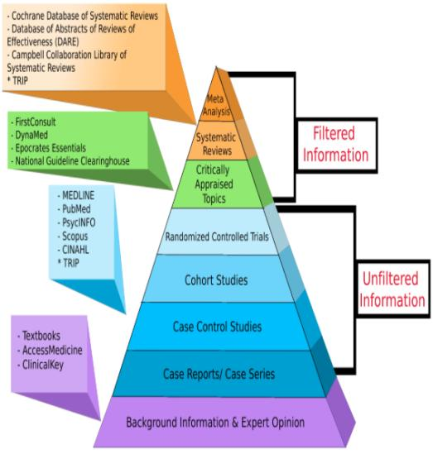
Right about now, you need to know more
Is question important?
Has it been studied before?
Is the timing right to answer this now?
What is the knowledge gap?
Insight into methodology?
A good literature review!
http://guides.himmelfarb.gwu.edu/c.php?g=27724&p=4447440

Slide 8
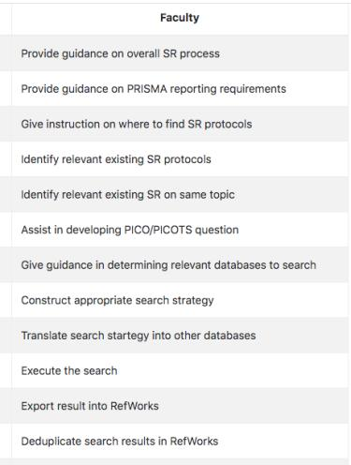
Librarian Assists Systematic Review
Systematic Review Service
Himmelfarb Library info
Systematic Reviews Research Guide here
Liason librarian or
Elaine Sullo (elainej@gwu.edu
or 202-994-2853)
Essential research step, might be a research product

Slide 9
Formulating the Question: PICOT
Specify the patient population (P), the intervention of interest (I), the comparator (C), the outcomes of interest (O), the study time period, when outcomes measured (T)
How broadly to define the patients?
How to define intervention (dose, intensity, setting)?
Is your study ethical?
Try PICOT on your first research question, now

Slide 10
How broadly to define?
effects of antiplatelet agents on vascular disease
include only patients with transient ischemic attacks
those with ischemic attacks and strokes
those with any vascular disease (cerebro-, cardio-, or peripheral vascular disease).
intervention might be a relatively narrow range of doses of aspirin; all doses of aspirin; or all anti-platelet agents.
Generally want broad eligibility criteria
Specify a priori possible explanations of variability in study results for each PICOT element

Slide 11
PICOT
P- Population; elderly? Particular condition? Healthy? Urban?
I- Intervention; analytic, experimental , comparison group?
C- Comparison
O-Outcome; disease, parameter of interest-pain,
T-Time period, when outcomes measured, reflect study period
Your other 2 questions
Read More: https://www.evidencepartners.com/resources/methodological-resources/framing-the-question-and-a-priori-hypotheses/

Slide 12
Research Questions Lead to Study Design
Observational study to find associated risk factors or predictors for suicide among adolescents 10-19 yrs.
Case control-one group committed suicide other group did not, within 3 years time.
Assess risk factors in both groups like drug use, stress, academic performance, etc
Geriatric population, community hospital, exposed to new drug, compared to standard drug for relief of pain.
Interventions might be therapeutic, diagnostic, prophylactic, surgical, etc
Outcomes can be subjective, objective, biological, lab, radiological, etc
A good research question has logical clarity,
leads to study design

Slide 13
Little data exist on the use of pharmacological treatments for osteoarthritis in very old people
Important, painful joints affect activity
relevant, because of the ageing population, comorbidity
One drug versus combination?
One joint versus another (elbow, knee)?
Many trials are short term (eg 6 weeks)
Affect clinical practice (dose escalation, substitution)?

Slide 14
Do you proceed? FINER
Characteristics of a good research question
F-feasibility; resources, time, stat power, expertise
I-Interesting; to investigator, subjects
N-Novelty; innovation, interest to funders?
E-Ethical, safeguard interests of participants (IRB etc)
R-Relevant
Nice questions at scalelive.com
You can’t decide without a grounding in the literature.
If feasible but not valid, unethical!
Is your study feasible? Consider any modifications

Slide 15
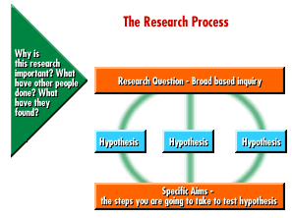
Research Strategy
A strong research idea should pass the “so what” test.
What is the benefit of answering your question?
What is the purpose of your research?
Why did you chose the approach?
Consider anticipated results and alternatives
How the proposed studies will move the field forward?

Slide 16
Leads to a Hypothesis
A statement. Defines the assumption you are to test.
Example: Study elderly subjects and drug for knee osteoarthritis. Test two drugs, ABC and ibuprofen; measure is relief of pain
Hypothesis spells out anticipated relationship between variables. May be true/not true
Drug ABC is superior to standard for knee pain relief.
One sided to find superior, two sided if equivalent;
Hypothesis has impact on power and sample size
State hypothesis for your research question

Slide 17
Experimental Design
How will you test hypothesis?
What is experimental approach?
Describe sample sizes, blinding, statistics, controls, replication
Cite papers, but do not expect reviewer to read
What are “Anticipated outcomes?”
What are “Alternative approaches”

Slide 18
Objectives are SMART action points
Objectives can be action points you want to achieve in study
Example: Study elderly subjects and drug for knee osteoarthritis. Test two drugs, ABC and ibuprofen; measure is relief of pain
Specific self management, carer
Measurable pain scale, quality indicator, joint deterioration
Achievable ambulatory, education, annual assessment
Realistic resources to do it?
Timed 6 months, 1 year

Slide 19
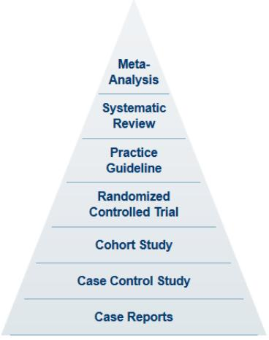
Methodology & Biostats Consult
Helpful formulas
Sensitivity and specificity
False positive false negative
Predictive value
Relative risk
Odds ratio
Grad Cert, MS Clinical Research
CRA 6205 Clinical Investigation
CTS 6202 Res Meth CTR
CTS 6203 Legal Ethical Issues CTR
CTS 6246 CTR Capstone Project
HSCI 6263 Biostatistics for CTR
HSCI 6264 Epidemiology for CTR
Biostatistics & Epidemiology
Consult Service: CTSI-CN
SPARC Request
Study Design 101 online tutorial help
What’s your approach?

Slide 20
Where does this fit in Specific Aims
Provide 2 or 3 aims
Address a hypothesis that is logical, testable,
focused, informative, simple
Sample structure:
First paragraph: Capture attention-hook, what’s known, the gap you will address, why it’s important
Second Paragraph: Introduce your solution to fill the gap
Each Aim: Devote a short paragraph to each aim
Summary Paragraph: What new things we will know, why the application should be supported now
Consider: Models/Charts/Diagrams
Specific Aims Handout

Slide 21
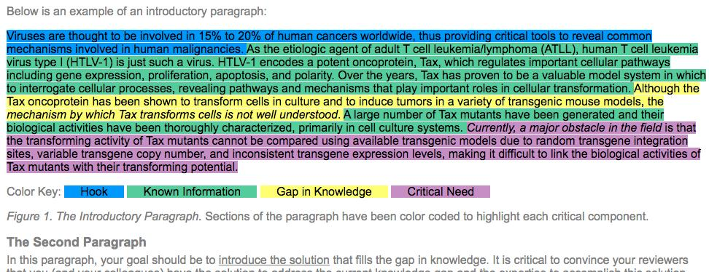
Biosciencewriters.com here

Slide 22
Framing the Question
Research begins with a question,
that leads to a hypothesis
that leads to aims and approach
Question
Hypothesis/ Aims
Study Design & Methodology
Data collection
&
Analysis

