Slide 1
Roadmap to the 4th Year
Lorenzo Norris, MD, Associate Dean for Student Affairs
Terry Kind, MD, MPH, Associate Dean for Clinical Education
Steven Davis, MD, Interim Assistant Dean for Student Affairs
Pritha Ghosh, MD, Interim Assistant Dean for Student Affairs
Fall 2023 – for Class of 2025

Slide 2
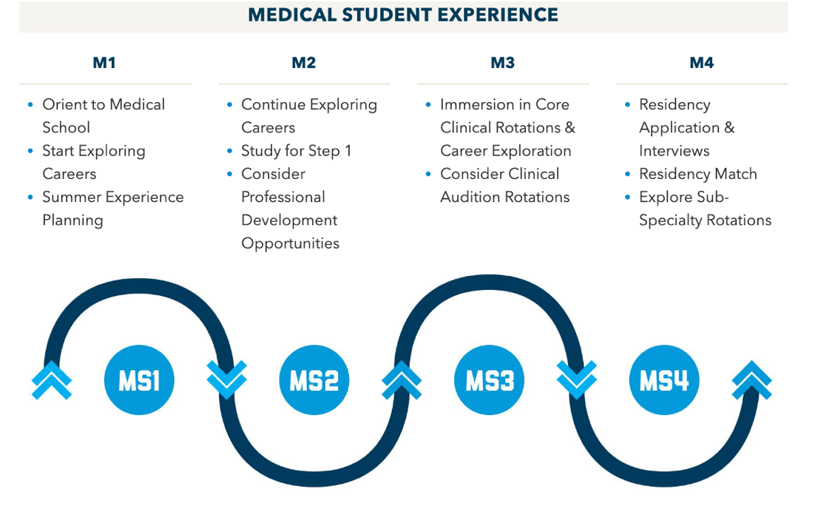
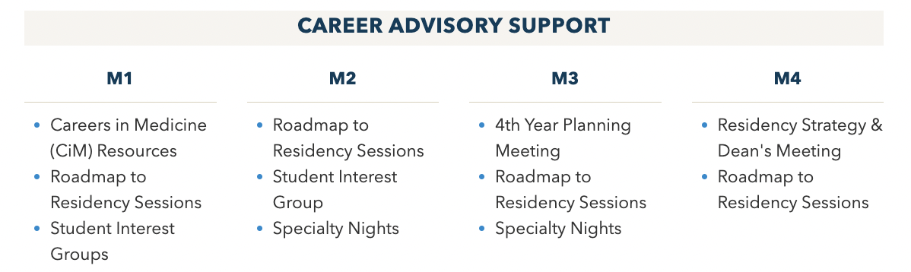
You’ve come a long way!
And we’re here to support you!

Slide 3
Goals of 4th year
Hone your clinical skills as you transition to advanced clinical practice
Identify a career path that excites you
Land in a residency program that fits you
Graduate from medical school
PAUSE, RELAX and EXPLORE on this exciting and flexible part of the medical school!

Slide 4
Roadmap to the 4th Year
Part 1:
Choosing a Career and applying to residency

Slide 5
Identifying a Career Path
Gain insights on specialty choice in clerkships
Get exposure to other specialties (Radiology, EMed, Anesthesiology, etc)
Explore Resources:
SMHS Advising website (www.advising.smhs.gwu.edu)
Attendings, residents, specialty mentors
clerkship faculty
career advisory dean
School-wide career specialty night 1/12/23 from 5pm-6:30pm
When should you know your specialty choice(s)?
June… At the latest

Slide 6
Timeline for the rest of 3rd Year
Dec. 2023
“Guide to the 4th Year” posted on advising website
Start updating CV
Jan. 2024
4th year lottery in mid-January
Specialty night (Jan 11)
VSLO opens for SOME programs
Feb/Mar. 2024
Mandatory 1:1 scheduling meeting with career advisory deans
Complete MSPE Questionnaire
Spring 2024
VSLO applications opens at most programs
Register for Step 2 (Mar/April)
End of 3rd year clinical skills exam in CLASS Center
Choose a Specialty Advisor

Slide 7
Residency Application Timeline
Interviews
ERAS Application Opens
Match/SOAP week and
Match day
Submit Rank Order list
GRADUATION!!
Submit application
PD’s view applications
Jun
July
Aug
Sept
Oct
Nov
Dec
Jan
Feb
Mar
Apr
May
SF (Optho) &
Urology Match
Military Match

Slide 8
(Detailed) Residency Application Timeline
June-Aug
Take Step 2 (We advise you try to get it done by mid-August!)
Complete online R2RLQ (Roadmap to Residency Longitudinal Questionnaire) questionnaire – by Jun 1, so that your deans can start working on the dean’s letters
Solicit letters of recommendation
Work on Personal Statement
Prepare ERAS application
Late September
Programs receive student applications from ERAS
Register for the National Resident Matching Program (NRMP)
MSPE released
October thru early February
Interview

Slide 9
Residency Application Timeline (cont.)
December
Military Match complete
January
San Francisco Match complete (ophthalmology)
Urology Match complete
February
Submit rank lists to NRMP
March
Match Week! (Third week of March)
May
GRADUATION!

Slide 10
Roadmap to the 4th Year
Part 2:
Meeting Graduation Requirements

Slide 11
4th Year Graduation Requirements
Acting Internship: must complete 1 of the following 4 week courses to meet GW’s core AI graduation requirement:
Critical Care Medicine @ GW only (ANES 384)
Inpatient Internal Medicine
GW (MED 332) or VA (MED 334)
Inpatient Pediatrics (PED 361, 362, 364, 366)
Children’s (3 resident teams/ 1 non-resident team)
PICU (PED 379)
Inpatient Family Medicine (IDIS 390) – extramural/away
Inpatient General Surgery
General/Oncology (SURG 380)
Thoracic, Hepatobiliary, and Transplant (SURG 382)
General/Minimally Invasive (SURG 383)
Vascular (SURG 388)
Trauma and Critical Care (SURG 400)
Colorectal and Breast Surgery (SURG 402)

Slide 12
4th Year Graduation Requirements Continued
Emergency Medicine 4 weeks
Adult (EMED 302) or Pediatric (PED 405)
Neuroscience NEUR 380 for 4 weeks
Sites by lottery
Adult neurology
Can include some Pediatric neurology as part of NEURO 380
Can include some Neurosurgery as part of NEURO 380
Anesthesiology (ANES 302) 2 weeks
can take ANES 380 (4 weeks) to satisfy this requirement, but ANES 302 (2 weeks) suffices

Slide 13
4th Year Graduation Requirements Continued
Transitions to Residency Course
Feb 27- March 26, 2023
Independent Study (IDIS 999)
14 weeks (interviews, Step 1/Step 2 study, clerkship make-up)
Free Choice Electives-
Total of 18 weeks in 4th year (plus the 8 weeks from 3rd year)

Slide 14
4th Year Requirements Continued
You are required to pass Step 1 and Step 2 to graduate
We recommend you take it by mid-August
Results take 3-4 weeks – residencies will want to see them!
You MUST take it by Dec 31, 2023
Completion of Intersession IV longitudinal projects
Scholarly Concentration Capstone/Senior Elective Requirements

Slide 15
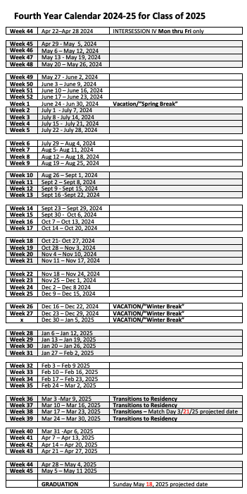
Preparing a Schedule
Consider Step 1 study (if not taken yet)
Consider no more than 6-8 weeks
Enter as Independent Study (IDIS 999)
Consider Step 2 study
4 weeks
Enter as Independent Study (IDIS 999)
Consider interview time
4 weeks minimum
Enter as Independent Study (IDIS 999)
Consider extramural electives
Block out with department name and 390 code:
MED 390, SURG 390, PED 390
Add other electives and requirements

Slide 16
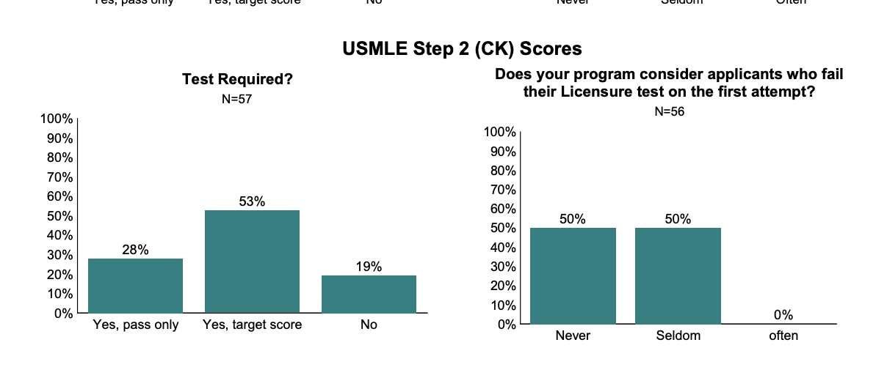
Step 2
Must Study Hard!! 4 weeks intensively
Many programs will NOT rank students without Step 2 results
Some programs will NOT interview students without Step 2 results
Many students now try to take it early (April –Aug)
HPSP must take early
OBGYN applicants must take early

Slide 17
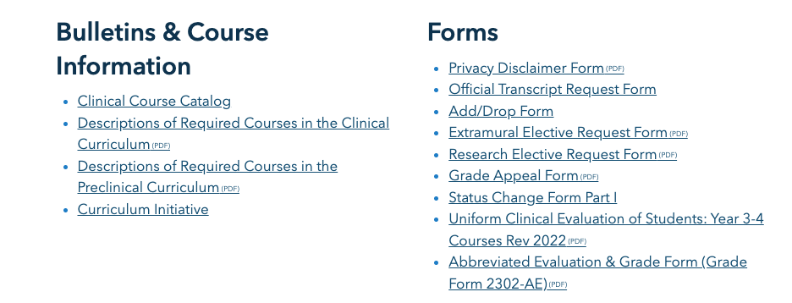
Away/Extramural electives
Why do an away rotation?
Required by some specialties (EMed, Ortho, Derm, Urology, Plastics, Vascular Surgery, Neurosurgery)
If you have a strong regional preference
If you need to emphasize your clinical skills - off paper
To explore medicine in another environment
Does everyone need to do an Away?
No! Most specialties don’t expect it
In some cases, it might be a disadvantage
How do you do an Away?
Apply through VSLO – deadlines vary, most in late spring
Need permission from the GW home department that coincides with your requested elective (Permission to Take Off-Campus Elective Form) turned into dean’s office
Stay tuned for more guidance on this
https://smhs.gwu.edu/academics/md-program/current-students

Slide 18
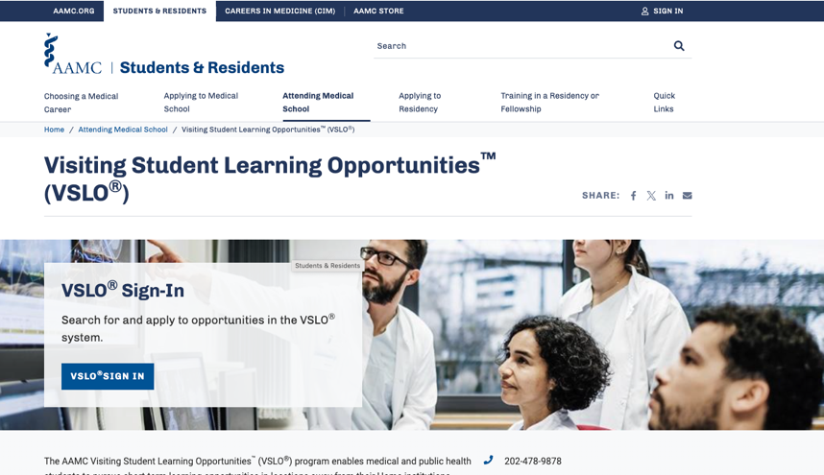
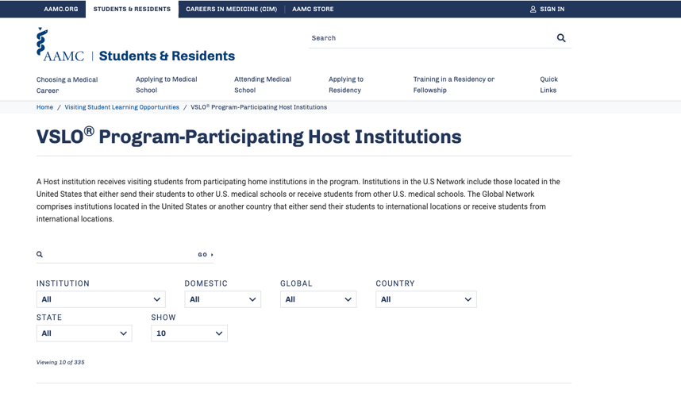
Away/Extramural electives
(NEW!) You will get your VSLO token THIS WEEK.
You can begin by exploring programs you may want to apply to, and looking at their individual application requirements.
Standard VSLO application requirements: Letter of interest, transcript
Some programs may ask for CV, letters of recommendation, etc
Stay tuned for a AAMC webinar about this!
Reach out to your advisory dean with questions

Slide 19
Scheduling Advanced Electives
For some specialties we block out some space in the first few months of the year so students can negotiate scheduling directly with the department.
Radiology
Orthopedics
Ophthalmology
Anesthesiology
Dermatology
Emed
ENT
Contact the course coordinator
to reserve a spot in January when
lottery opens
Enter the department name
followed by the 390 code in
your schedule, ie: Rad 390

Slide 20
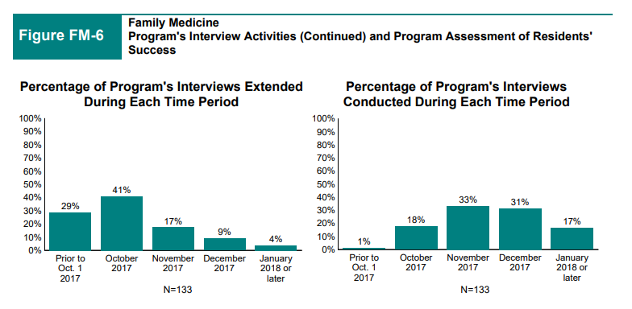
Scheduling Interview Time
Must have minimum of 4 weeks unrestricted time (Independent Study time – IDIS 999)
EARLY MATCHES:
Military (during ADTs)
San Francisco Match: Ophthalmology (Oct/Nov)
Urology (Oct/Nov)
National Resident Matching Program:
(Nov/Dec/Jan)

Slide 21
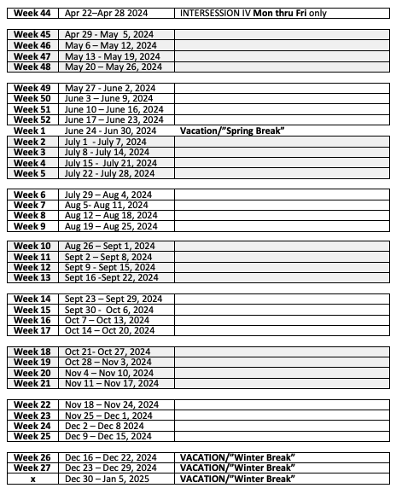
4th year calendar Class of 2025
Complete any remaining clerkships
Step 1
End of Third Year Exam
Step 2 CK
Advanced electives
Acting internships
Away rotation(s)
Required Courses (Neuro, Emed, Anes)
Other electives
ERAS applications in September
Required Courses (Neuro, Emed, Anes)
Advanced electives
Acting internships
Away rotation(s)
Other electives
Interviews

Slide 22
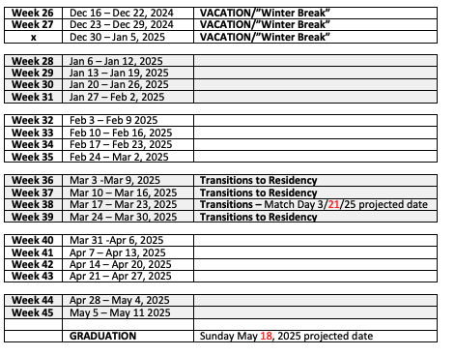
4th year calendar Class of 2024
Required Courses (Neuro, Emed, Anes)
Interviews
Electives
Urology, Ophtho, Military matches
Rank lists due for main match
Electives, including international
Required Courses (Neuro, Emed, Anes)
Required Courses (Neuro, Emed, Anes)
Electives, including international
GRADUATION!!!!

Slide 23
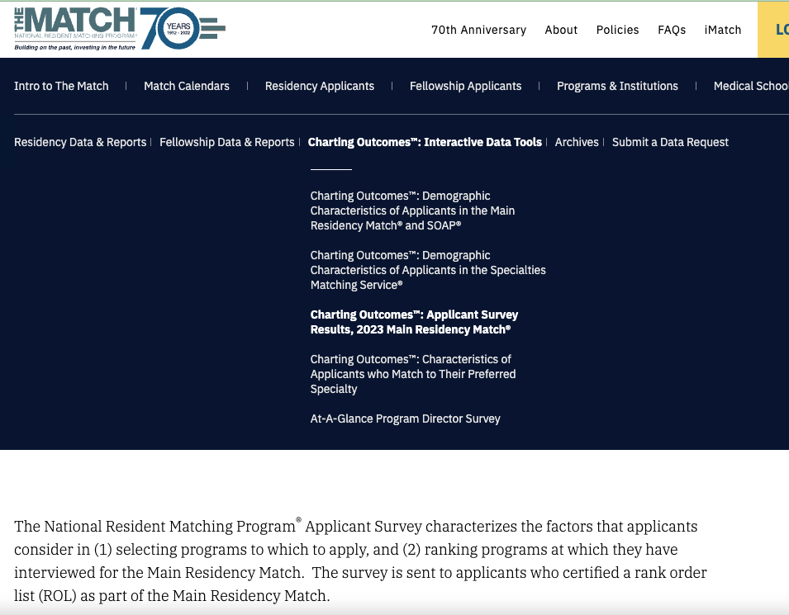
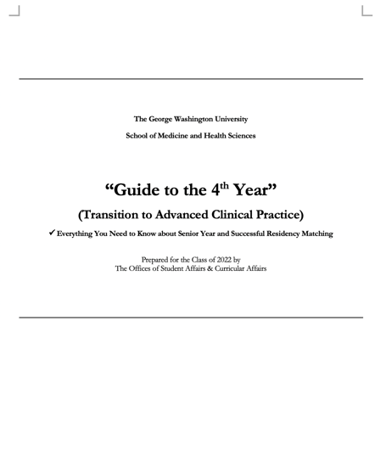
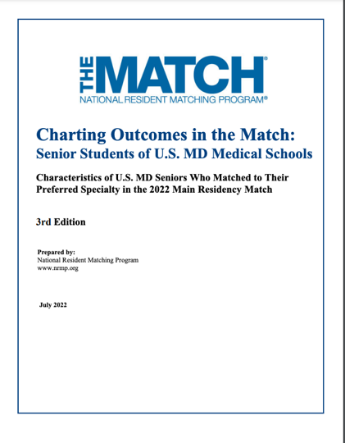
Mandatory reading!
…Information is Power…
COMING SOON
https://www.nrmp.org/match-data-analytics/interactive-tools/charting-outcomes-applicant-survey-results-main-residency-match/

Slide 24
Next steps in your Road to Residency?
Identify your specialty of choice
Specialty Night – Jan 11 from 5pm-6:30pm in Ross Hall!
Start working on your CV
Helpful to apply to Aways, request LORs
R2R Session: CV Writing Workshop – Jan 5
Work on your R2RLQ Questionnaire
4th Year Lottery (mid-late January)
Mandatory 4th year planning meeting with Career Advisory Dean (Feb/March)

Slide 25
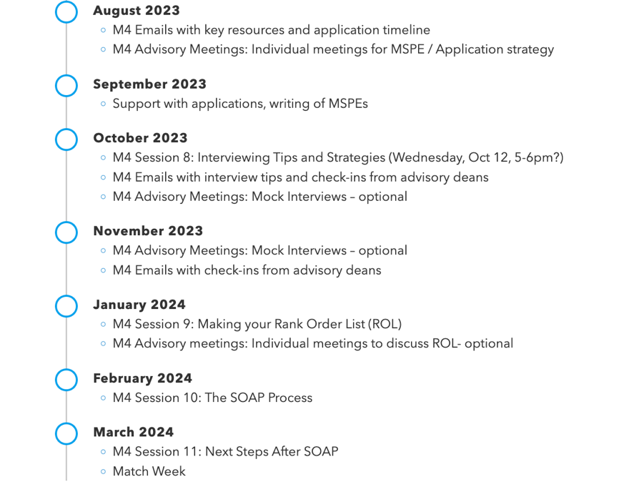
The Roadmap Ahead: Upcoming R2R Initiatives

Slide 26
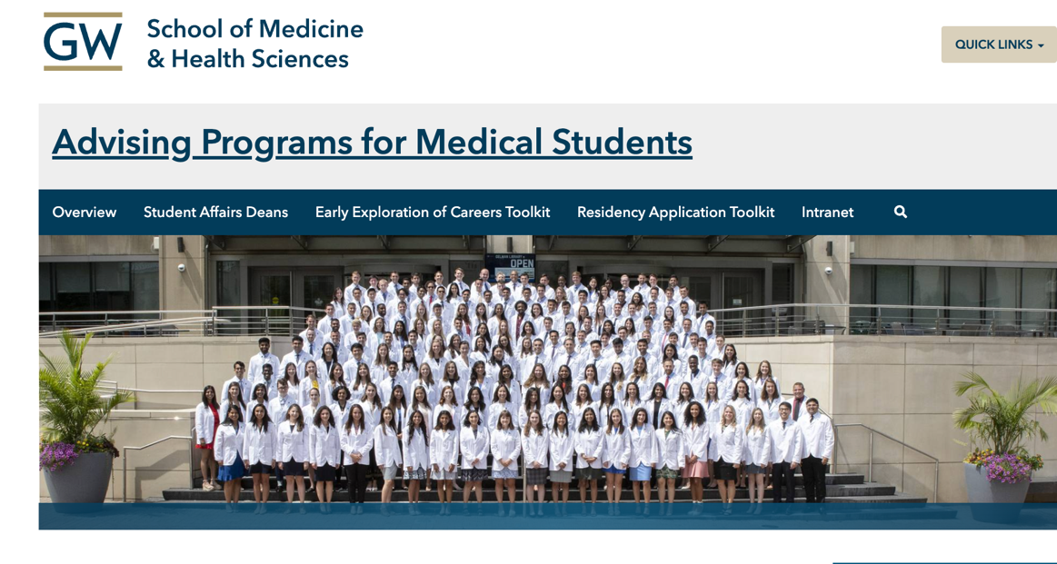
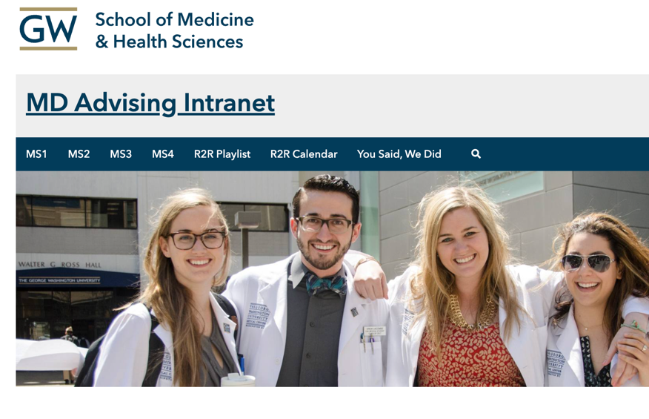
Updated advising website
with toolkits of key resources
R2R WEB TOOLS
Password-protected Intranet site with
GW-specific advising materials
Username: GWstudent
Password: medstudent

Slide 27
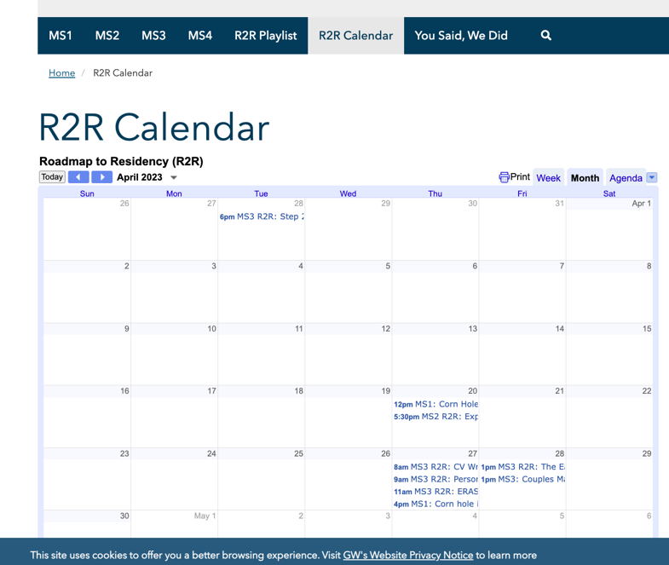
R2R
Channel
R2R WEB TOOLS
YouTube Channel with recordings of key R2R sessions and large-group departmental advising sessions
Shared calendar with advising sessions, webinars, workshops, key dates and timelines

Slide 28
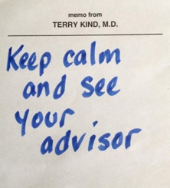
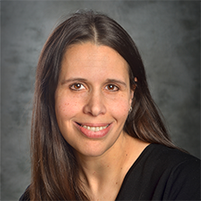
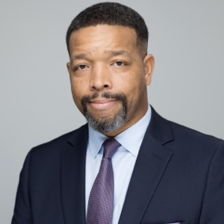
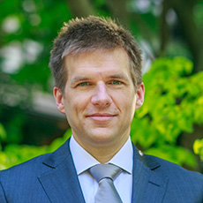
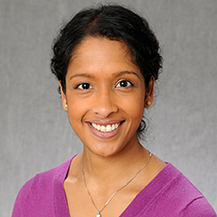
Questions about 4th year?
Reach out to your deans anytime!
Clinical Education Dean
Career Advisory Deans
Dean Terry Kind
tkind@childrensnational.org
tkind@gwu.edu
Dean Lorenzo Norris
lnorris@mfa.gwu.edu
Dean Steven Davis
spdavis@gwu.edu
Dean Pritha Ghosh
pghosh@gwu.edu

Slide 29
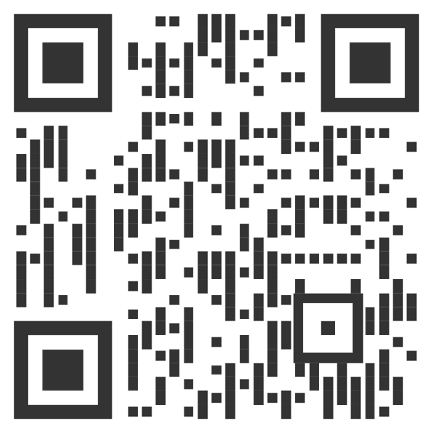
YOU CAN DO THIS!!!
Let us know how else we can help!
R2R Feedback QR Code

