Slide 1

Bootcamp on Clinical Research for
New Investigators
Session 1 – Thursday November 17
2022

Slide 2

Principal Investigator Responsibilities (10 slide max; 15 min ea speaker)
• 12:00-12:15 Industry-sponsored or investigator-initiated studies: Henry
Kaminski
• 12:15-12:30 Investigators rely on trained clinical research staff: Aileen
Chang
• 12:30-12:45 Investigators need to recognize conflicts: Laura Sigman
Protocol & Study Frameworks (10 slide max; 15 min ea speaker)
• 12:50-1:05 Cohort discovery & databases: Hiroki Morizono
• 1:05-1:20 Protocol Builder/ OnCore: Richard Lush
• 1:20-1:35 Investigational drug pharmacy-do-able: Dorinne Mettle-
Amuah
1:40-2:00 Breakouts: “How To Get Started as an Investigator in an Externally
Sponsored Study”
•
•
Radwa Aly, Richard Lush, GW
Jurran Wilson, Patrick O’Keefe, CNH

Slide 3
Industry-sponsored or investigator-
initiated studies single/ multi-site
Henry J. Kaminski, MD
Meta A. Neumann Professor of Neurology
Department of Neurology & Rehabilitation
Medicine
Principal Investigator
NIH Rare Disease Clinical Research Network
for Myasthenia Gravis MGNet

Slide 4
Relevant Relationships
Henry J. Kaminski, MD has the following financial
relationships to disclose:
Grants: PI, Rare Disease Clinical Research Network MGNet
(U54 NS115054), Scientific Consultant, MV2C2 antibody as a
new therapeutic for Myasthenia Gravis, R43NS12432 to
Mimivax, LLC with subcontract to George Washington
University, 2022-2024
Consultant: Alnylam Pharmaceuticals, Cabelleta Bio, Lincoln
Therapeutics, Ono Pharamaceutials, Roche, Takeda, UCB
Pharmaceuticals
CEO and CMO: ARC Biotechnology, LLC based on US
Patent 8,961,981 with R21 NS110331
Spouse with additional industry subcontracts to GWU

Slide 5
What are we talkingWhat do these
about?
all have in
common?
• Unfunded, clinical
study at single site
• Funded clinical
study at single site
You as PI are
responsible for
EVERYTHING
• Unfunded, clinical
study at multiple
sites
• Funded, clinical
study at multiple
sites

Slide 6
Develop a hypothesis that is
impactful
What compelling reason
justifies the expenditure of
time, effort, and money as
well as the exposure of
subjects to harm including
potential for death?
Aly R, Cutter GR, Kaminski HJ. Clinical Trial Design in
Myasthenia Gravis. Myasthenia Gravis and Related
Disorders, 3rd Edition. Kaminski HJ, Kusner LL
(editors). Springer Publishing, 2018

Slide 7
Prior to study initiation
• You and colleagues develop a
hypothesis that is impactful
• You and colleagues assess the
approach/methods.
• Can the work be done? If you
cannot recruit subjects, do not try
to do the study.
• Assure you address COI issues with
sponsor, Hospital and University
and yourself, if you think there is a
potential COI disclose
• Attend/direct the investigator start-
up meeting
• If you are leading an investigator
initiated trial, remember the
Investigational New Drug
application to the FDA
• Appreciate authorship governance
• Establish your team, which includes
research coordinators,
administration at many levels,
mentors, colleagues, compliance,
others
•
Engage the business team early to
assist with contracts and budget
development and negotiations
• Do you have the resources? Time
and $$$ and personnel
• Understand the budget, negotiation • Cannot start any research activates
and engage the business office without an IRB approval!
EARLY (contracting)

Slide 8
During the study
• Assure safety
• Attend start-up and
investigator meetings
• Understand inclusion and
exclusion criteria and
keep them in mind when
you see patients in clinic
• Be part of the informed
consent process
• See the subjects and
make sure you have back-
up
• Work with your
coordinator to complete
study assessments
immediately
• Review safety
assessments promptly
and act on them as
needed
• Be mindful of regulatory
and compliance issues

Slide 9
During the study
• Do your best to assure • Remember the
hitting recruitment
expectations
• If you are not, analyze
why not with your study
team
• Be responsive to the
sponsor and available
for routine inspection
or site audit
subcontract is NOT
REVENUE to you, there
are costs, don’t think
you brought $250,000
to support you directly,
there are costs
• If you want to do clinical
research for the money,
better not to.
• Maintain enthusiasm

Slide 10
After Study Completion
• Attend the study results • Do not become a
meeting
marketing shill for the
company that has
sponsored the research
• Do not disclose the
results until approved to
do so
• Do NOT invest in the
company that has run the
clinical trial
• Do put into context how a
new drug fits into the
therapeutic landscape of
the disease you study
• Do not become
intoxicated with the
thought that you are
subject matter expert or
thought leader

Slide 11
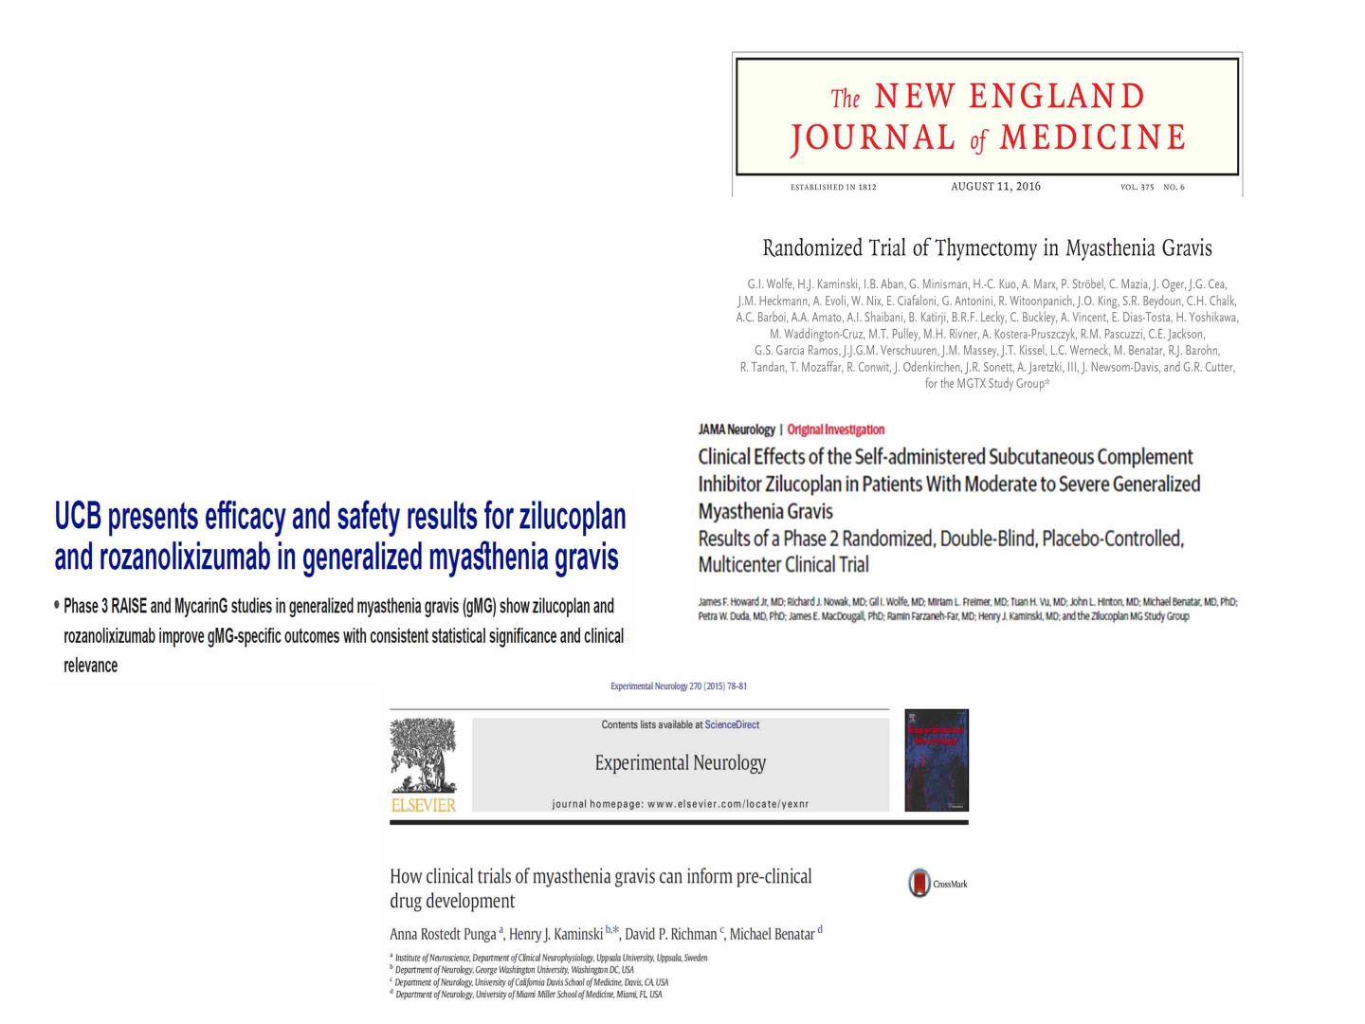
Why?
There is nothing
more satisfying, then
answering a question
and being part of the
process and …

Slide 12
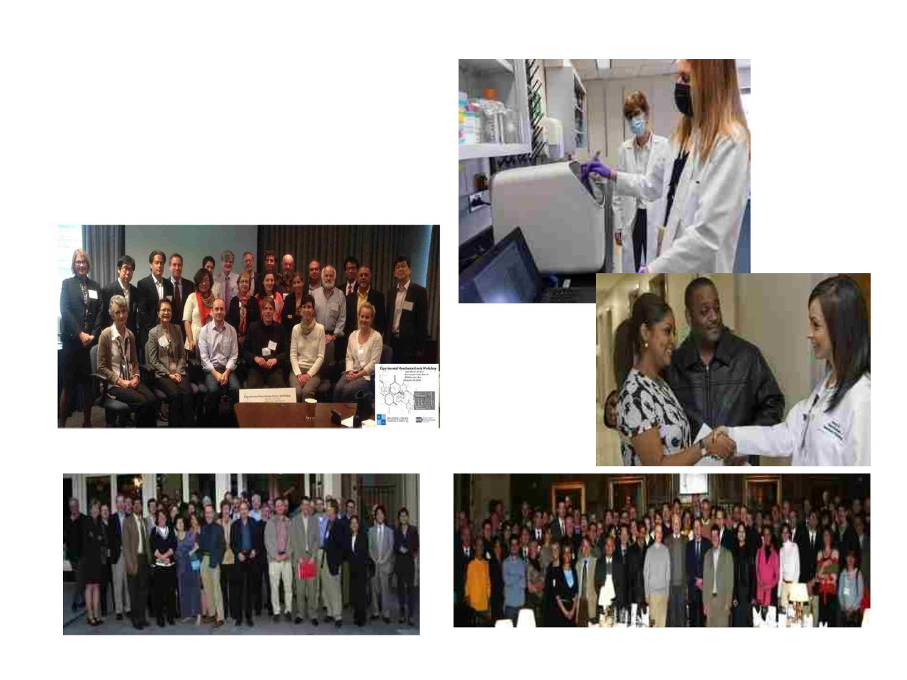
…working with amazing,
talented colleagues

Slide 13

INVESTIGATORS RELY
ON TRAINED CLINICAL
RESEARCH STAFF
AILEEN CHANG MD MSPH

Slide 14

OUTLINE
• SOURCING TALENT
• ONBOARDING
RESOURCES
• PROJECT
MANAGEMENT

Slide 15

FEDERAL
WORK
STUDY
• US DEPARTMENT OF
EDUCATION
• https://careerservic
es.gwu.edu/federal-
work-study
• Need-based
financial assistance
• Undergraduate and
graduate students
• Fall and spring
semester

Slide 16

VISITING
SCHOLARS
• https://columbian.g
wu.edu/internationa
l-visiting-scholars-
program-current-
visiting-scholars
• J-1 visa/DS2019
paperwork online
for the Department
of State
• Proof of funding

Slide 17

HIRING
• https://hr.gwu.edu/
• Job description
• Job classification
• Posting
• Interview at least 3
eligible candidates
• Offer
• Background check

Slide 18
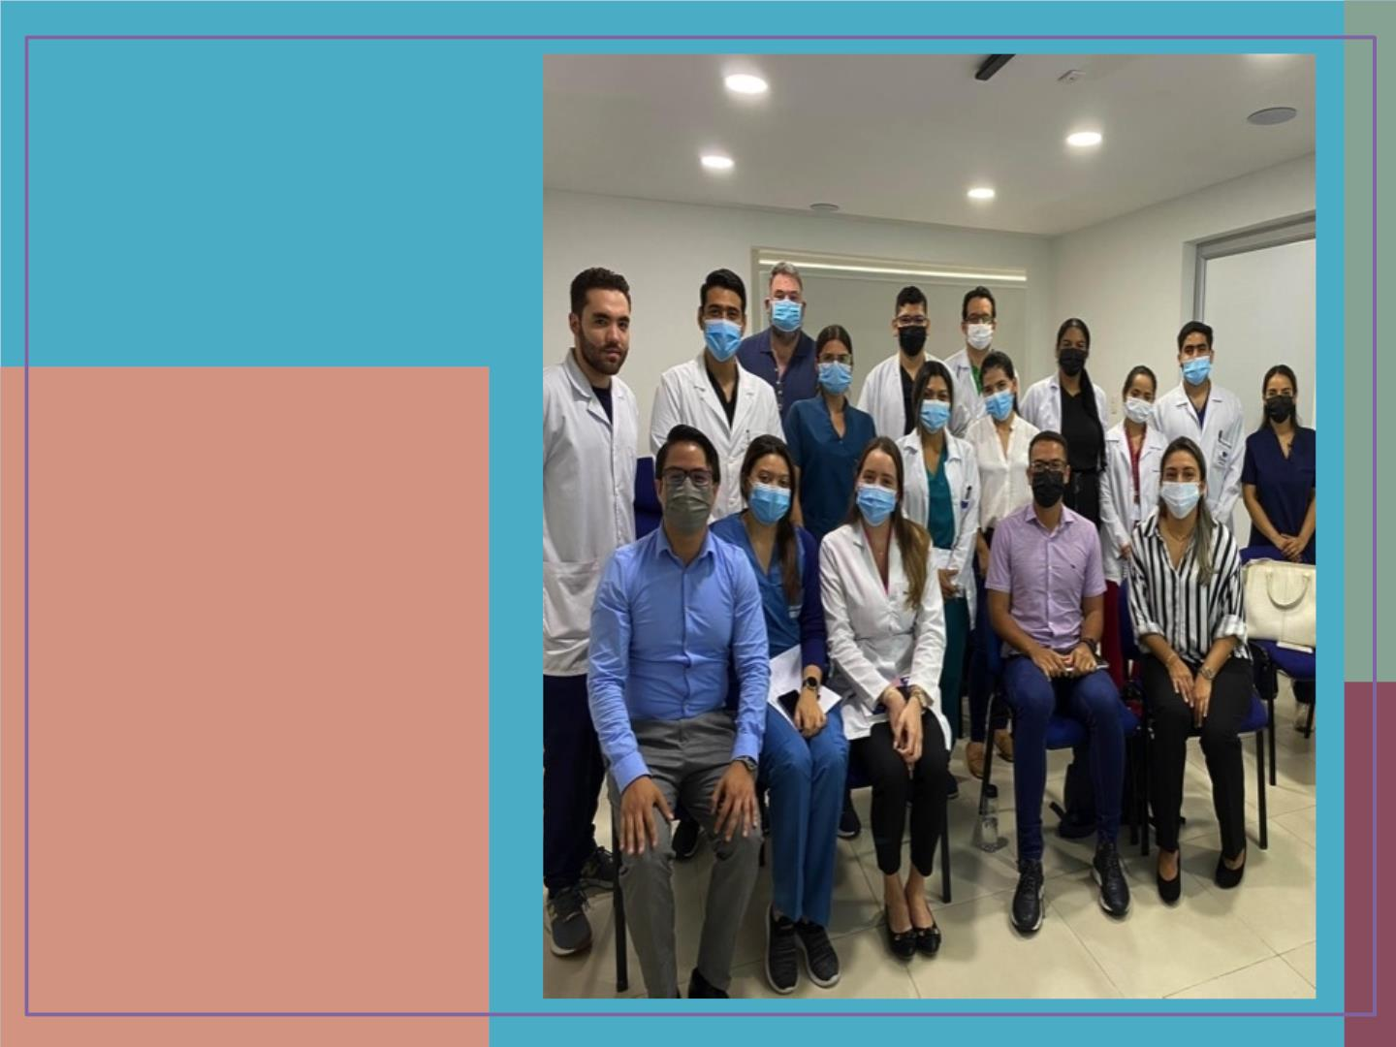
ONBOARDING
RESOURCES

Slide 19
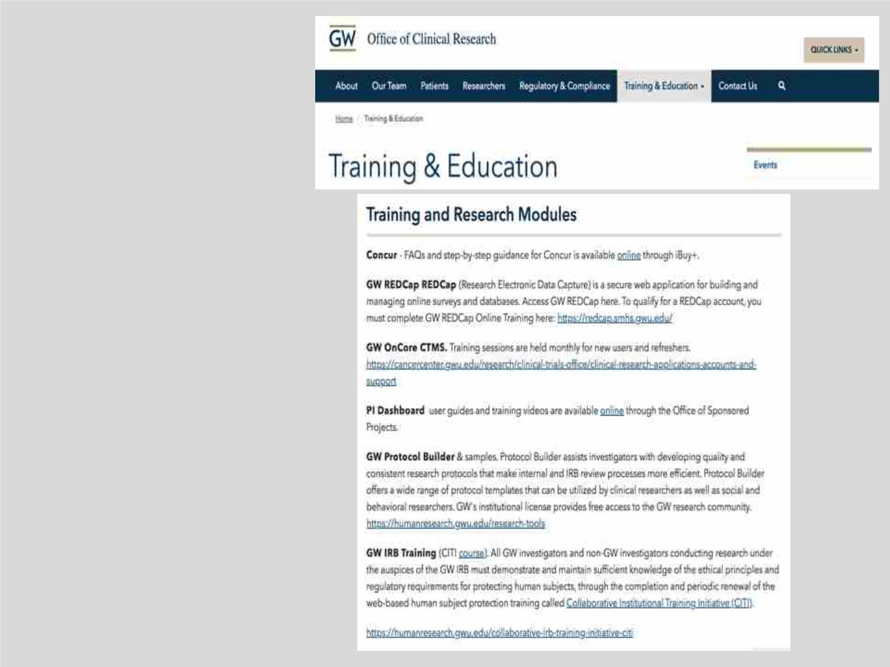
OFFICE OF
CLINICAL
RESEARCH
• https://clinicalresearch.
gwu.edu/training-
education

Slide 20

GW
REDCAP
• https://redcap.smhs.gw
u.edu/

Slide 21
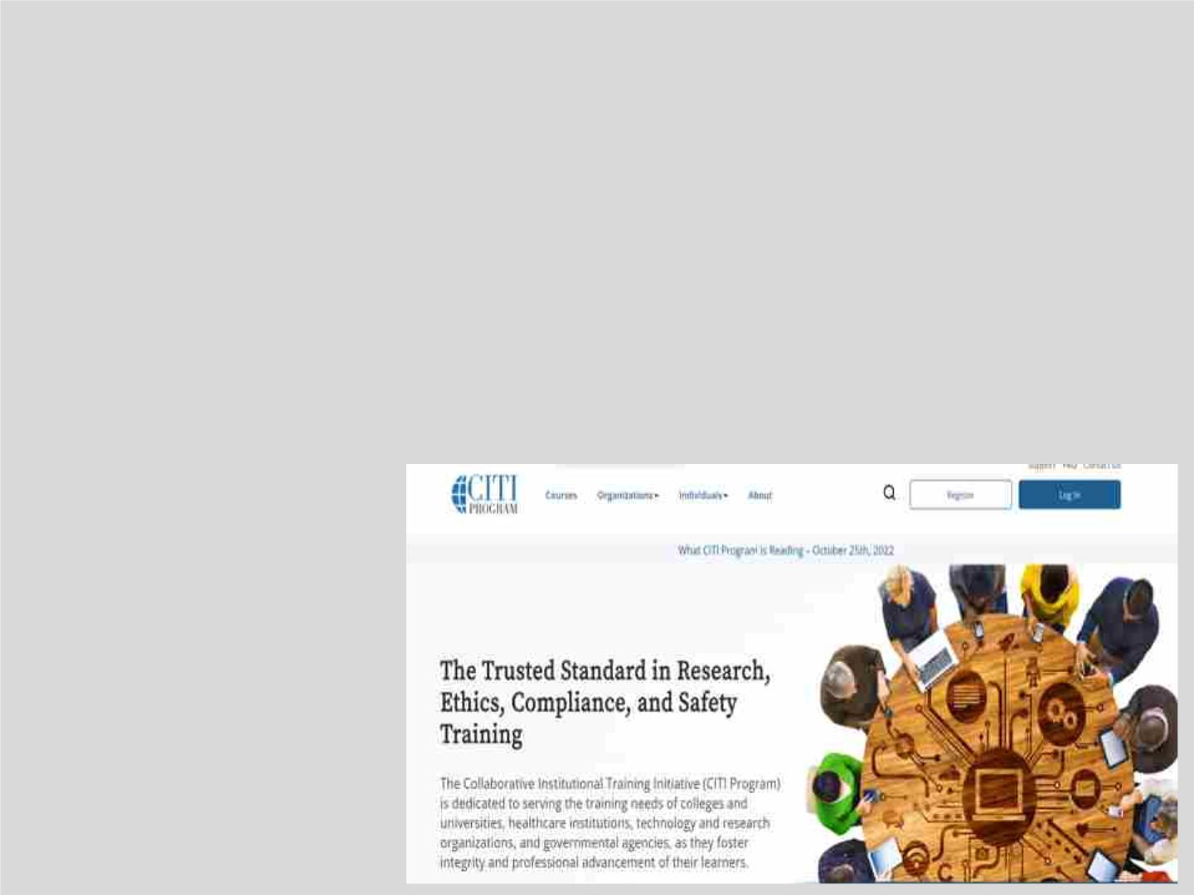
CITI
• https://about.citiprogra
m.org/

Slide 22
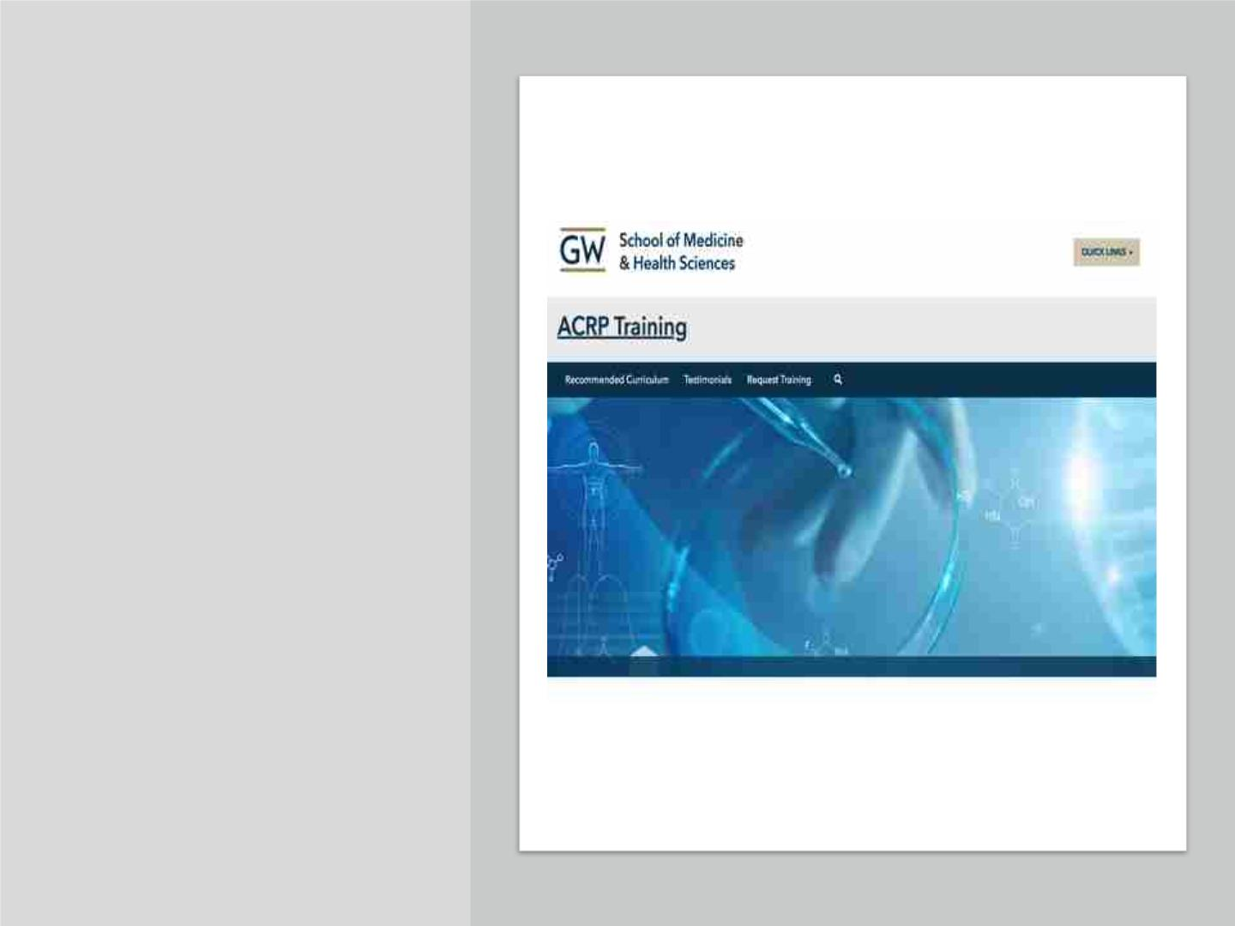
ASSOCIATION OF
CLINICAL RESEARCH
PROFESSIONALS
(ARCP)
• Enhanced clinical
research courses and
certifications.
• GW provides free
training to enhance
your career.
• https://acrp.smhs.gw
u.edu/

Slide 23
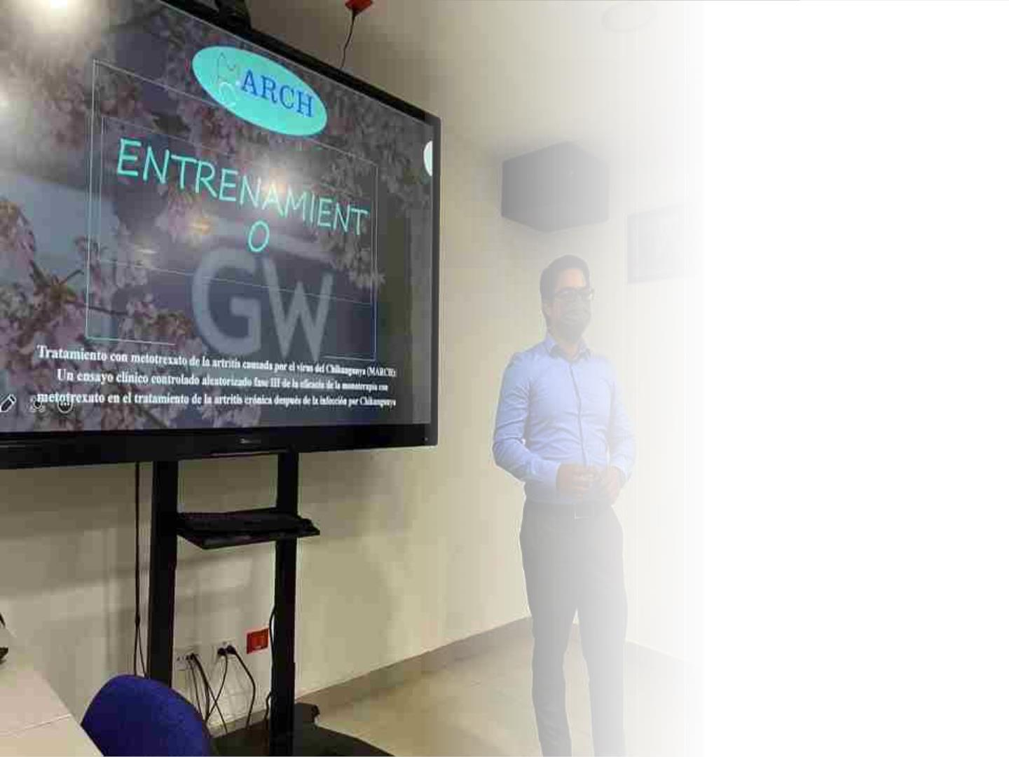
ARCP
RECOMMENDED
COURSES
• GCP
• Introduction to Clinical
Trials
• Clinical Trial Protocols
• Ethics and Human Subjects
• Eresearch
• Event reporting
• Risk based monitoring
• FDA 1572
• Inspection readiness
• Quality Management tools

Slide 24

Program
Management

Slide 25
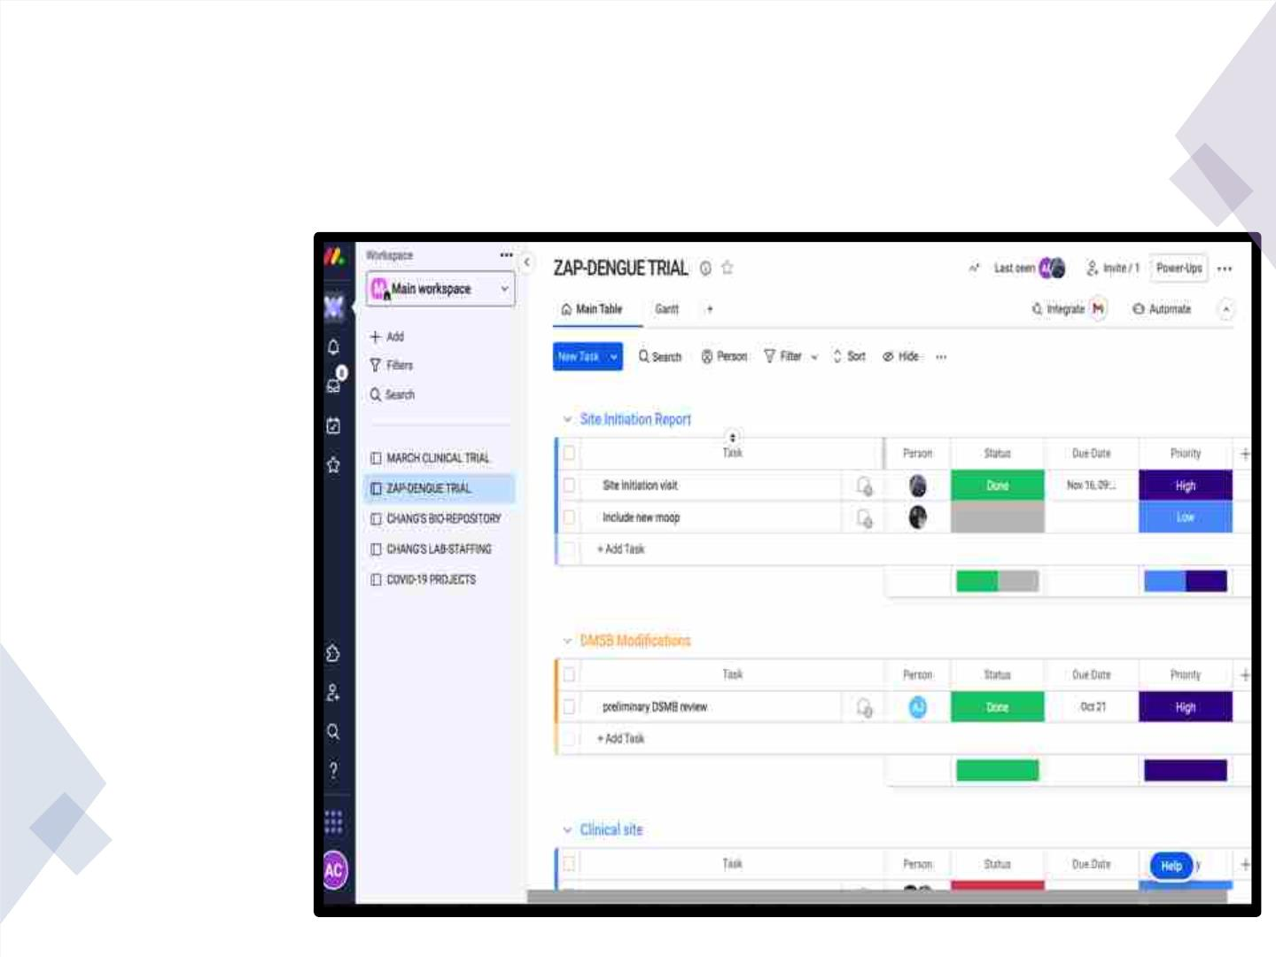
PROGRAM MANAGEMENT
• Example of
program
management
software:
Mondays.com

Slide 26

THANK YOU
Good luck with your research!

Slide 27
Investigators Need to
Recognize Conflicts
Laura Sigman, MD, JD
Emergency Division
Children’s National Hospital
11/17/2022
*Disclaimers: I do not serve as an attorney for Children’s National or GW.
This talk is not meant to provide legal advice.

Slide 28
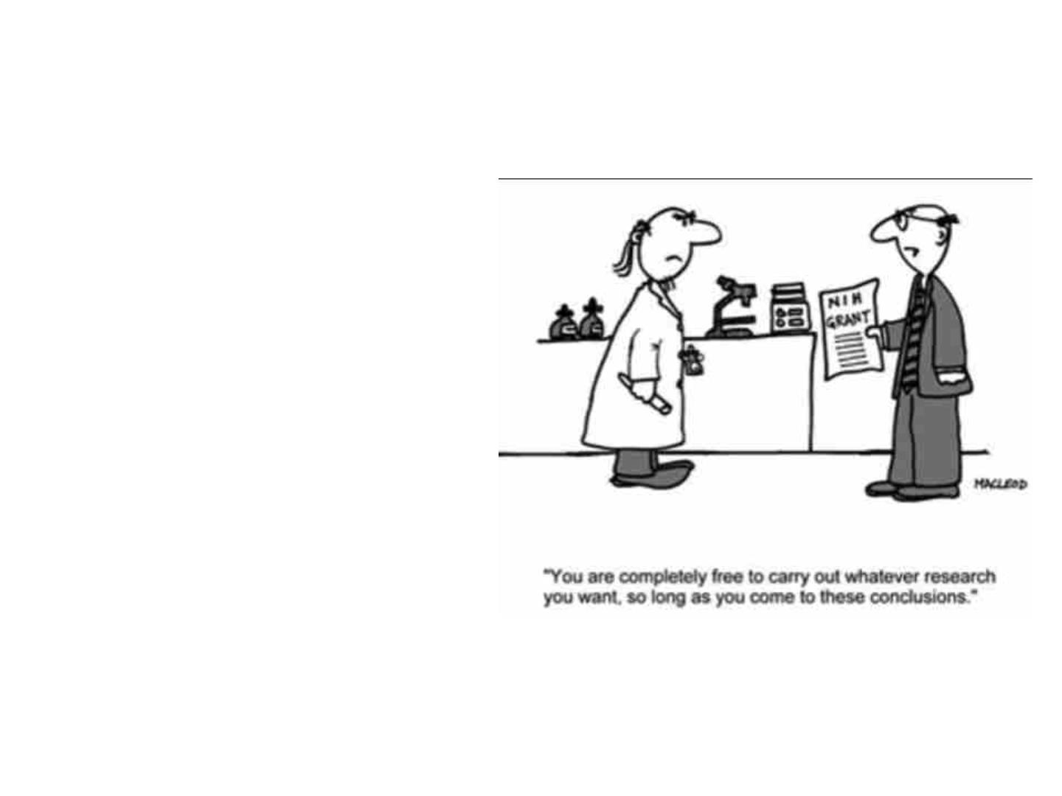
Learning Objectives
• Recognize sources of
conflicts in research.
• Differentiate types of
conflicts.
• Implement procedures
to identify, report, and
disclose conflicts.

Slide 29

Is There a Conflict of Interest?
1. A close family member of a researcher
works for an organization whose product the
researcher is evaluating.
2. An investigator conducting basic science
research on processes involved in
neurotransmitter release obtains funding from
a producer of a popular antidepressant. The
work naturally leads to a next study on the
efficacy of that same antidepressant.
3. An oncologist recommends a patient
participate in a clinical trial which he or she is
an investigator for.

Slide 30
What is a Conflict of Interest (COI)?
•
•
Personal, financial, political
Position of influence directly or indirectly related to
institutional business
•
Could lead to advancing one’s own or one’s family’s
interest to the detriment of integrity or service to
the public
•
•
•
Brings about an ethical problem
Erodes or undermines trust
Can affect judgement, reasoning, motivation,
behavior, and bias

Slide 31
COIs Include…
•
Appearance or perception of a COI can have same
effects as an actual COI
•
PI’s are responsible for what goes on under them
•
Individuals responsible for the design, conduct
or reporting of research
Technicians, other staff members
•
•
Doctor’s involvement in a trial recommended to a
patient

Slide 32

When an investigator’s relationship to an organization affects, or gives the
appearance of affecting, his/her objectivity in the conduct of scholarly or
scientific research, a conflict of interest is said to occur.
Naturally, some conflicts of interest are unavoidable and having a conflict
of interest is not in itself unethical.
GUIDELINE 28: Authors must become aware of possible conflicts of
interest in their own research and to make every effort to disclose
those situations (e.g., stock ownership, consulting agreements to the
sponsoring organization) that may pose actual or potential conflicts of
interest.
https://ori.hhs.gov/brief-overview-conflict-interests

Slide 33
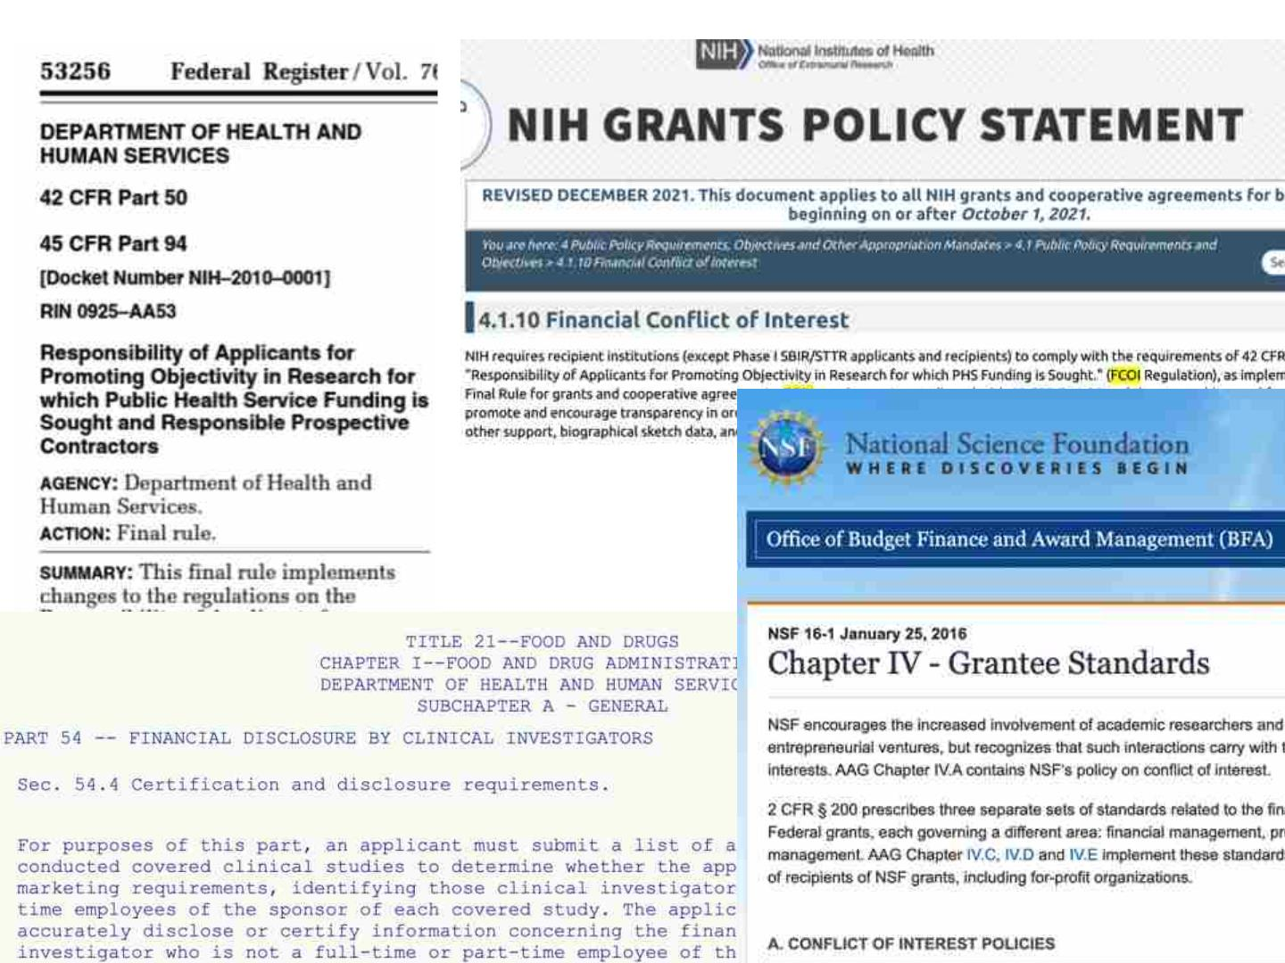

Slide 34

•
Divergence between private interests and
professional service
•
•
•
•
Different natures and degrees
Actual and apparent conflicts
Goal is NOT to eliminate all conflicts
Rather, establish boundaries, processes for review,
and mechanisms for management
Avoid inappropriate conflicts
•

Slide 35

Conflicts Requiring Review
1. Conflicts with compensated time and effort
2. Substantial use of human and material resources of
the University
3. Financial involvements affect or appear to affect
academic responsibilities or freedom (e.g., hiring
family; agreeing to limit access to results of sponsored
research)
4. Deprives the University of appropriate potential
financial gain (e.g., patents)
Conflict of Interest Policy [compliance.gwu]

Slide 36
Policy
1. Provides a mechanism to report and seek guidance to ensure
appropriate disclosure
2. Each school administers a procedure for periodic review of COIs
3. "Immediate family member" means spouse/domestic partner and
dependent children.
4. "Significant financial interest” is valued at $10,000 or 5% of total
ownership interests of outside entity
5. Includes expectation to receive income exceeding $10,000 total in the
last or next 12 months
6. Includes services as a PI or holding a management position in an
outside entity

Slide 37
When to Report
• Ad hoc basis
• As soon as such situations become known
• According to school policies
• To the department chair or other pertinent head
• Before the University enters into a transaction with a
potential COI
• Written disclosure to school dean

Slide 38
Covered Transactions
1. Gifts to the University of cash or property
2. Sponsored-project proposals where investigator or
family has a significant financial interest
3. University technology-licensing arrangements
4. Procurement of materials or services from an outside
entity
5. Submission to an external sponsor of an application for
funding of University research

Slide 39
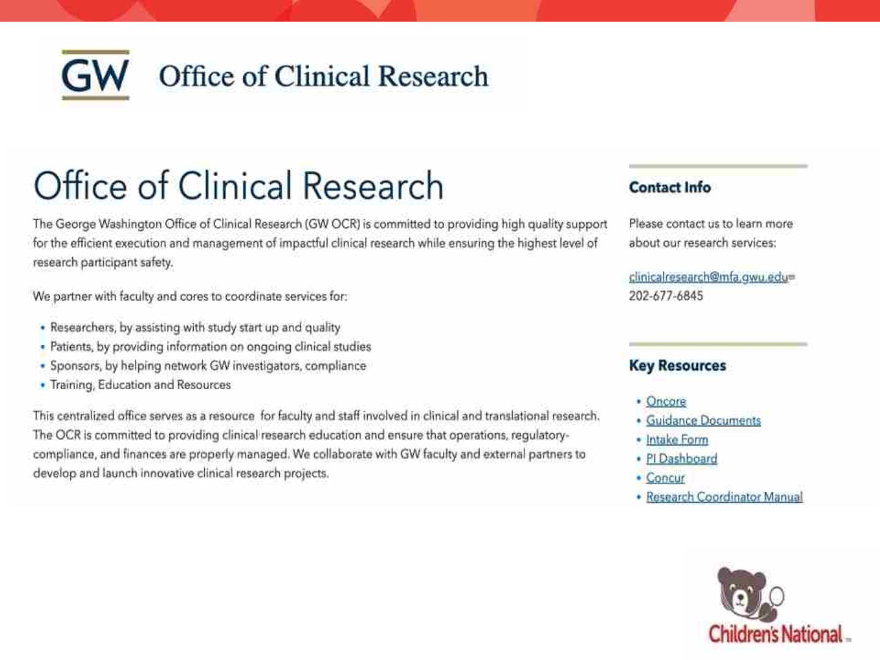
https://clinicalresearch.gwu.edu/

Slide 40
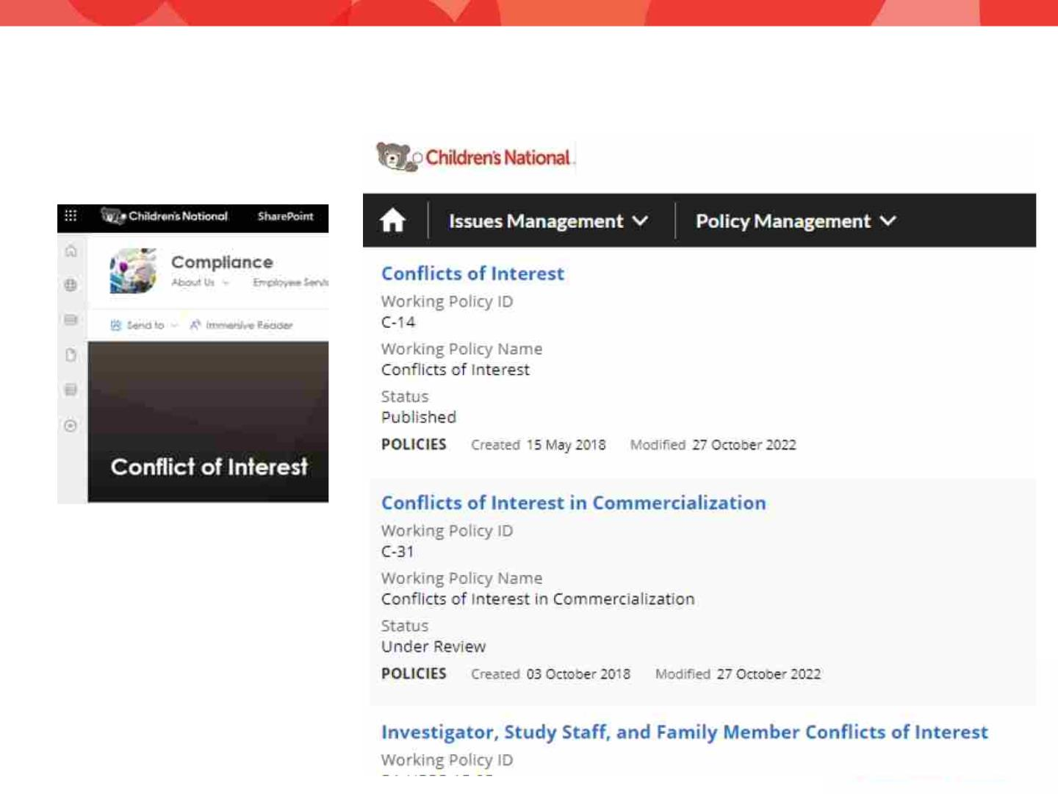
Children’s National Policies

Slide 41

What to Disclose
External compensation related to job responsibilities
• In-kind compensation
• Consulting feels
• Royalties, Honararia, Reimbursements
• Meals, gifts
• Proceeds from book sales
Ownership in healthcare start-ups or other entities related to job
Relationships with CNH vendors
Compensation received by family & personal relations related to job
responsibilities, healthcare startups, vendors, other relevant entities
Submit annually and within 30 days of any change
Significant Financial Interests: >$5,000 or more than 5% ownership

Slide 42
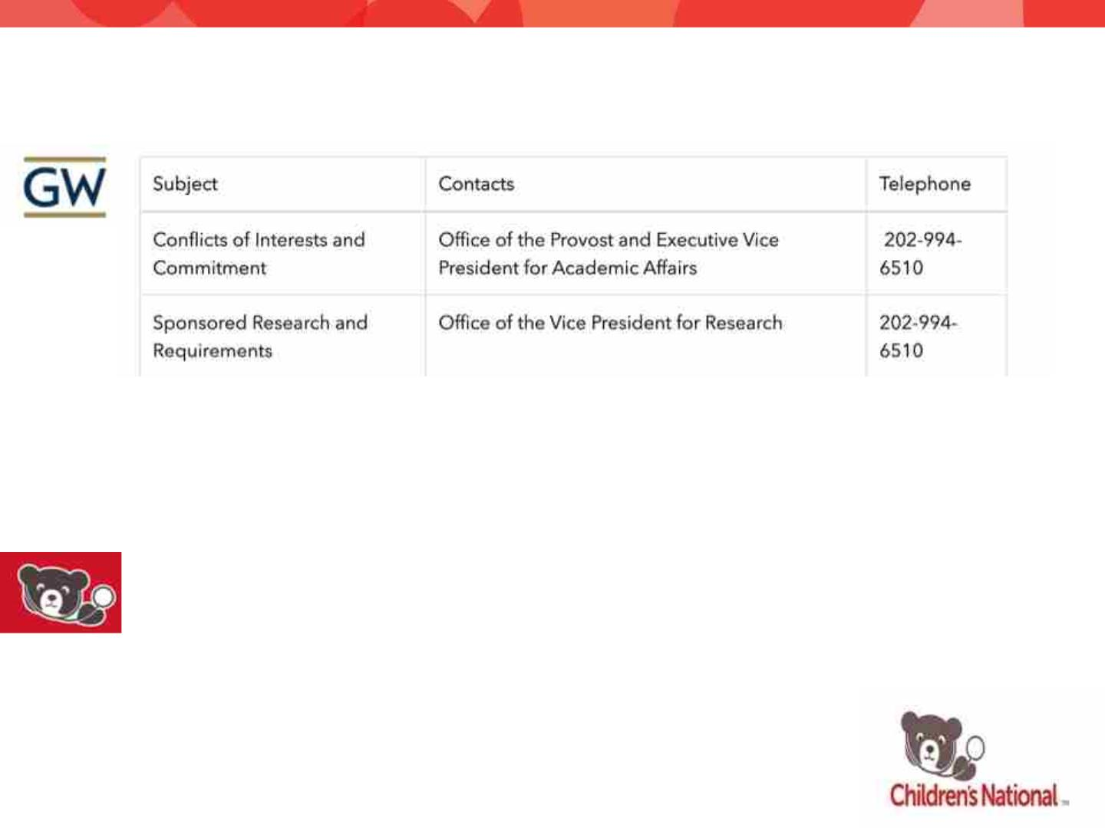
Contacts
For the Periodic Faculty Member and Investigator Disclosure Form: Contact the Office
of Ethics, Compliance, and Privacy at comply@gwu.edu
For research related disclosure forms, please visit OVPR's Research Integrity website or
contact askovpr@gwu.edu
Compliance, Children’s National Institutional Conflict of Interest Committee, and the
Chief Academic Officer
compliance@childrensnational.org
COI-Smart Link: https://childrensnational.coi-smart.com/main.php

Slide 43

IOM
2009

Slide 44


Slide 45
Cohort discovery & databases
Hiroki Morizono, PhD
hiroki@gwu.edu

Slide 46
Accessing Data
• Some complexities due to four organizations CNH GW GWH
MFA.
• A 4 way Data Use Agreement has been completed but processes
not completely operationalized
• Licensing rules for some data systems prevent data from being
moved from site to site
• Data Use Agreements exist for some specific systems
– A single IRB agreement exists between GW and CNH so should only
need to prepare one protocol
• To start visithttps://ctsicn.org and chat with a Research
Navigator
© 2022 CTSI-CN | CLINICAL
AND TRANSLATIONAL SCIENCE
INSTITUTE AT CHILDREN'S
NATIONAL | ctsicn.org

Slide 47
TriNetX
• Self service access to deidentified structured data with an easy to use interface
• In addition to queries of patients at Childrens National, queries can be floated
across the TriNetX network that includes US, Europe Brazil, Japan, South Korea and
includes nearly 250 million patients
• CTSICN BERD and Informatics can work with GW investigators and perform queries
to determine study feasibility
• Can float queries across the TriNetX network to find other sites that may have
patients matching your criteria
• TrinetX IDs can be converted to MRNs after obtaining IRB approval
• .
• To obtain TriNetX access visithttps://is.gd/INSIGHTS

Slide 48
HealtheIntent Enterprise Data
Warehouse
• HeI takes data found in the Cerner Millenium EHR and
creates longitudinal records of patients.
• Data is from structured data, not notes
• Not deidentified
• Need to know SQL to work with HeI
• Large data sets based on an investigators criteria are
possible with reports generated automatically using
data syndication
• Can use Tableau to visualize and analyze data
• To obtain access submit a request to the Bear Institute
https://cnmc.sharepoint.com/sites/MyIT

Slide 49
Cerner PowerTrials Screener
• After creating inclusion and exclusion criteria,
PowerTrials Screener provides how many
patients at Children’s National may meet
criteria and notify staff of potentially eligible
study subjects.
• IRB approval for use of PowerTrials to recruit
subjects is required
• To request access to PowerTrials visit
https://is.gd/INSIGHTS

Slide 50
Cerner Real World Data
• Aggregates and deidentifies Cerner HealtheIntent
data from multiple healthcare organizations
• Queries can be floated over ~ 250million patients
in the US
• A data enclave is established and work must be
done in the data enclave using Jupyter
Notebooks, Python/R and Apache Spark
• Access through the Cerner Learning Health
Network

Slide 51
MFA Epic EHR
• MFA request portal
https://gwumfa.sharepoint.com/sites/DaybreakProject/Lists/Research Reporting
Access Requests and Approval/NewForm.aspx
• Requests are reviewed by the MFA Epic Research Committee and then assigned to an
analyst
• If a simple exploratory analysis such as cohort size AND the investigator has access to
Epic, they can use Epic SlicerDicer, a self service data exploration tool
• Training on Epic is needed to gain access to SlicerDicer
• For individual patient level data, both IRB and Epic Research Committee approval will be
needed
• MFA is in the process of joining the Epic Cosmos – this will allow queries to be floated
across the deidentified data of ~167 million patients from healthcare centers using the
Epic EHR
• Liz Owens is in the MFA business intelligence group elowens@mfa.gwu.edu
• Jorge Sepulveda is the MFA Chief Medical Analytics Officer

Slide 52
GW Hospital
• GW Hospital uses the Cerner Electronic Health
Record
• Investigators with GW Hospital permissions can
access the Cerner EHR.
• Research use requires approvals
• Discern Analytics uses a SQL-like language called
CCL to construct queries from the tables in the
Cerner EHR to extract data
• Data Requests and Questions should be directed
to Nathan Bible Nathaniel.Bible@gwu-
hospital.com

Slide 53
Regional and National
Data Sets
© 2022 CTSI-CN | CLINICAL
AND TRANSLATIONAL SCIENCE
INSTITUTE AT CHILDREN'S
NATIONAL | ctsicn.org

Slide 54
CRISP
• Health Information Exchange for MD and DC
https://www.crisphealth.org
• CNH GW hospital and MFA all contribute to
CRISP
• Data can be requested through GW
Biomedical Informatics Center
© 2022 CTSI-CN | CLINICAL
AND TRANSLATIONAL SCIENCE
INSTITUTE AT CHILDREN'S
NATIONAL | ctsicn.org

Slide 55
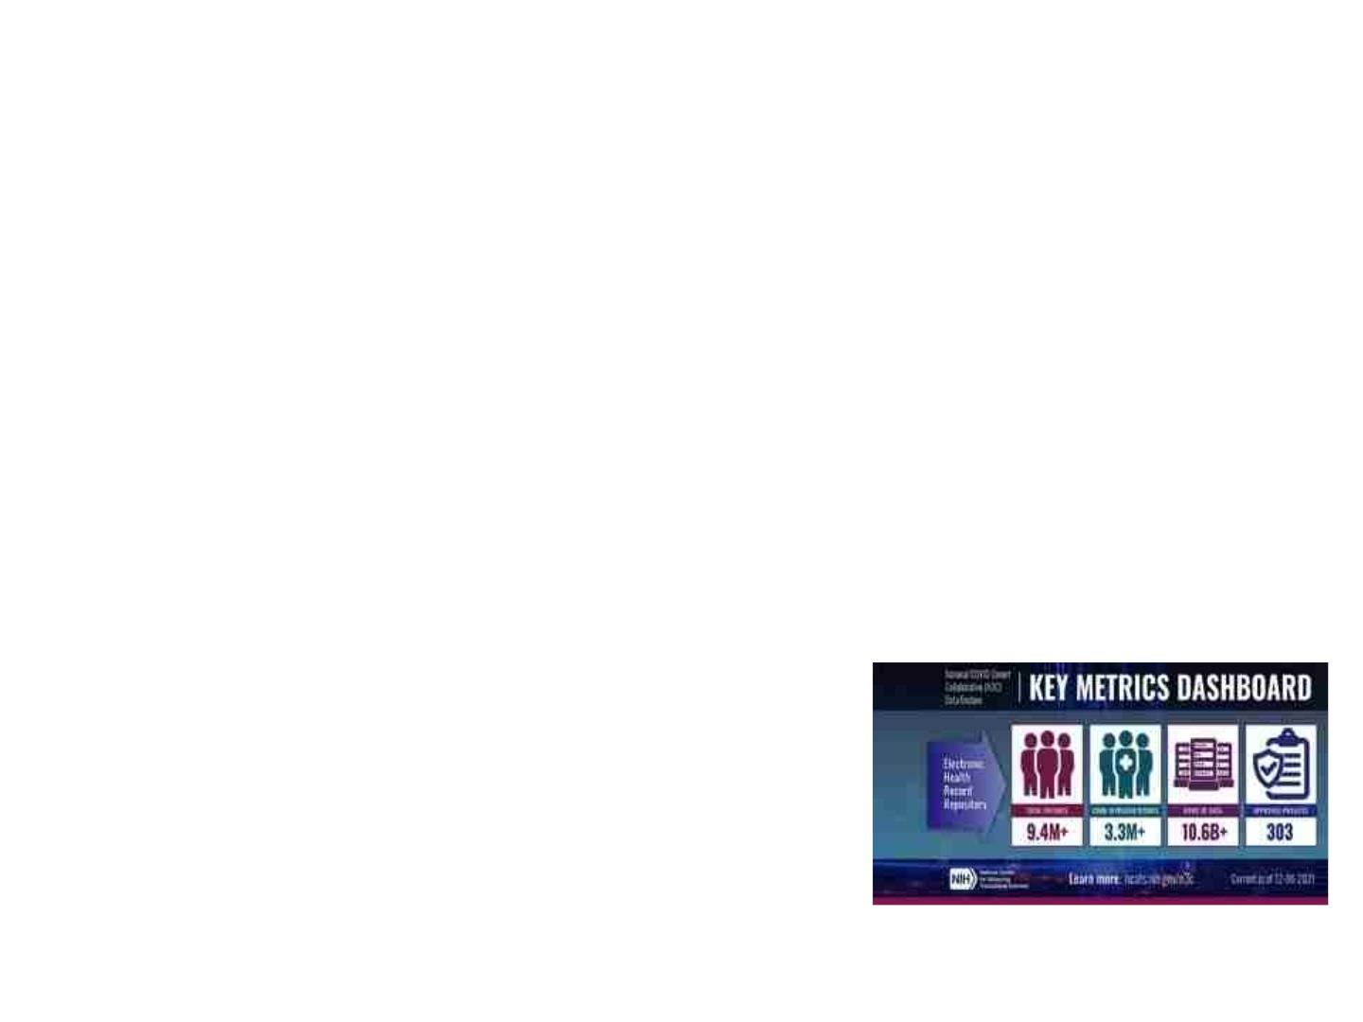
National Covid Cohort Collaborative
• N3C is a NCATS project capturing COVID patient
data
• CNH and GW are contributing data to N3C
• Data is provided by hospitals around the US
• Can sign up for access to N3C data enclave and
after training on use of the Palantir platform,
can perform big data analytics
https://ncats.nih.gov/n3c/resources/data-access
© 2022 CTSI-CN | CLINICAL
AND TRANSLATIONAL SCIENCE
INSTITUTE AT CHILDREN'S
NATIONAL | ctsicn.org

Slide 56
PEDSnet
• Pediatric Learning Health System
• Currently 10 pediatric hospitals contribute
data
• CNH data is now added to PEDSnet
• Modified OMOP schema is used, can use
ODHSI ATLAS to explore data
• Need to fill out a collaboration request form to
gain access https://pedsnet.org
© 2022 CTSI-CN | CLINICAL
AND TRANSLATIONAL SCIENCE
INSTITUTE AT CHILDREN'S
NATIONAL | ctsicn.org

Slide 57
All of Us Researcher Workbench
• Both GW and CNH have an Institutional agreement in place
• Available to any researcher
• https://www.researchallofus.orgto fill out data use agreement and
request access directly.
• Data from ~ 500,000 participants
• Can explore aggregate data without an account
• https://databrowser.researchallofus.org/
• Can access individual level data after registration
•
Data analysis is done from inside the Researcher Workbench
• Jupyter Notebooks R and Python available
© 2022 CTSI-CN | CLINICAL
AND TRANSLATIONAL SCIENCE
INSTITUTE AT CHILDREN'S
NATIONAL | ctsicn.org

Slide 58
Protocol Builder & Oncore
Overview

Slide 59
Outline
• Protocol Builder
– Purpose
– Functionality
– Access
– Resources-Assistance
• Oncore
– Purpose
– Functionality
– Access
– Resources-Assistance

Slide 60
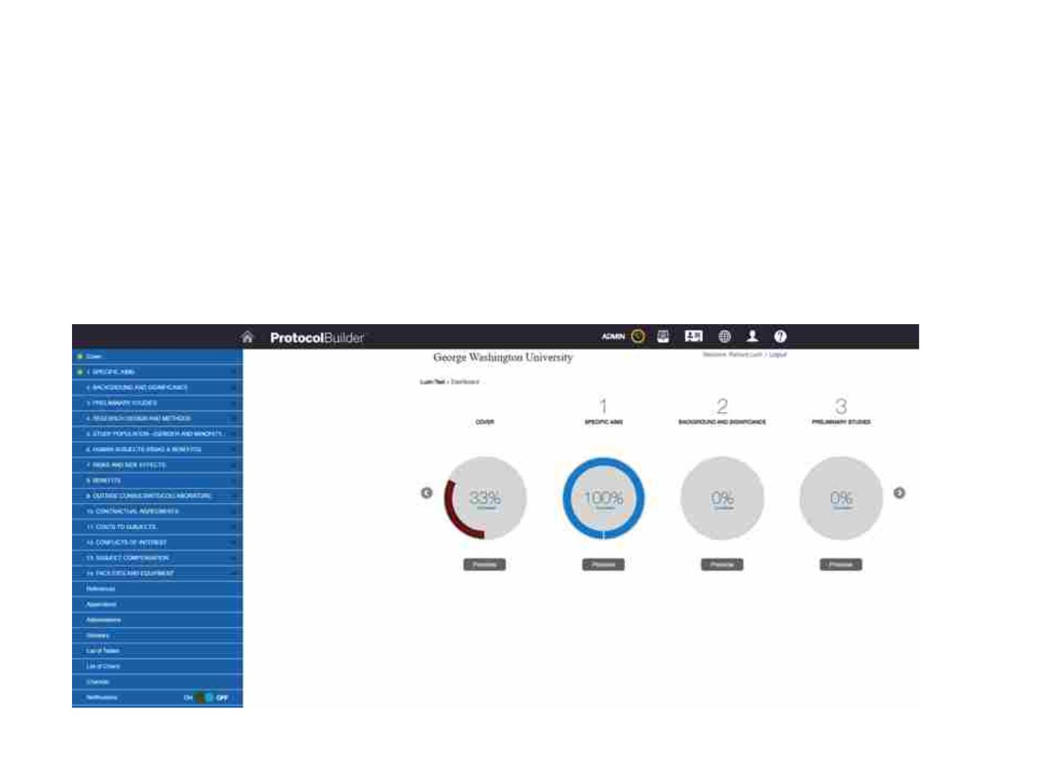
Protocol Builder
• Online Protocol Collaboration Application
– Allows multiple users to simultaneous edit/write
protocol

Slide 61
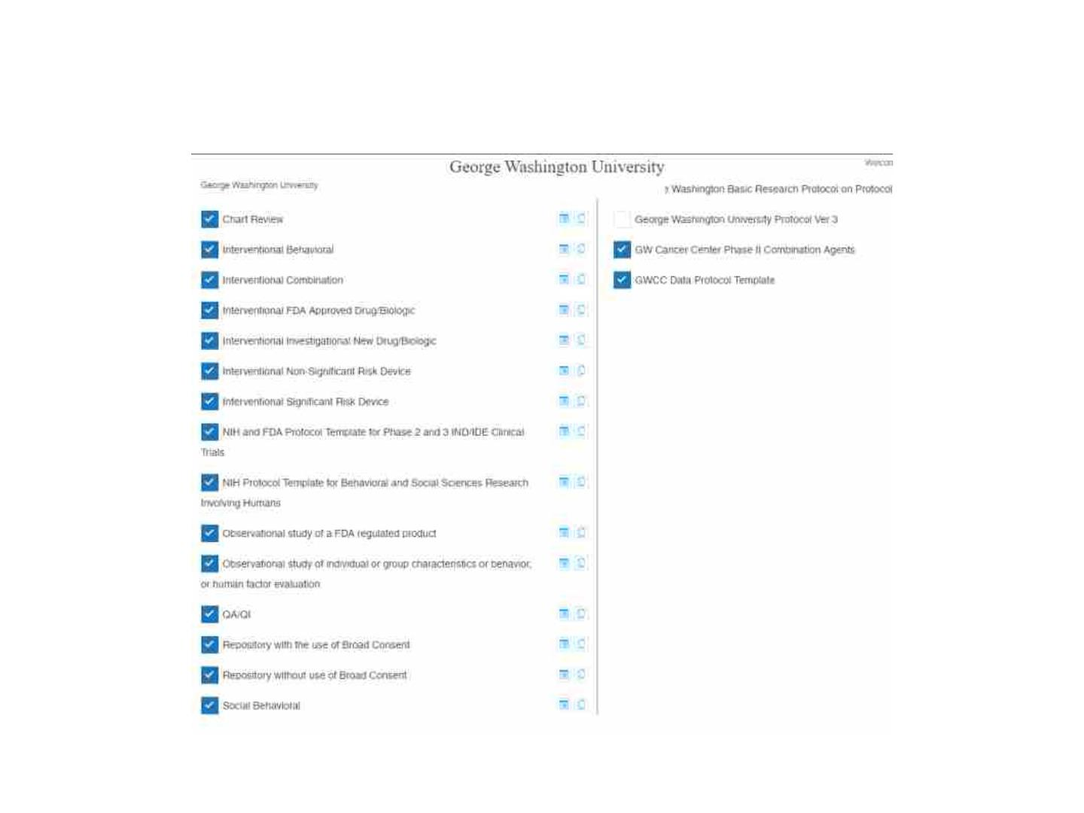
Protocol Builder- Templates

Slide 62
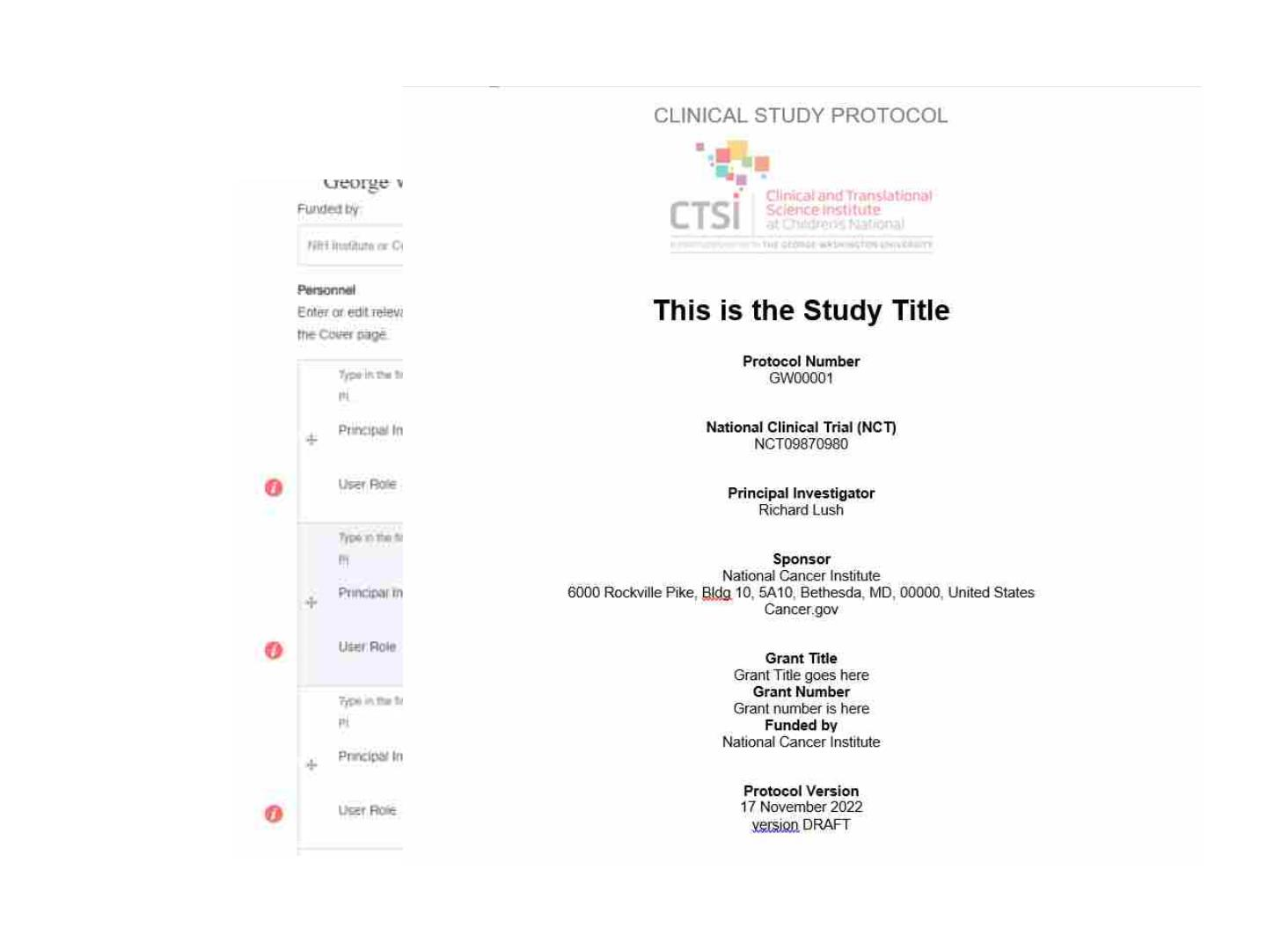
Adding

Slide 63
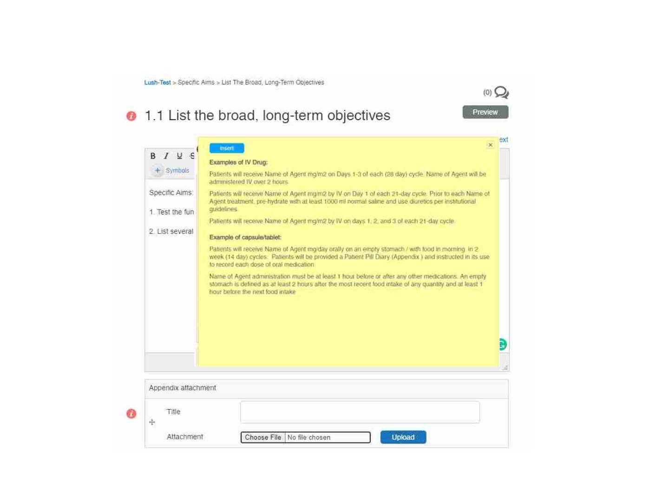
Protocol Builder

Slide 64
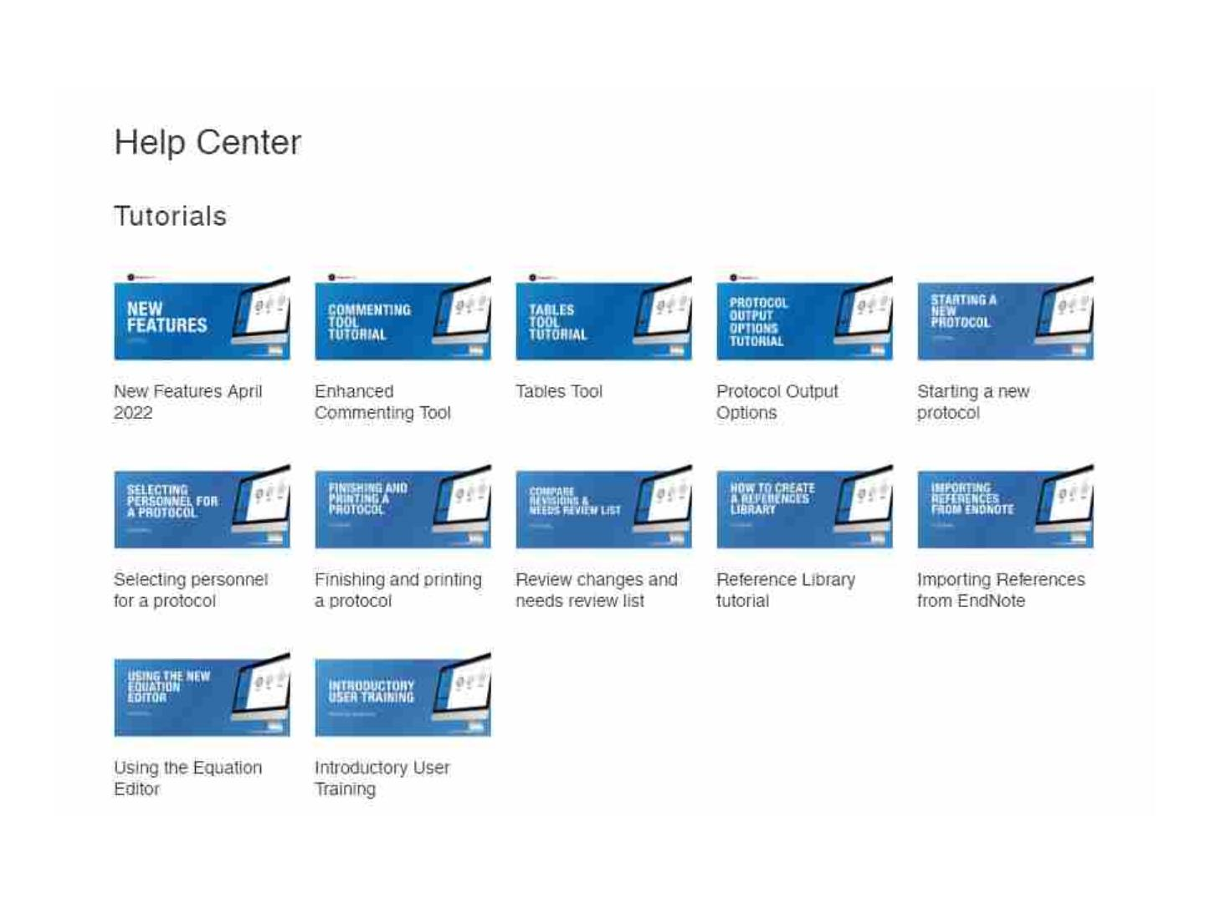

Slide 65
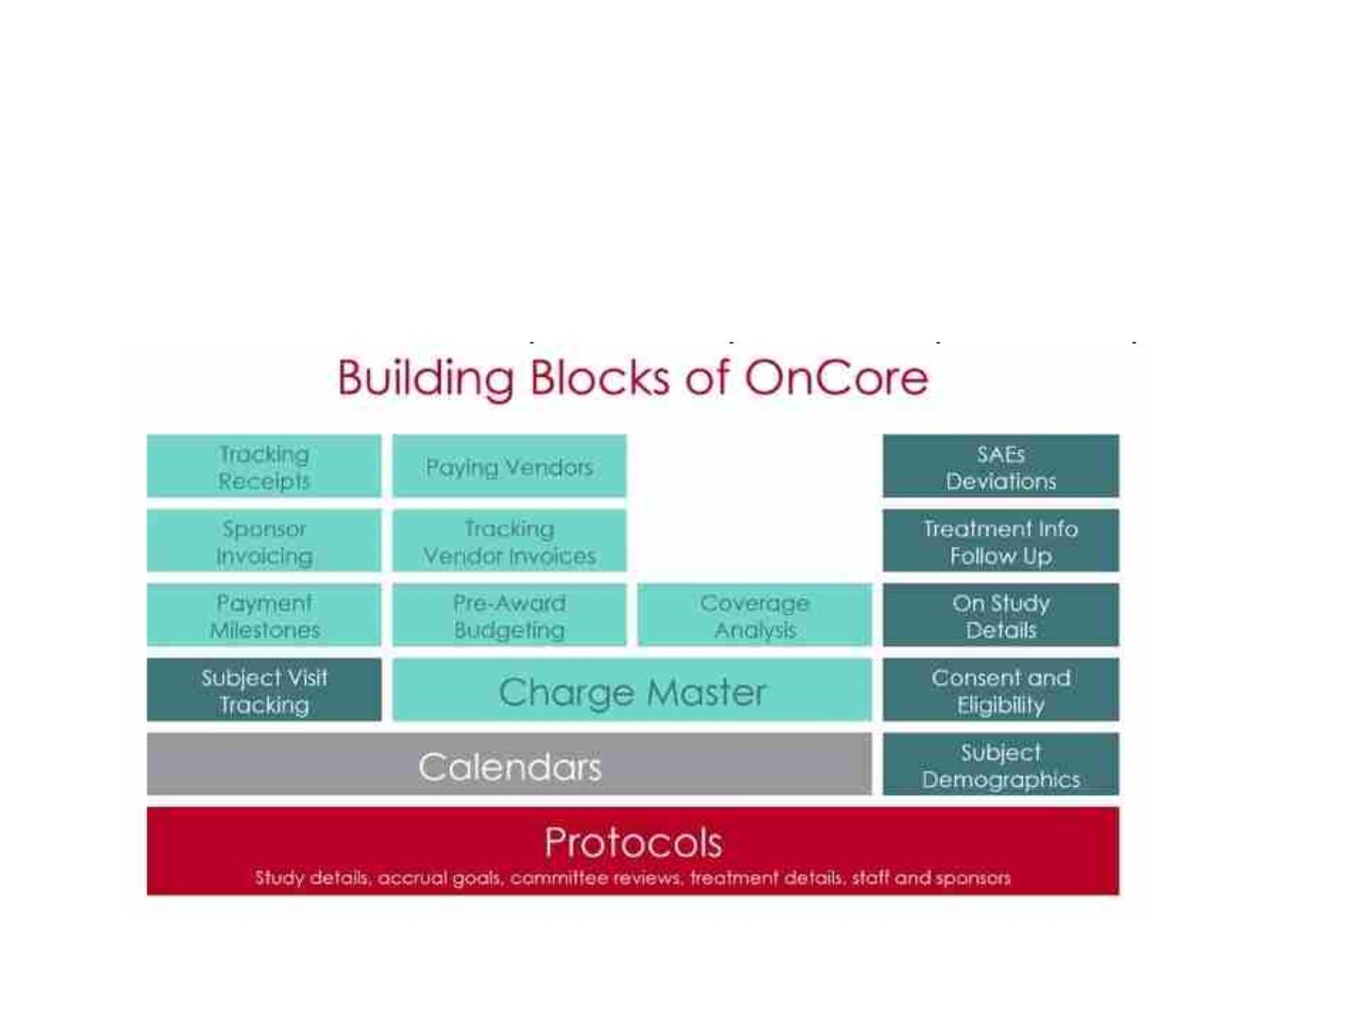
Oncore
• CTMS- Clinical Trials Management System
–
etc.

Slide 66
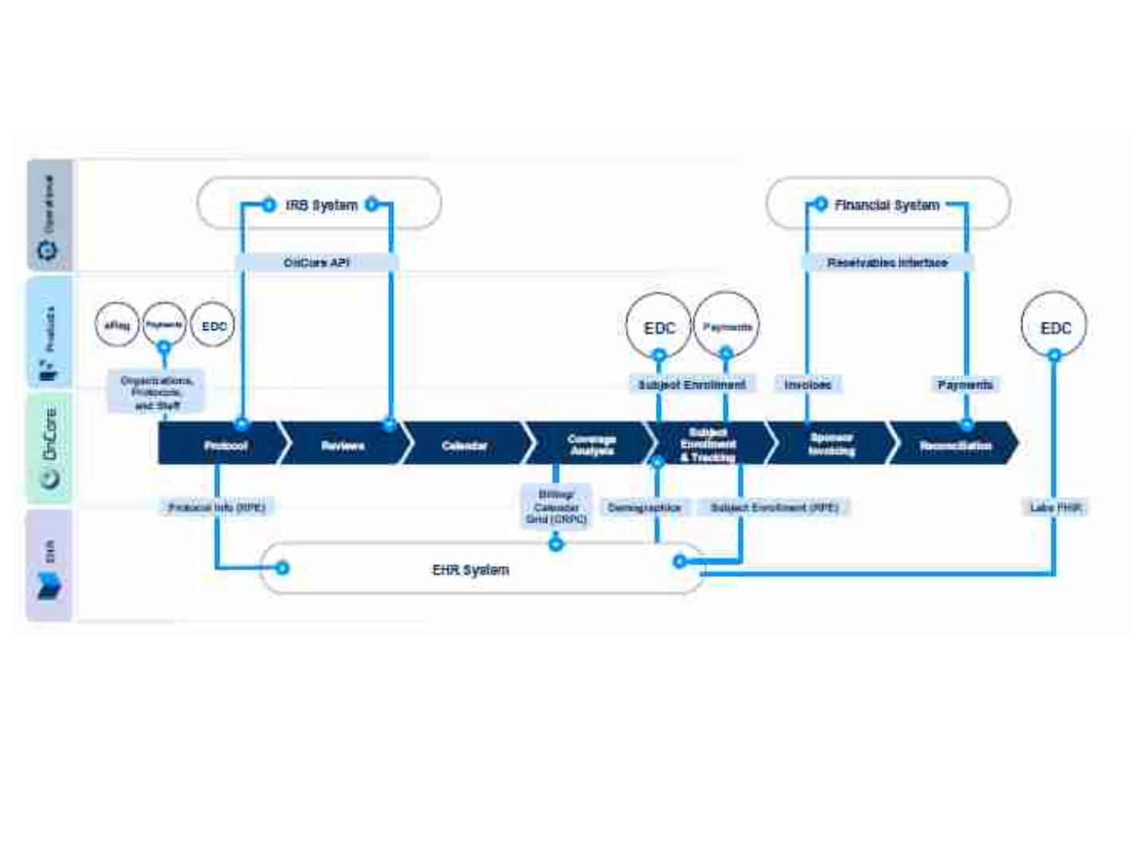
Interface Overview Data Flow

Slide 67
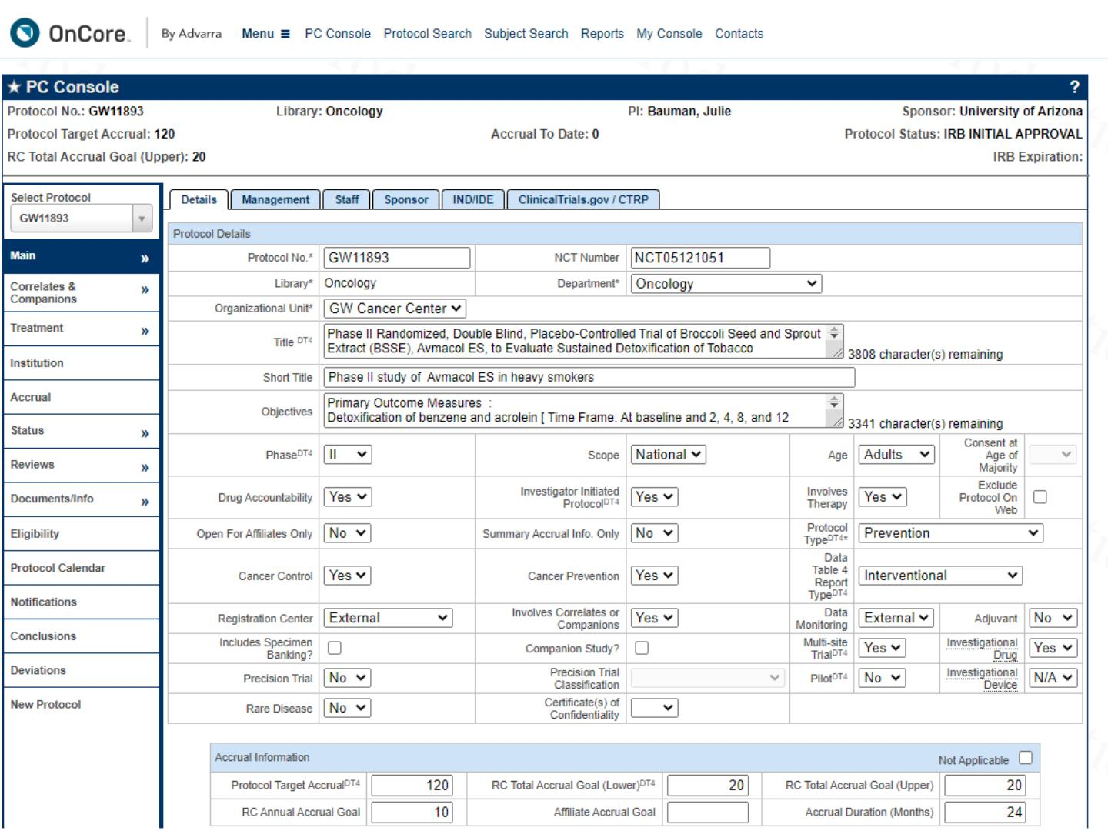

Slide 68
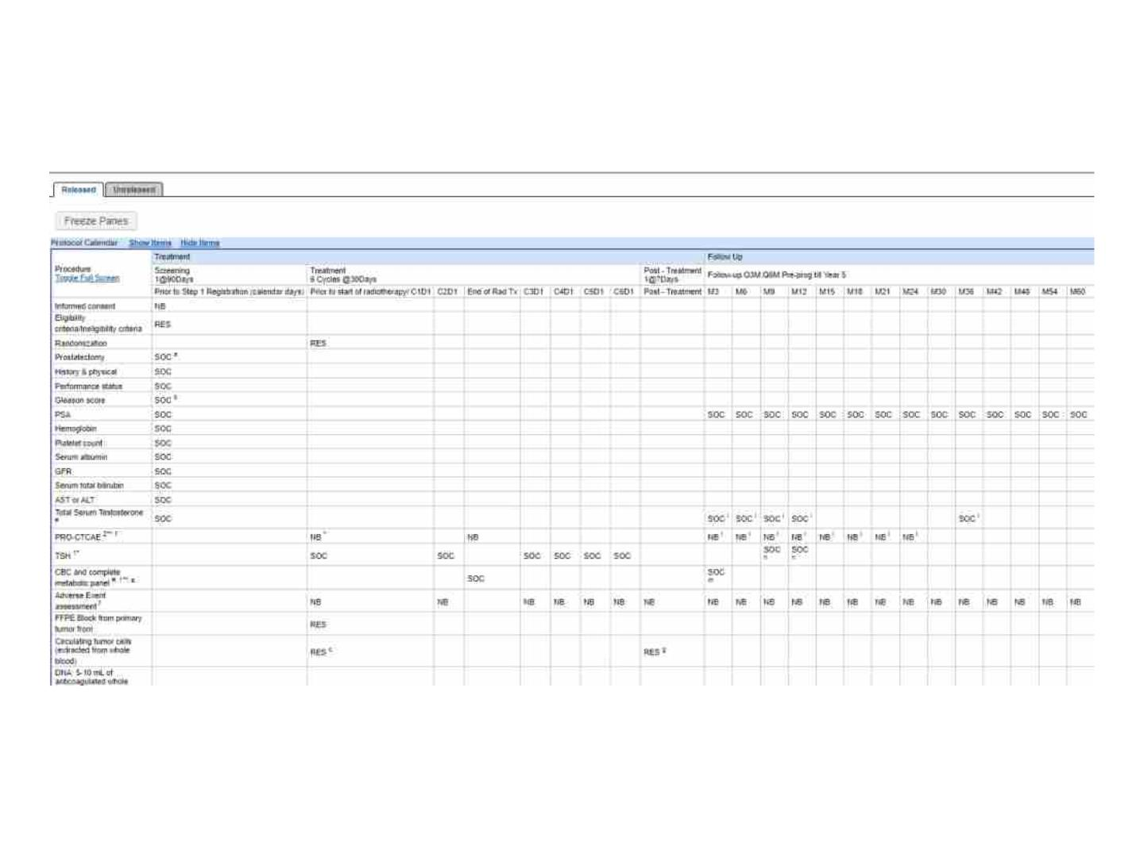
Oncore- Calendar

Slide 69
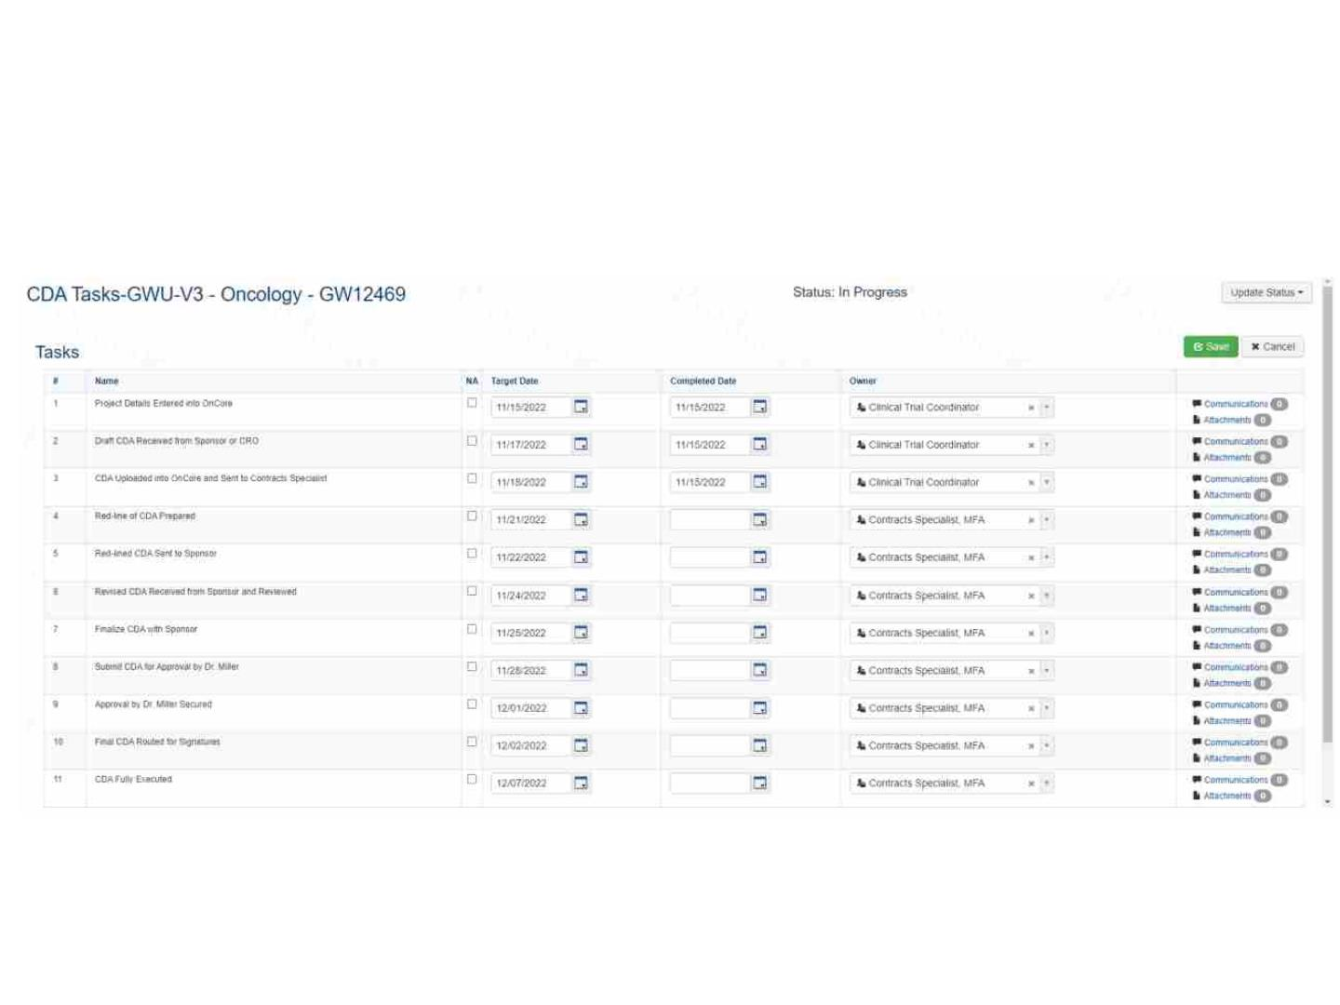
Oncore- Task List

Slide 70
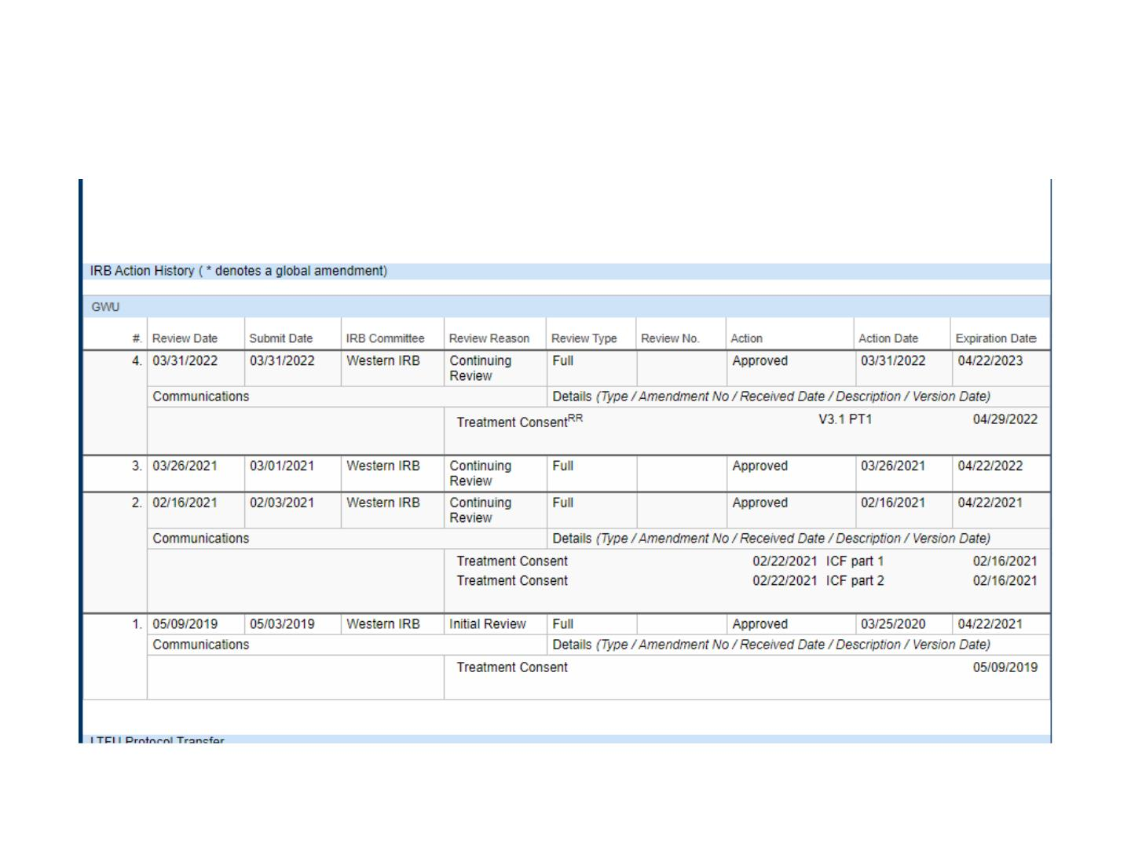
Oncore- review history

Slide 71
Training
• Advarra University https://advarrauniversity.learnupon.com/store
• User Community/Documentation
(Onsemble.net)
• Local training sessions and materials

Slide 72
Oncore – Access and Help
CNH
• Request access from sharepoint
https://cnmc.sharepoint.com/sites/research/SitePag
es/GrantsContracts/OnCore.aspx
• questions – CRMS@childrensnational.org
• Sarah Anderson- STAnderson@childrensnational.org
GWU
• Access –
https://cancercenter.gwu.edu/research/clinical-
trials-office/clinical-research-applications-accounts-
and-support
• Help- Kate Weber- Oncore@gwu.edu

Slide 73

Investigational Drug Service
Pharmacy
Presented by Dorinne Mettle-Amuah,
PharmD, BCPS
73

Slide 74
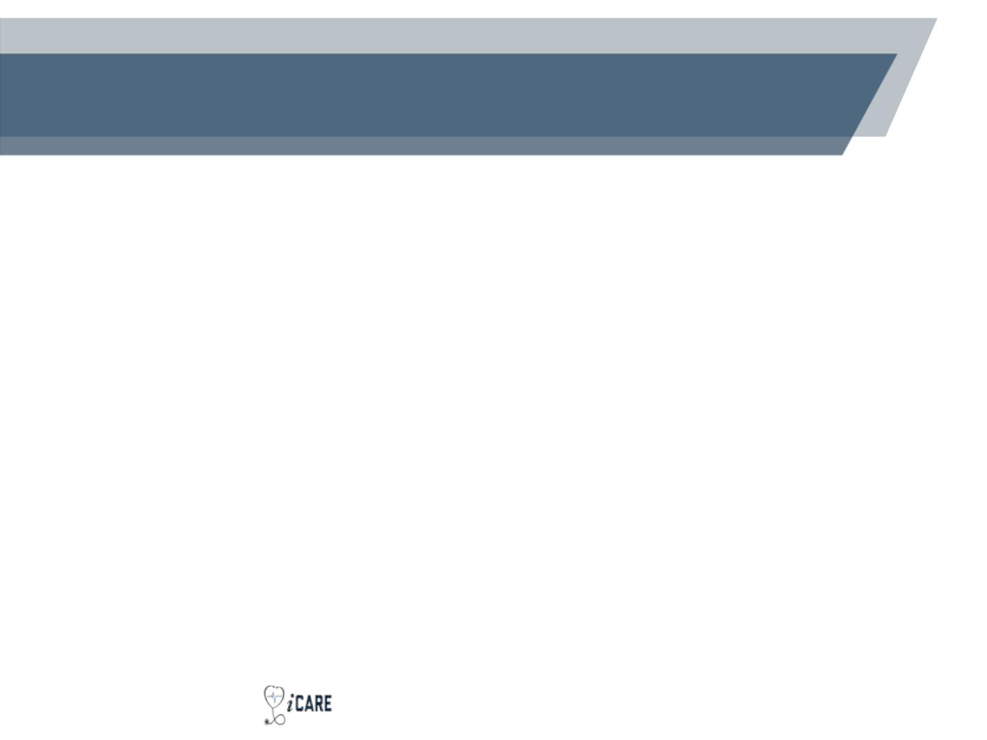
Investigational Drug Service
Pharmacy (IDS)
• Comprised of:
• Good Clinical Practice (GCP) trained Clinical Pharmacists
• Good Clinical Practice (GCP) trained Certified Pharmacy
Technician
• Purpose:
• Support human clinical research involving investigational
products
• Maintain compliance with all applicable standards and
regulations
• Function:
• Assist with over 90 clinical trials for 14 different clinical
departments
74

Slide 75
Where Are We Located?
Investigational Drug Service at The George Washington
University
George Washington Medical Faculty Associates (GW MFA)
2150 Pennsylvania Ave NW, Suite 6A-404
Washington, DC 20037
Hours: Monday through Friday, 7:30 AM to 4:00 PM
Phone: 202-741-3624
Fax: 202-741-3621
Email: ids@mfa.gwu.edu (preferred method of contact)
75

Slide 76
Overview of Services Provided
• Comprehensive clinical review of all medication
orders by a Clinical Pharmacist
• Assessment of monitoring parameters
• Dose adjustments and dose calculations
• Drug-interaction analysis
• Provision of drug information to patients and
healthcare team
• Study drug accountability
• Drug and supply procurement
• Maintenance of blinding for blinded studies
76

Slide 77
Overview of Services Provided
(cont.)
• Assistance with clinical trial development (for
investigator-initiated studies)
• Assist with protocol development
• Protocol review for feasibility
• Development of pharmacy budget
• Development of a randomization tool
• Development of a matching placebo
• Participation in initial, interim, and close-out sponsor
visits
• Record keeping and retention
• Facilitate drug builds (for all studies) and Beacon
treatment plan builds (for only oncology studies) in
EPIC
77

Slide 78
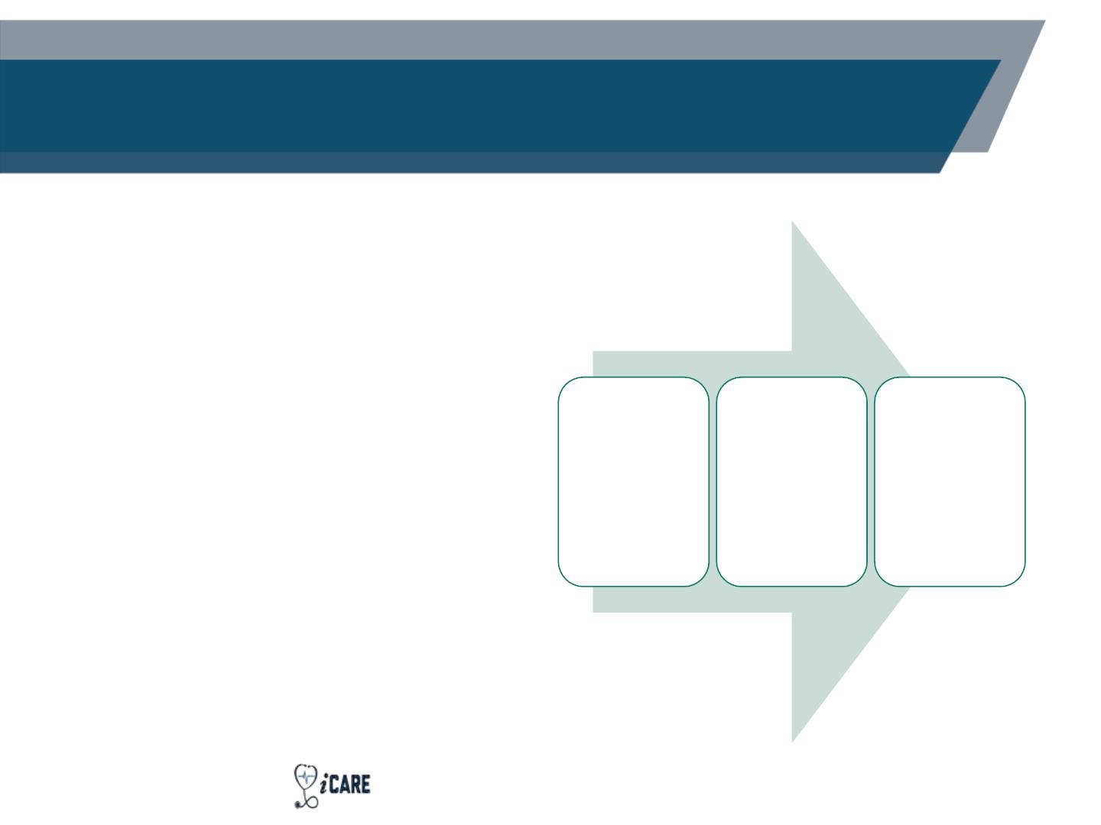
Research Drug Builds in EPIC
• Enable the principal
investigator (PI) and co-
investigators to e-
prescribe non-oncology
investigational products
via EPIC
•IDS
IDS submits
a ticket to
IT
reviews the
drug build
for accuracy
and gives
approval
• IDS must review the
protocol, pharmacy
manual, and investigator
brochure before the
process can start
IT builds
the drug
• Duration = 2 weeks
The GW Medical Faculty Associates -
Respect. Empathy.
- Innovation. Collaboration. Accountability.
78

Slide 79
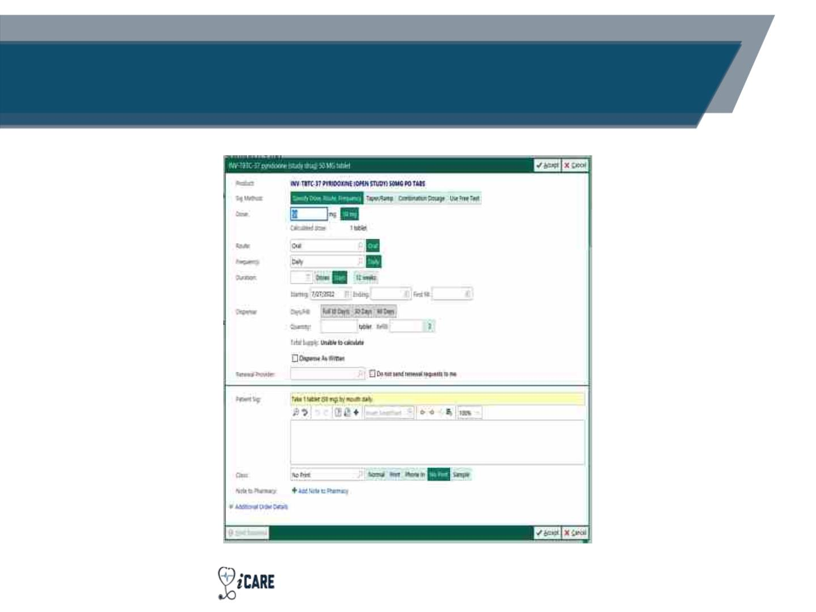
Research Drug Builds in EPIC
(example)
The GW Medical Faculty Associates -
Respect. Empathy.
- Innovation. Collaboration. Accountability.
79

Slide 80
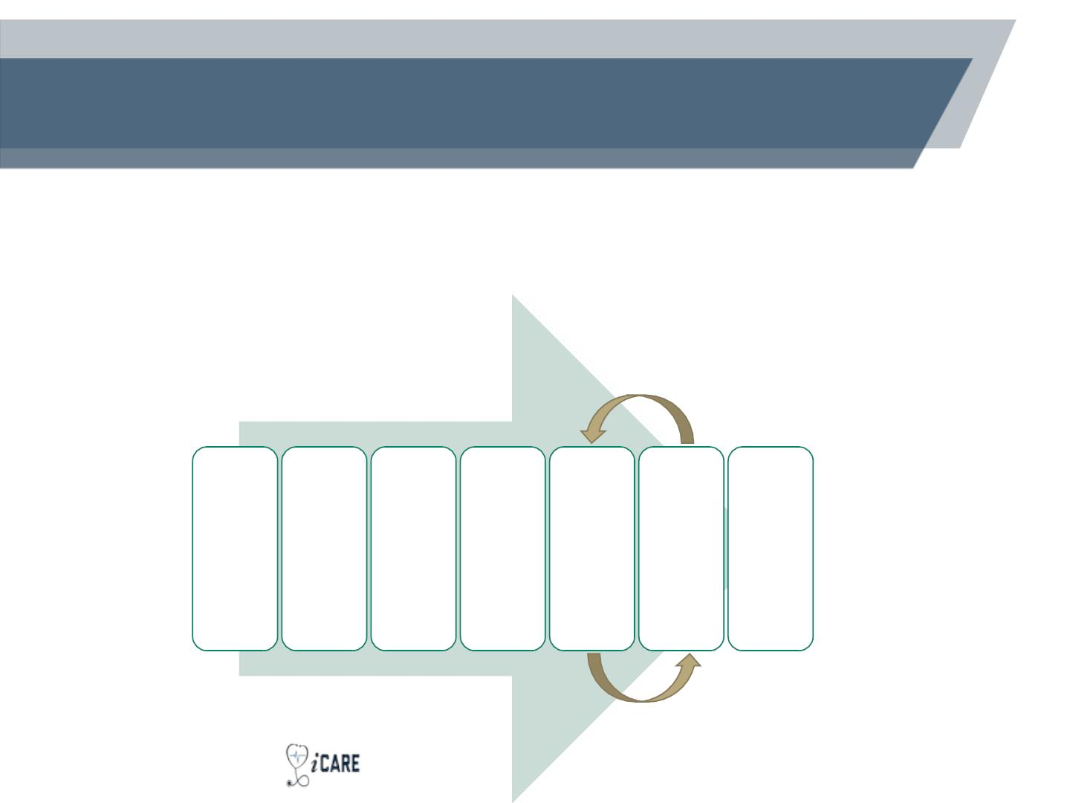
Beacon Treatment Plans in EPIC –
Cancer Trials
• Enable the PI and co-investigators to e-prescribe
oncology investigational products
(chemotherapy) via EPIC
• Duration = 4 - 6 weeks
•IDS reviews
the drug
build for
accuracy
and gives
approval
•IDS reviews
•IT
•IT builds
the Beacon
Treatment
Plan
treatment
plan with
the study
team and
submits
incorporate
s feedback
into the
Beacon
IDS submits
a ticket to IT
IT builds the
drug
• IDS gives
approval
feedback to
IT
build
80

Slide 81
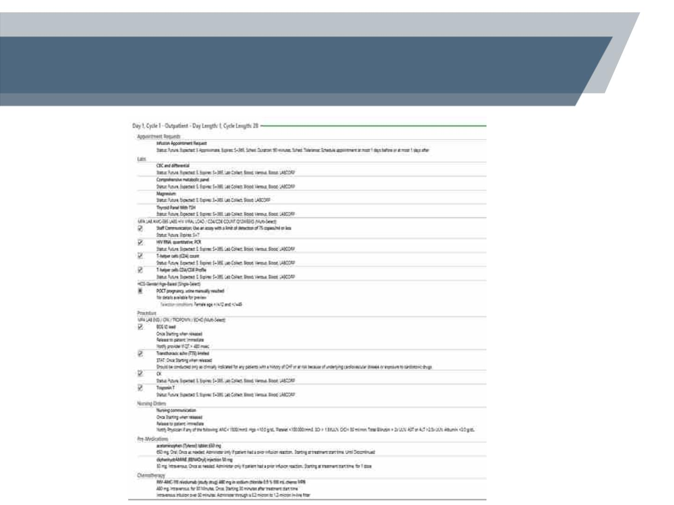
Beacon Treatment Plans in EPIC –
Cancer Trials (example)
81

Slide 82
Pharmacy Inventory Management
• The Research Pharmacy can provide inventory
management for investigational agents, which
includes:
• Compliance with sponsor, institutional, state and federal
regulations for documentation
• Inventory monitoring (temperature, product integrity)
• Tracking of inventory expiration dates and re-test dates
• USP 795, USP 797, and USP 800 compliant preparation
and dispensation of investigational product
• Destruction of investigational product
82

Slide 83
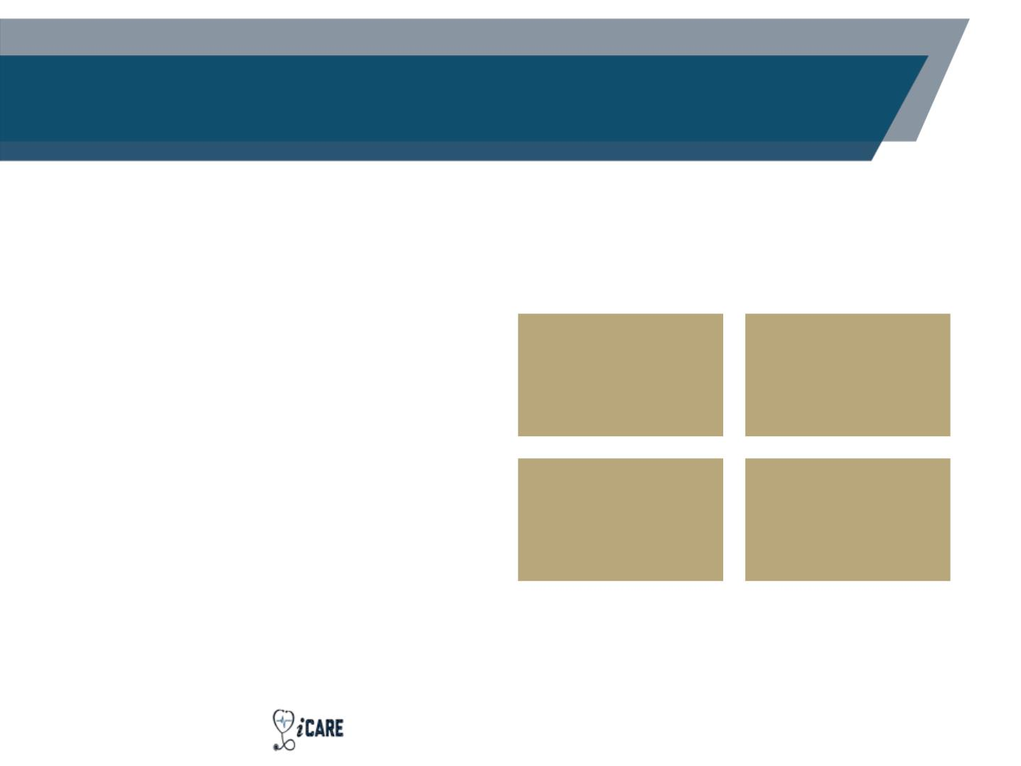
Temperature Control in the
Research Pharmacy
Storage areas:
• Capacity to store
investigational product
(IP) in refrigerators,
freezers, and room temp
Refrigerators
Freezer
(2-8 )
℃
(-20 )
℃
• Temperatures monitored
24/7
Room
Temperature
(20-25℃)
Ultra Low
Freezer
(-80 )
℃
• Immediate alert when
temperature excursions
occur
The GW Medical Faculty Associates -
Respect. Empathy.
- Innovation. Collaboration. Accountability.
83

Slide 84
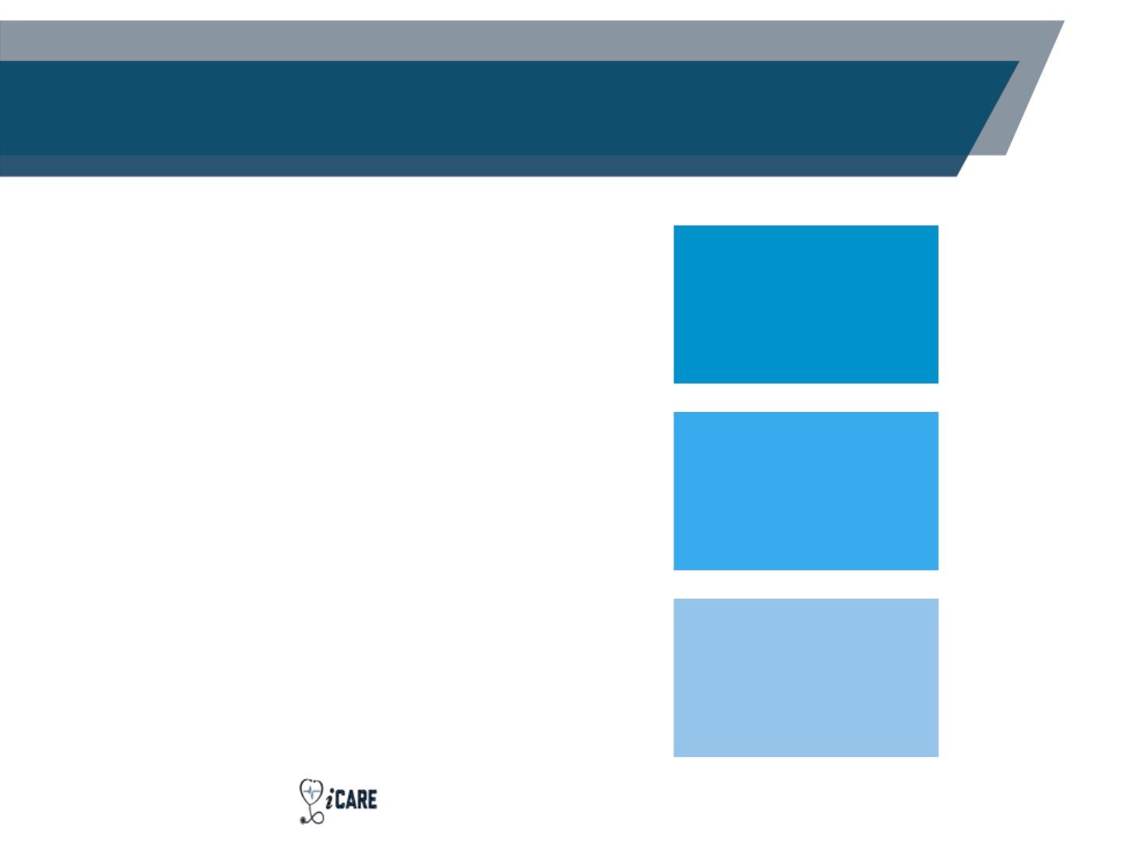
Investigational Drug Disposal
Handled in accordance with:
• Federal and State
regulations
Expired agents
(upon receiving
approval from
sponsor)
• GCP
• Institutional Policies
• Sponsor’s Requirements
Oral drug returned
by patients
All specifics found within the
GW MFA IDS SOP for
Investigational Drug Disposal
and Destruction policy
Punctured vials
used for injectable
dose prep
The GW Medical Faculty Associates -
Respect. Empathy.
- Innovation. Collaboration. Accountability.
84

Slide 85
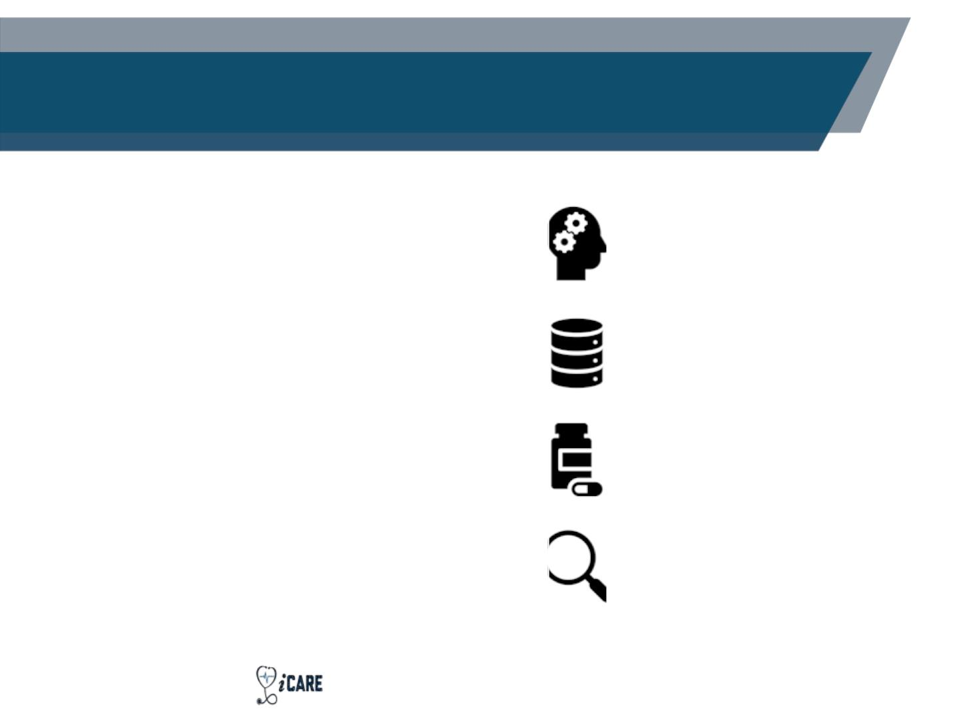
Research Pharmacy Fees –
Pharmacy Budgets
IDS team develops budgets to
estimate the costs required to
cover pharmacy expenses
Administrative set-up
and close-out
Contact the IDS pharmacy to
create an estimated budget
prior to completion of the
clinical trial agreement
Inventory management
Dispensing Fees (24/7
enrollment for
inpatients)
A proposed budget is an
estimate. If substantial changes
are made to the protocol, the
budget may require revisions
Monitoring fees
The GW Medical Faculty Associates -
Respect. Empathy.
- Innovation. Collaboration. Accountability.
85

Slide 86
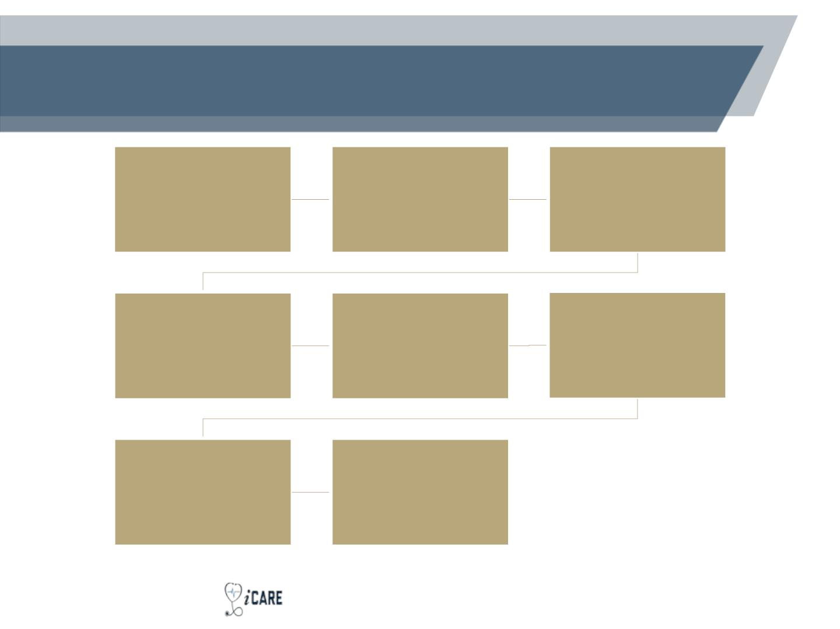
Summary: Where Does IDS Fit In?
Pre-Study Site Visit:
Clinical Trial Protocol
Development (investigator-
initiated studies):
IDS Pharmacy assesses study
feasibility, provides a tour of the
research pharmacy suite
Drafting a Clinical Trial
Agreement:
IDS Pharmacy provides a budget
IDS writes pharmacy manual,
designs randomization, develops
matching placebo, and more
IRB Approval:
Clinical Trial Set-Up:
Site Initiation Visit:
IDS Pharmacy completes safety
analysis documents for IBC
Committee
IDS Pharmacy works with IT to
build the drug and Beacon
treatment plans in EPIC
IDS Pharmacy attends
Initial Drug Shipment:
1st Drug Dispensation:
IDS pharmacy sets up the
pharmacy (storage requirements
are met)
IDS pharmacy performs a clinical
review before dispensing drug
86

Slide 87
Contact Information
• IDS Pharmacy Email – Ids@mfa.gwu.edu
• Dorinne Mettle-Amuah, PharmD, BCPS
• Office: 202-741-3624
• Fax: 202-741-3621
• Michael Williams, PharmD
• Office: 202-741-3624
• Fax: 202-741-3621
• Address: 2150 Pennsylvania Ave NW, Suite 6A-
404, Washington, DC 20037
• Hours: 7:30am-4:00pm
87

Slide 88
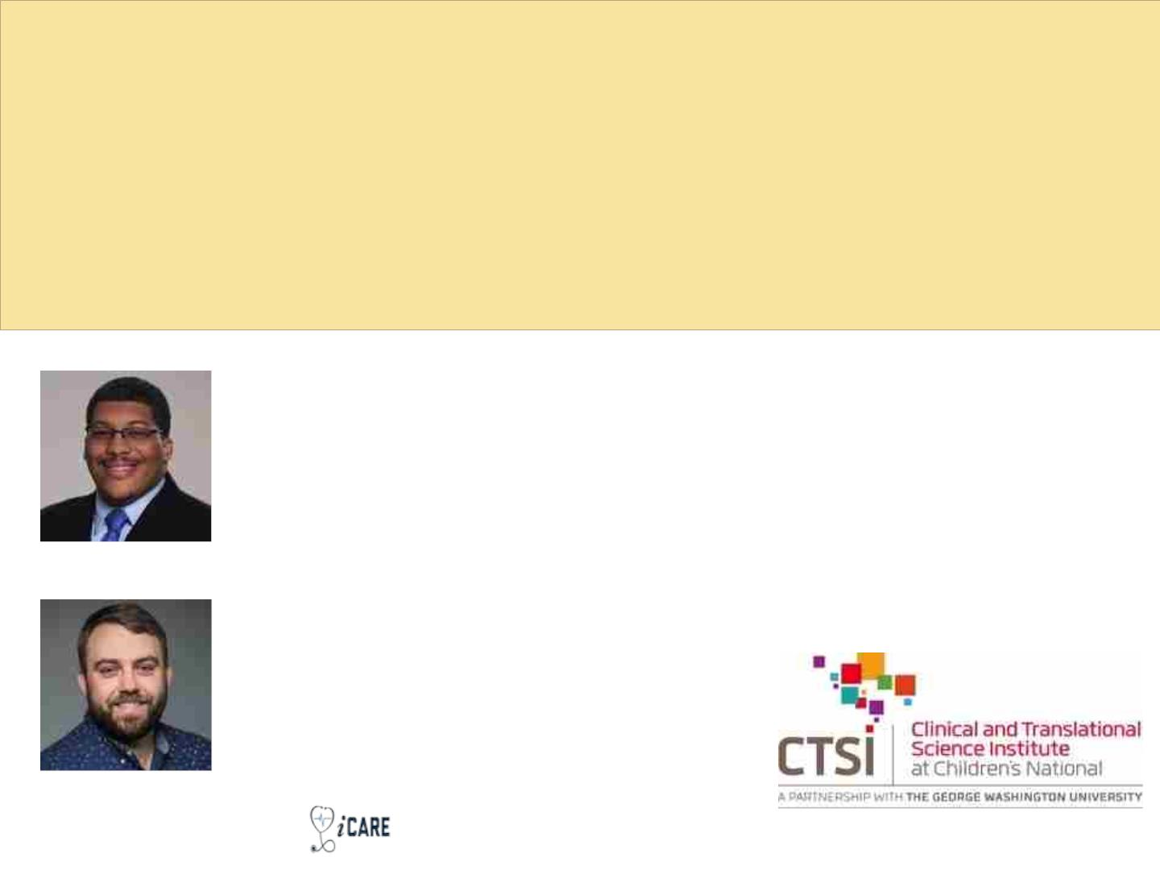
Getting Started as an Investigator in an
Externally Sponsored Study
@ Children’s National
Jurran Wilson
Program Lead, CTSI-CN
juwilson@childrensnational.org
Patrick O’Keefe
Administrative Director, CTSI-CN
pokeefe@childrensnational.org
© 2022 CTSI-CN | CLINICAL AND TRANSLATIONAL SCIENCE INSTITUTE AT CHILDREN'S NATIONAL | CTSICN.ORG

Slide 89

What is Externally Sponsored Research?
Any externally funded research activity in
which a formal written agreement (i.e., a grant,
contract, or cooperative agreement), is entered
into by the institution and an external
organization.
Includes research funded by:
• Industry (i.e., Pharma/CRO, Biotech)
• Private organizations/corporate entities (e.g.,
technology companies; vendors)
• Cooperative research agreements (e.g., COG,
PCORnet, PECARN)
• Federally funded research (e.g., funded by
HHS)
• State funded projects
© 2022 CTSI-CN | CLINICAL AND TRANSLATIONAL SCIENCE INSTITUTE AT CHILDREN'S NATIONAL | CTSICN.ORG

Slide 90
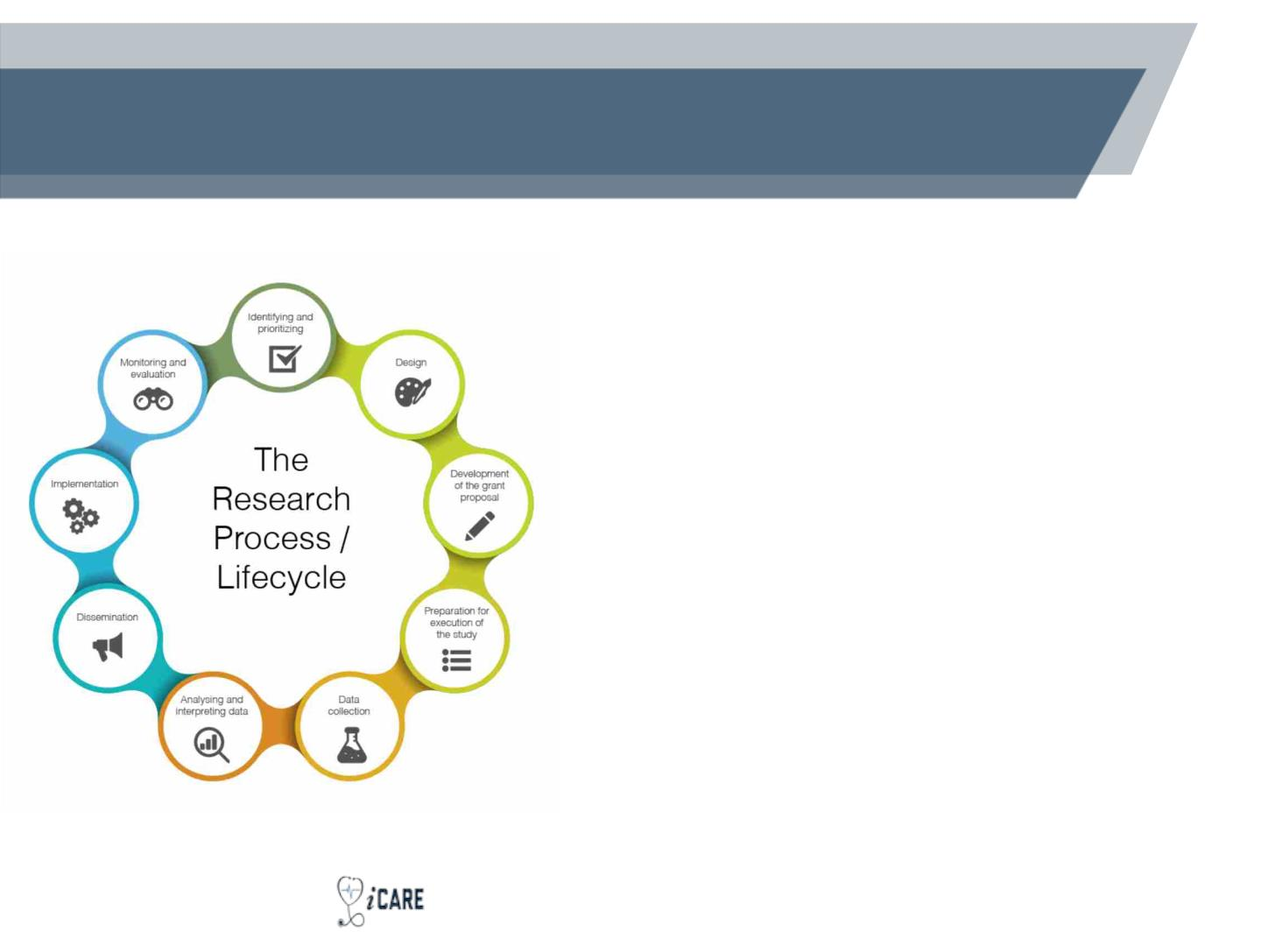
Externally Sponsored Research at Children’s
National
• At CNH, externally sponsored research
accounts for approx. 90% of total
research funding (>$85M)*
• Start-up process can be convoluted
depending on the complexity of the
study & institutional relationship with
sponsor
• Local process is collaborative, involving
many stakeholders/departments
• Requires access to Bear Grants, Bear
Contracts, & IRBear
*CNRI ACADEMIC ANNUAL REPORT
© 2022 CTSI-CN | CLINICAL AND TRANSLATIONAL SCIENCE INSTITUTE AT CHILDREN'S NATIONAL | CTSICN.ORG

Slide 91
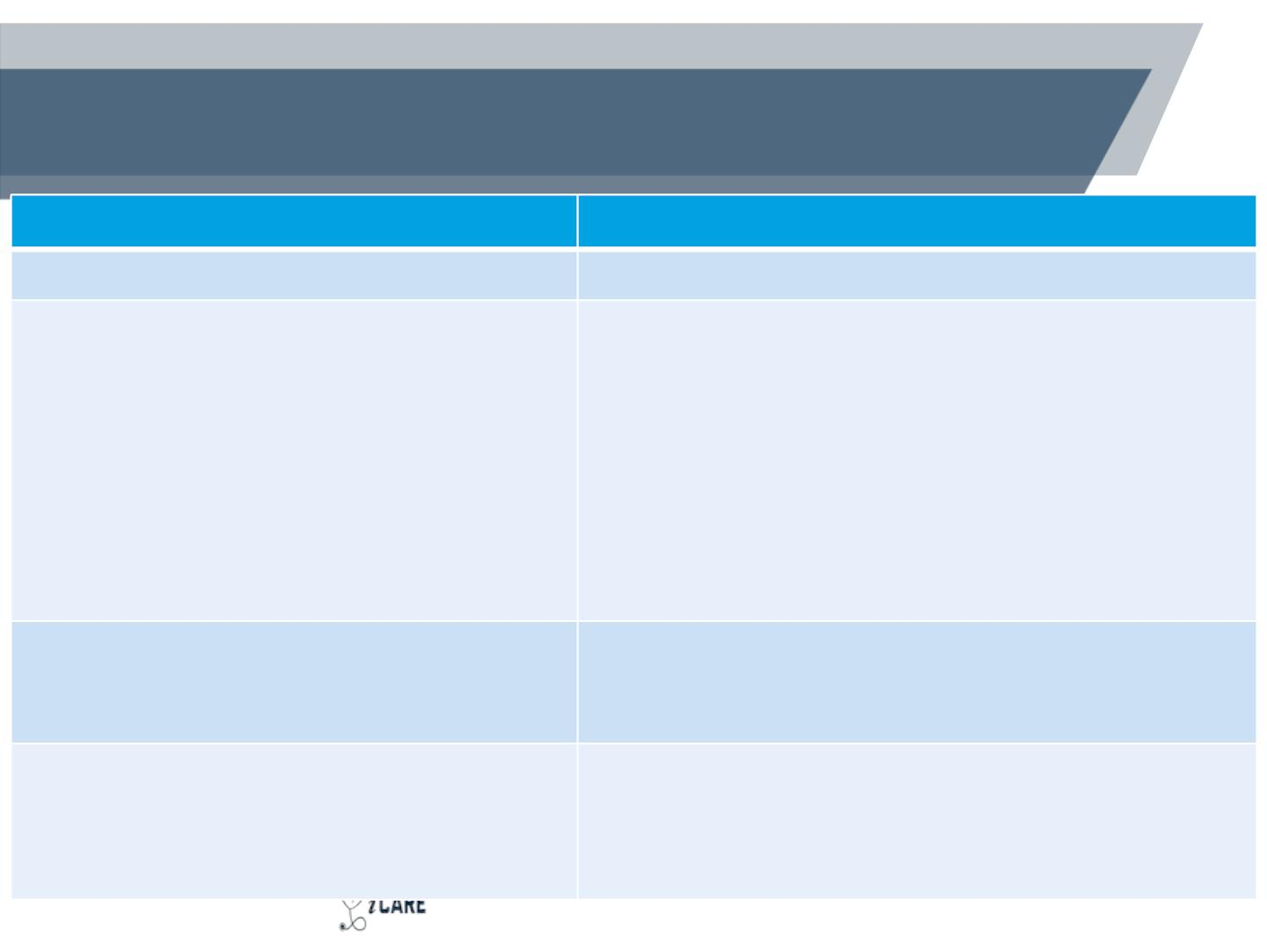
Sponsored Research Stakeholders
Department
Role
Principal Investigator/Study Team
Grantee/Collaborator; Primary local stakeholder
Grants and Contracts Administration and
Finance (GCAF)
• Office of Grants & Contracts (OGC)
• Business Office
• Grant Accounting
• Clinical Trials Office
• OGC: Primary sponsor-facing office within GCAF
• BO: Grant and Finance Administrators (GFAs);
Proposal budgeting and preparation
• GA: Financial reporting and invoicing
• CTO: Coverage analysis; Clinical trial financial
management
• Outbound Team
•
OT: Grant-funded subawards and consultant
agreements
Office for the Protection of Human
Subjects
Scientific, Ethical, and Regulatory oversight; Ancillary
review
• Institutional Review Board (IRB)
Clinical & Translational Science Institute Institutional research support center; Research
(CTSI-CN)
• Research Navigators
• Network Capacity Core
Tools/Services; Multi-site research support (Industry &
Investigator-initiated); Institutional guidance – CNH &
GW
© 2022 CTSI-CN | CLINICAL AND TRANSLATIONAL SCIENCE INSTITUTE AT CHILDREN'S NATIONAL | CTSICN.ORG

Slide 92
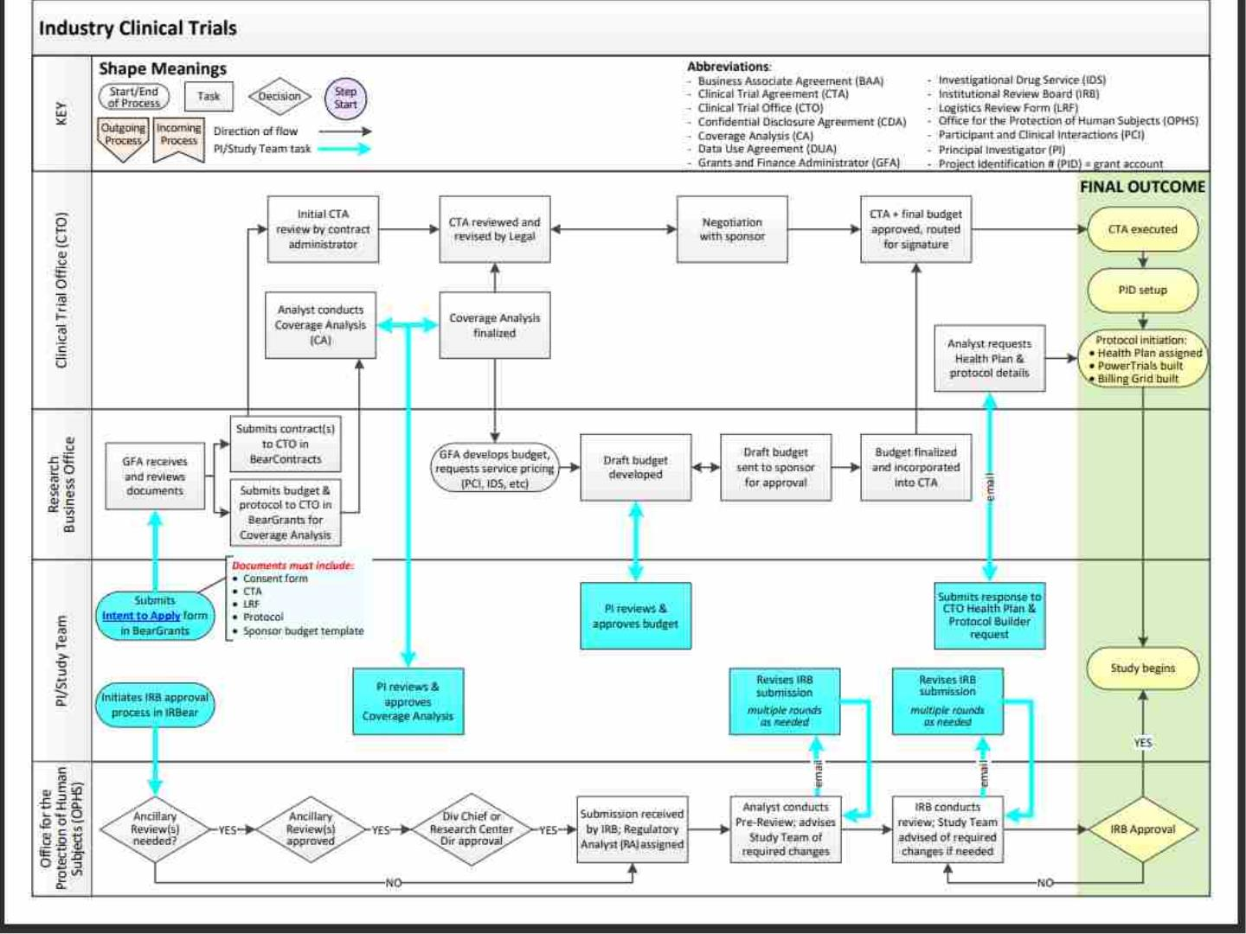

Slide 93
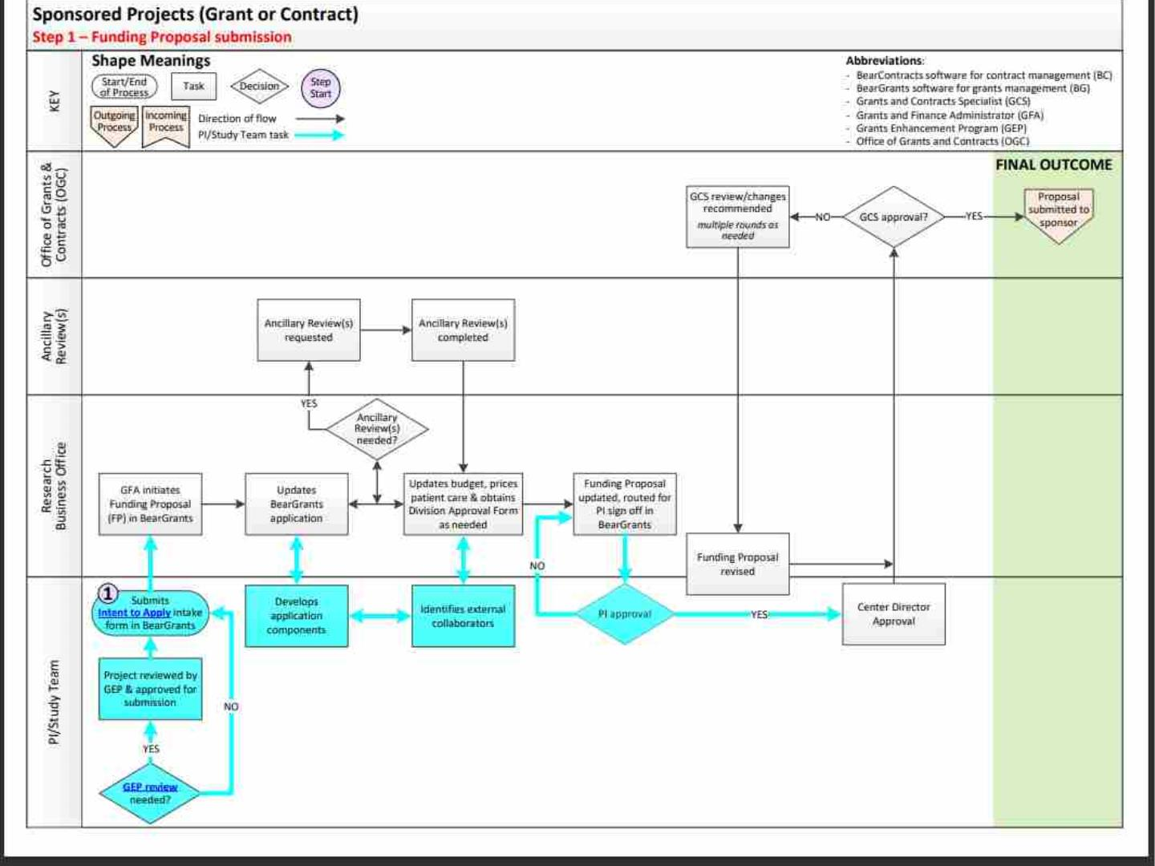

Slide 94
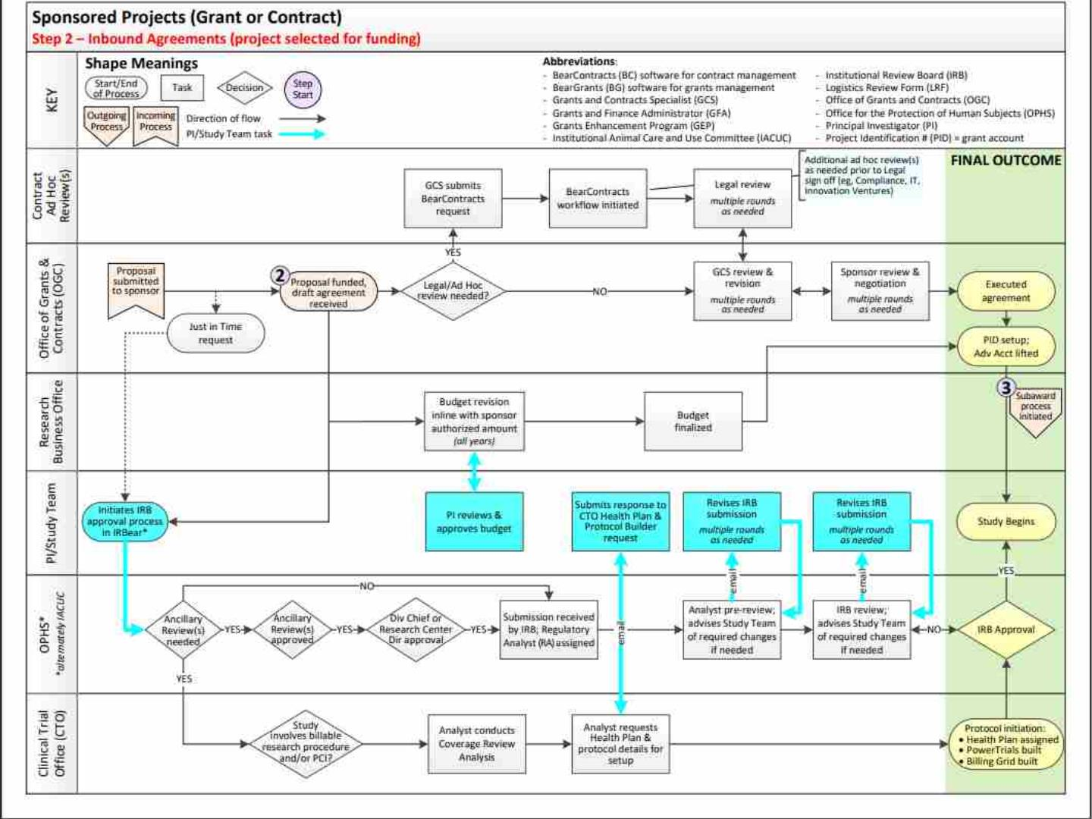

Slide 95
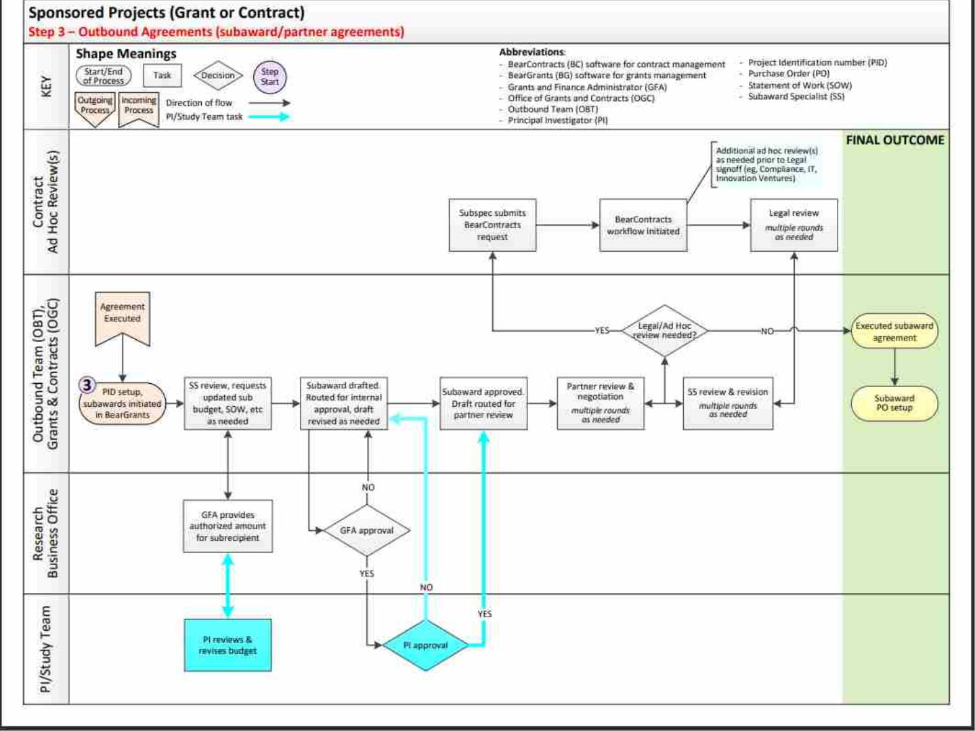

Slide 96
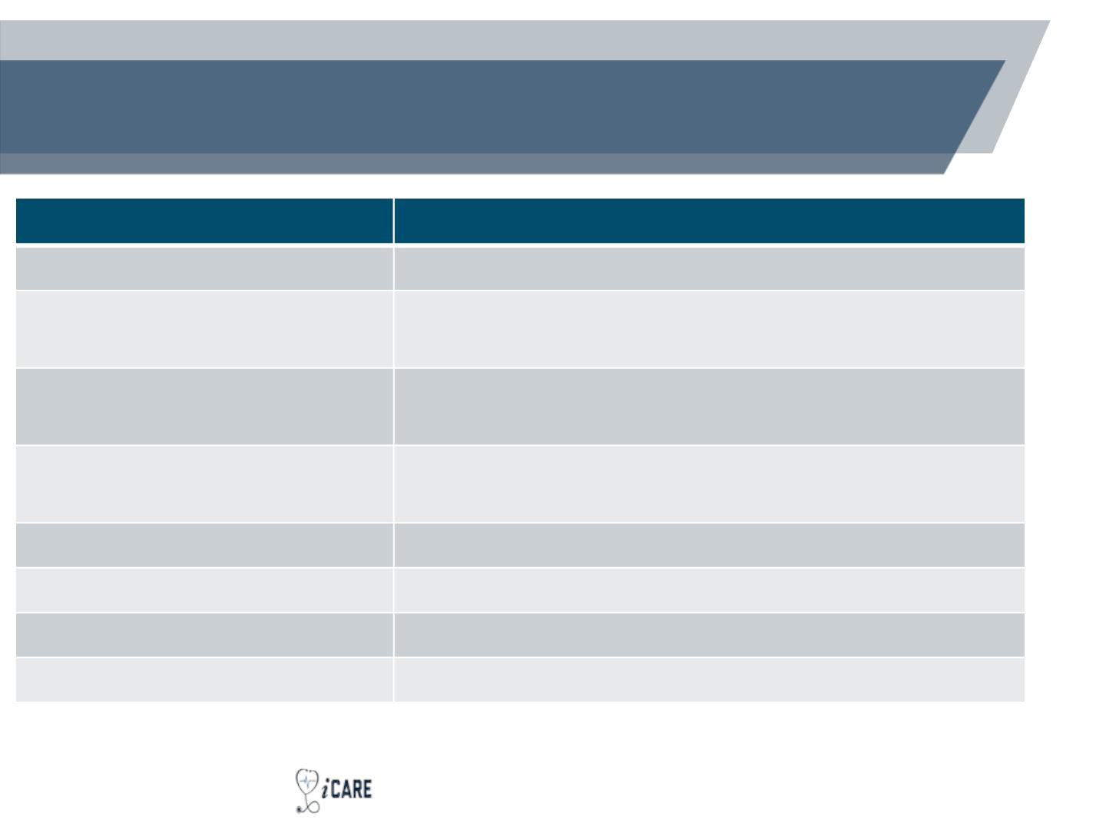
Helpful Resources at Children’s National
Resource
Location
Research Navigator Resources* Research Navigator Resources (sharepoint.com)
OCG Intranet Site*
OCG Overview Video*
GCAF Website
Office of Grants and Contracts (OGC)
(sharepoint.com)
Children's National Hospital - Clinical Research Staff
Consortium Meeting - Zoom
Grants, Contracts & Finance | Children's National
Research and Innovation (childrensnational.org)
Bear Grants*
Bear Grants (Childrensnational.org)
Bear Contracts*
IRBear *
Bear Contracts End User Portal (agiloft.com)
IRBear 2.0 (https://cnhirb.huronresearchsuite.com)
Virtual Organizer | GW CTSI (ctsicn.org)
CTSI-CN Virtual Organizer
*CNH network/VPN required
© 2022 CTSI-CN | CLINICAL AND TRANSLATIONAL SCIENCE INSTITUTE AT CHILDREN'S NATIONAL | CTSICN.ORG

Slide 97
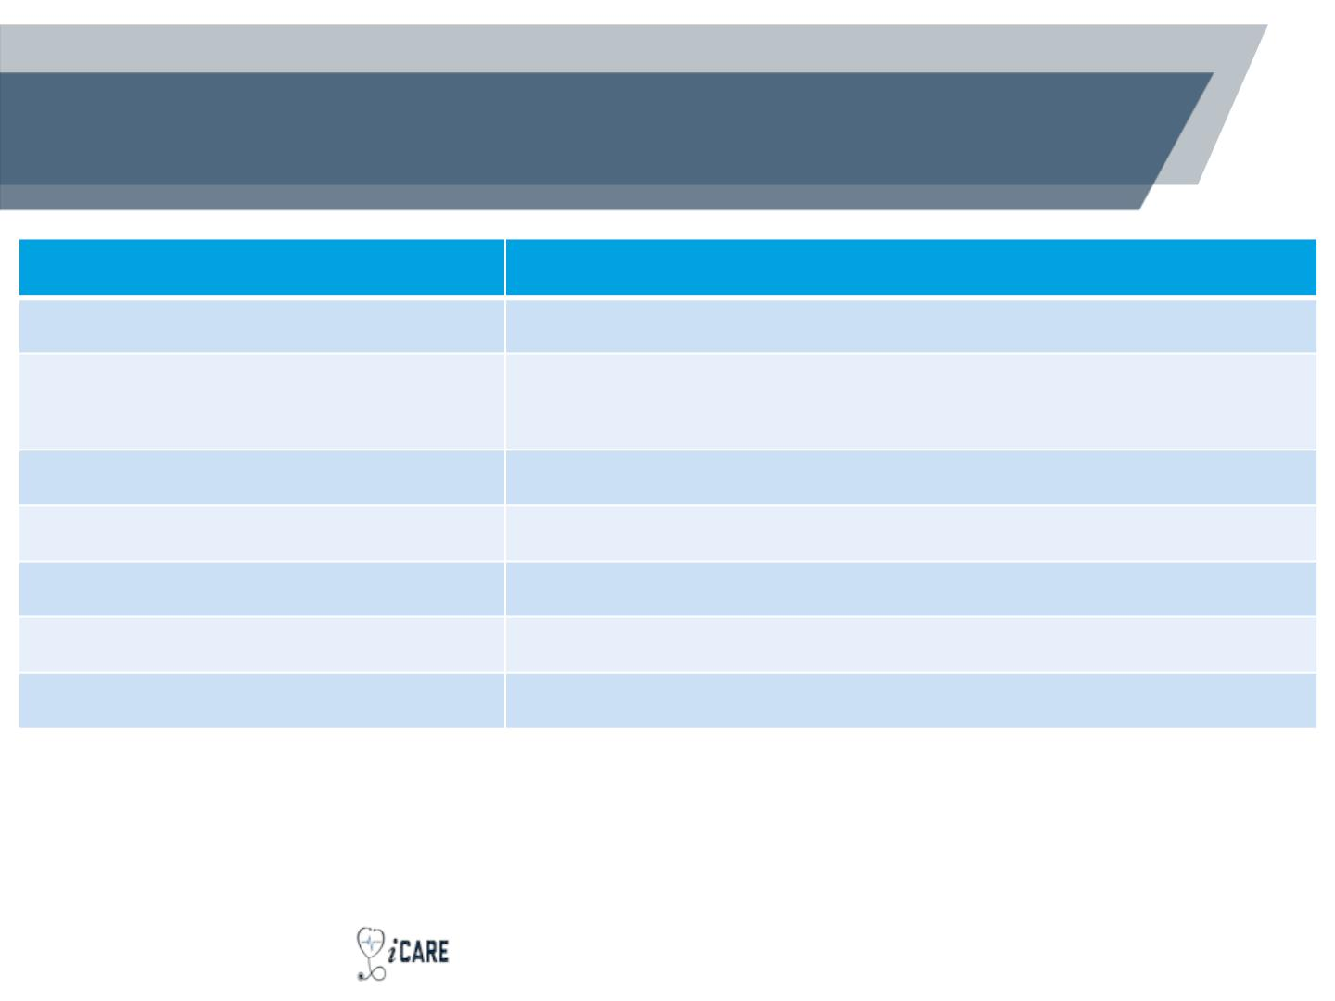
Stakeholder Contacts
Stakeholder
Email Address
Office of Grants and Contracts
grantsandcontracts@childrensnational.org
researchcontracts@childrensnational.org
Research Contracts Team (BAA,
CDA/NDA, DUA, etc.)
Clinical Trials Office
OPHS/IRB
cto@childrensnational.org
ophs@childrensnational.org
CTSI-CN Research Navigator
Bear Grants Support
Bear Contracts Support
CTSINavigator@childrensnational.org
BearGrants@childrensnational.org
contractsreview@childrensnational.org
*CNH network/VPN required
© 2022 CTSI-CN | CLINICAL AND TRANSLATIONAL SCIENCE INSTITUTE AT CHILDREN'S NATIONAL | CTSICN.ORG

Slide 98
Helpful Tips
• Connect with Stakeholders Early & Often: Reach out to OGC and
GFAs for guidance as soon as possible
• Confirm Your Appointment to CNRI’s Research Centers: In order to
conduct sponsored research, you must first have an appointment to
one of the five CNRI research centers
• Ensure You Have Access to Bear Grants, Bear Contracts, and
IRBear
• Provide All Relevant Documents (e.g., CDA/NDA, Contracts,
agreements, proposed budget, study documents) to your assigned
GFA
• Sign up to Receive the CTSI-CN Newsletter and Join CTSI-CN
Social Media
© 2022 CTSI-CN | CLINICAL AND TRANSLATIONAL SCIENCE INSTITUTE AT CHILDREN'S NATIONAL | CTSICN.ORG

Slide 99
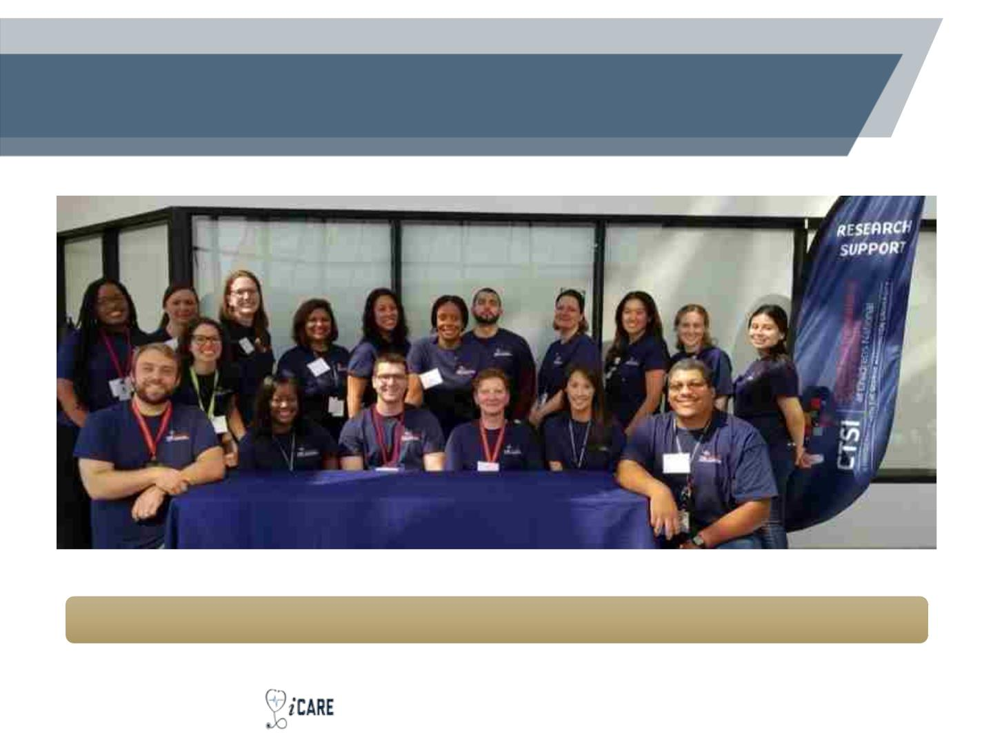
Research Navigators – we’re here to
help!
CTSINavigator@childrensnational.org
© 2022 CTSI-CN | CLINICAL AND TRANSLATIONAL SCIENCE INSTITUTE AT CHILDREN'S NATIONAL | CTSICN.ORG

